Slide 1
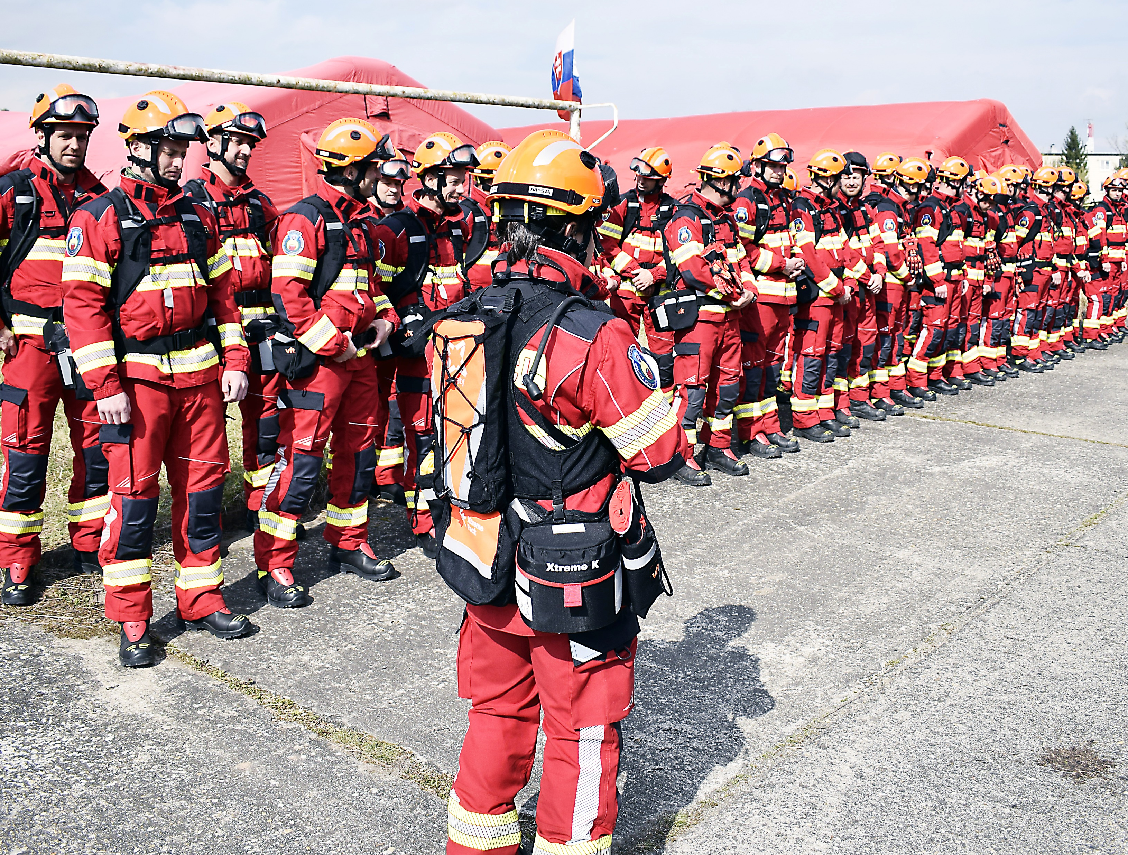
Item 6.
The ECPP for experts – State of play

Slide 2
UCPM Decision No 1313/2013/EU
Article 11
European Civil Protection Pool
1. A European Civil Protection Pool shall be established. It shall consist of a pool of voluntarily pre-committed response capacities of the Member States and include modules, other response capacities and categories of experts.
Notes:
The process that led to this proposal: meetings with the CEG in 2021-2022

Slide 3
(Draft) revised UCPM Implementing Decision
Article 16
Certification and registration procedure in the ECPP for experts
Team leaders and deputy team leaders of EUCP Teams shall be considered as certified and shall become eligible for registration in the ECPP once they have completed, where necessary, the relevant courses and exercises of the UCPM Training and Exercises Programme.
Member States shall register certified team leaders and deputy team leaders of EUCP Teams in the ECPP after sending a written commitment to the Commission.
Member States may commit and register a given number of coordination and assessment experts and technical experts under particular profiles, as set out in Annex IV.
The Commission shall verify the compliance of coordination and assessment experts and technical experts with their respective profiles upon their nomination for deployment.
Annex V: “Guidelines present the detailed procedure and tools for the certification, registration and selection of experts. The guidelines are approved by the Commission Expert Group on Capacities.”
Notes:
The process that led to this proposal: meetings with the CEG in 2021-2022
Objective: more predictability

Slide 4
ECPP for experts: (draft) guidelines
Capacity goals
Category | Capacity goal
Team Leader & Deputy Team Leader | 100
Coordination and Assessment experts of which: Operations Information management Logistics Safety and security | 140 40 40 30 30
Technical experts (16) | 161
Dam assessment | 10
WASH | 7
Environmental | 20
Geologist/volcanologist | 7
Seismologist | 7
Marine pollution response | 10
Waste management | 7
Structural engineer | 20
Epidemiologist/Public health experts | 10
Health coordination | 7
Forest fire | 20
Cultural heritage | 7
- CBRN | 10
Civil engineer | 7
Site planner | 7
Transport and Logistic | 5

Slide 5
ECPP for experts: (draft) guidelines
EUCPT TL/DTL:
Commitment ⇨ names, 1 to 3 years, renewable, does not imply permanent and compulsory availability
Certification ⇨ successful completion of the deployable path of the UCPM training programme, validity: 5 years
Registration ⇨ in CECIS
Selection ⇨ via the national CP authority
Other EUCPT experts:
Commitment ⇨ no name, but numbers; 1 to 3 years, renewable; does not imply permanent and compulsory availability
Certification ⇨ None, but expert profiles
Selection ⇨ unchanged

Slide 6
Commitment phase
COM invites NAs to commit candidate TL/DTL experts
NA identifies suitable candidate TL/DTL experts
NA commits candidate TL/DTL experts
3 scenarios
1/year
Commitment letter
Training &
certification phase
1. Candidate TL/DTL expert has completed UCPM deployable path (or equivalent)
2. Candidate TL/DTL expert has partly completed UCPM deployable path (or equivalent)
3. Candidate TL/DTL expert has not started UCPM deployable path (nor equivalent)
COM identifies missing training courses & exercises and informs NA/NTC
COM informs NA/NTC that the expert must start and complete the UCPM deployable path
NA/NTC registers expert to recommended training courses and exercises
NA/NTC registers the expert to training courses and exercises of UCPM deployable path
NA/NTC informs COM when recommended training courses and exercises completed
NA/NTC informs COM when expert completes all training courses and exercises
Validation &
registration phase
COM invites NA to register expert as EUCPT TL/DTL in CECIS
NA registers expert in CECIS
COM confirms in CECIS that the expert is certified
Validity: 5 years
Notes:
Commitment phase:
In the invitation letter to NAs, specify that the proposed candidate TL/DTLs should be proficient in English (C1), fit for international deployments and available for UCPM response operations (once trained)
In the commitment letter, the NA confirms these requirements are met by each of the candidate TL/DTL and gives the expert’s UCPM training record.
Training and certification phase:
Committed candidate TL/DTL are given priority for registering in the deployable training path

