Slide 1
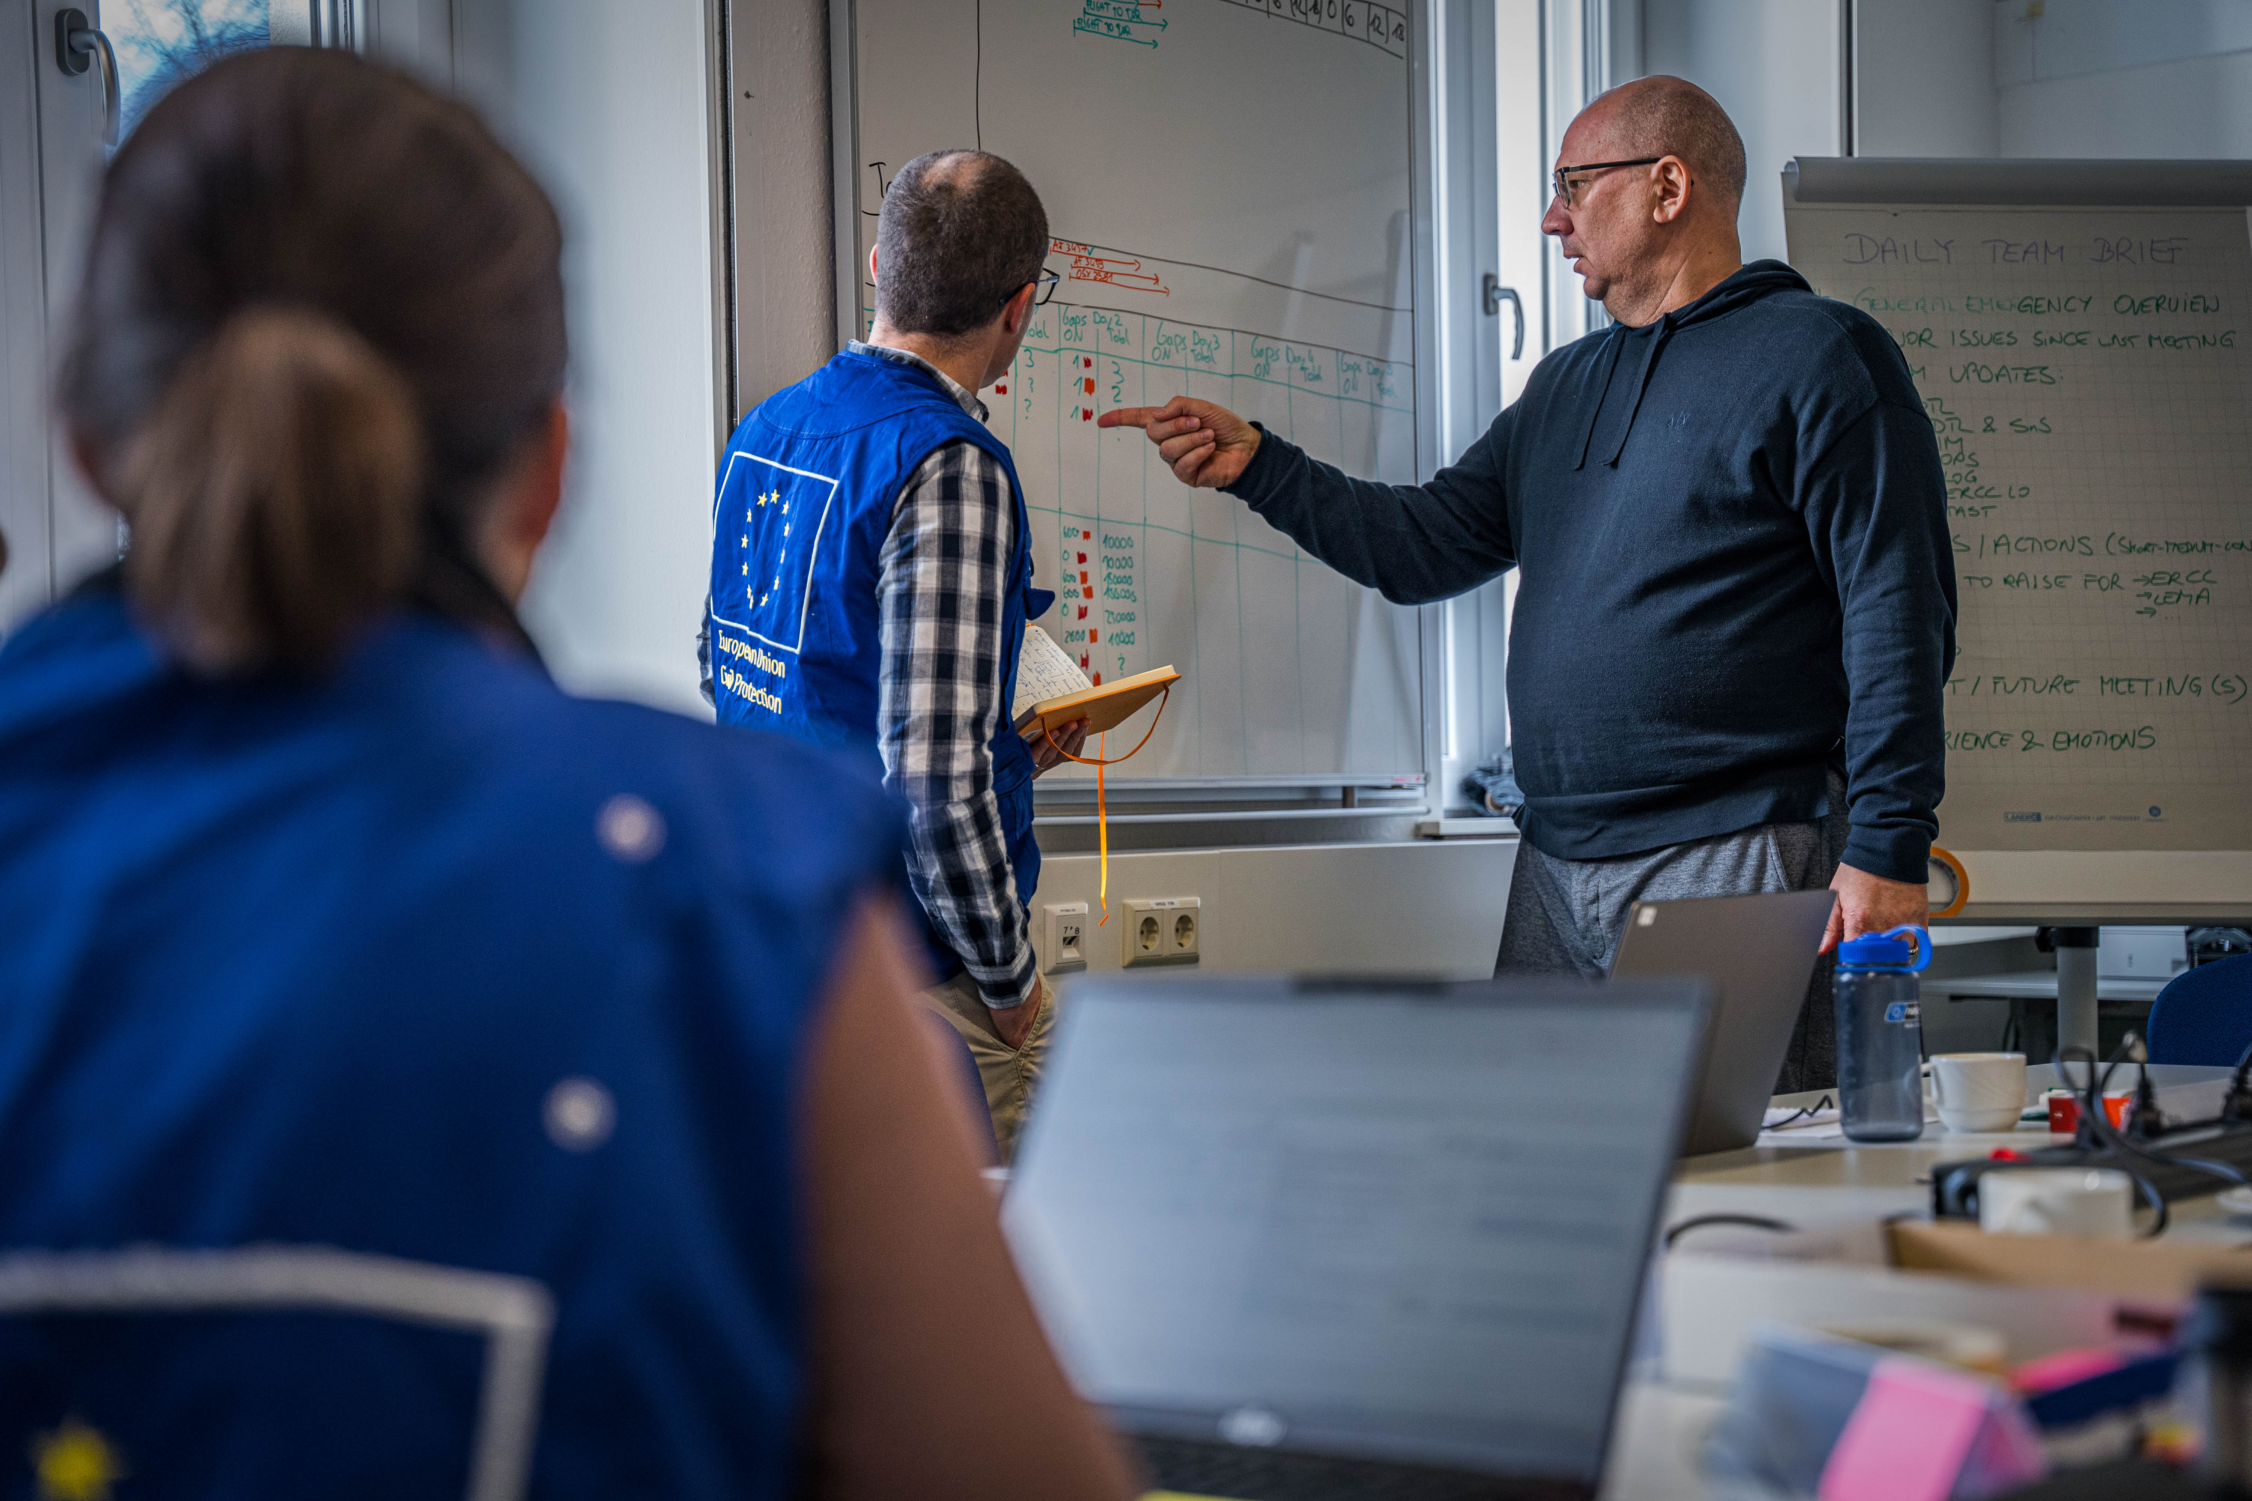
National Training Coordinators Meeting
UCPM Policy Headlines
Online, 12 November 2024

Slide 2
Agenda
New political guidelines
Niinistö - Safer together
New Cssr – mandate

Slide 3
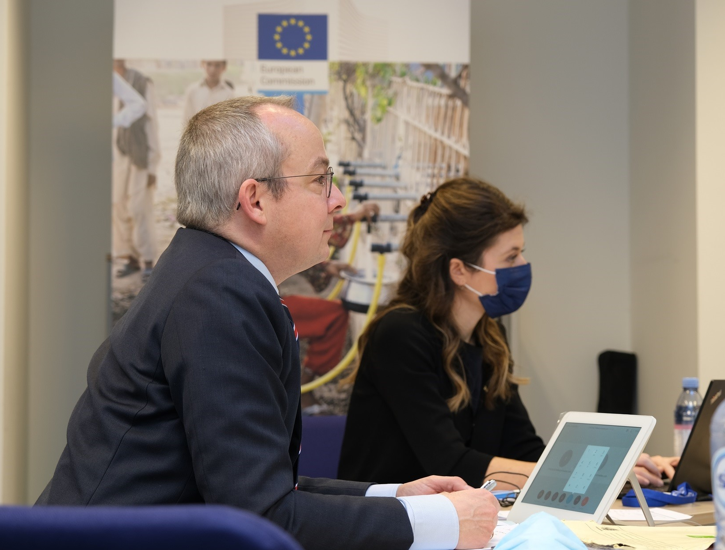
Special Eurobarameter

Slide 4
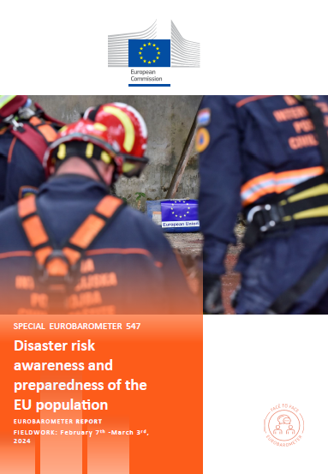
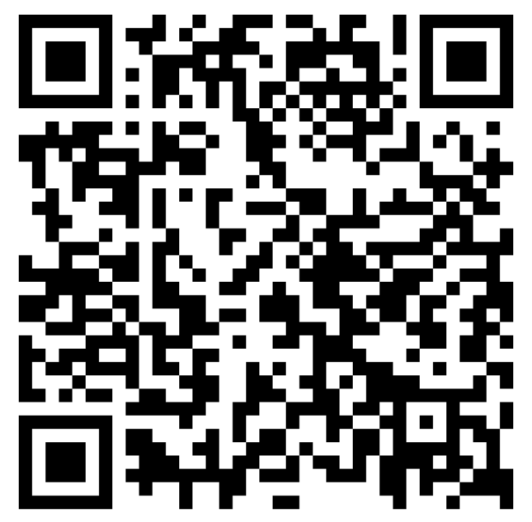



Special Eurobarometer on the disaster risk awareness and preparedness of the EU population
Exposure to disaster risks and experience of disasters
Level and sources of information about disaster risks
Population Preparedness for disaster scenarios
Reliance on social capital, trust in emergency services and authorities
Engagement in voluntary work to increase resilience
27 EU Member States covered
30 September, based on 07/02-03/03 fieldwork dates
26.411 interviews completed
15+ age groups targeted

Slide 5
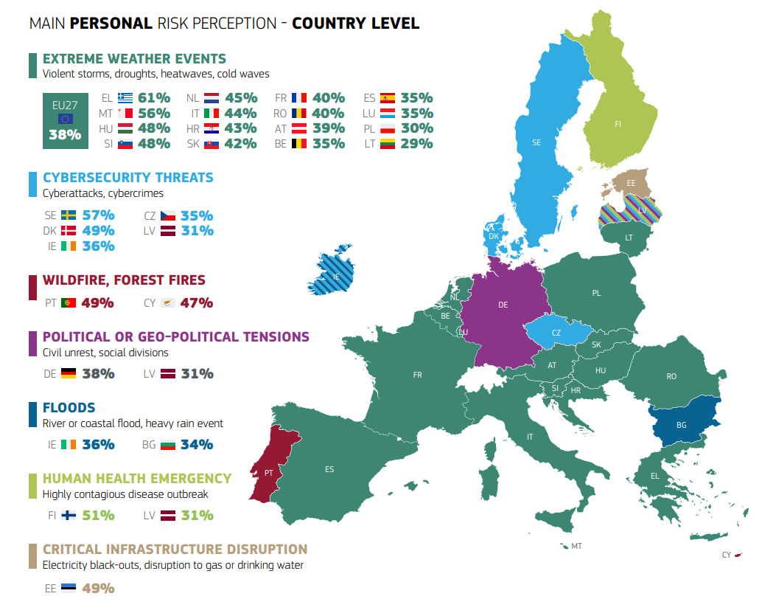
In most EU Member States (16), citizens report being firstly concerned about extreme weather events

Slide 6
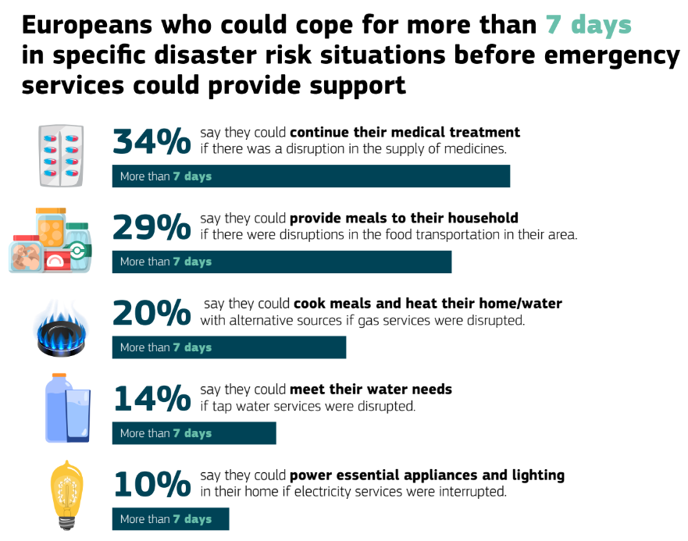
Household preparedness to face specific consequences of an emergency/disaster scenario

Slide 7
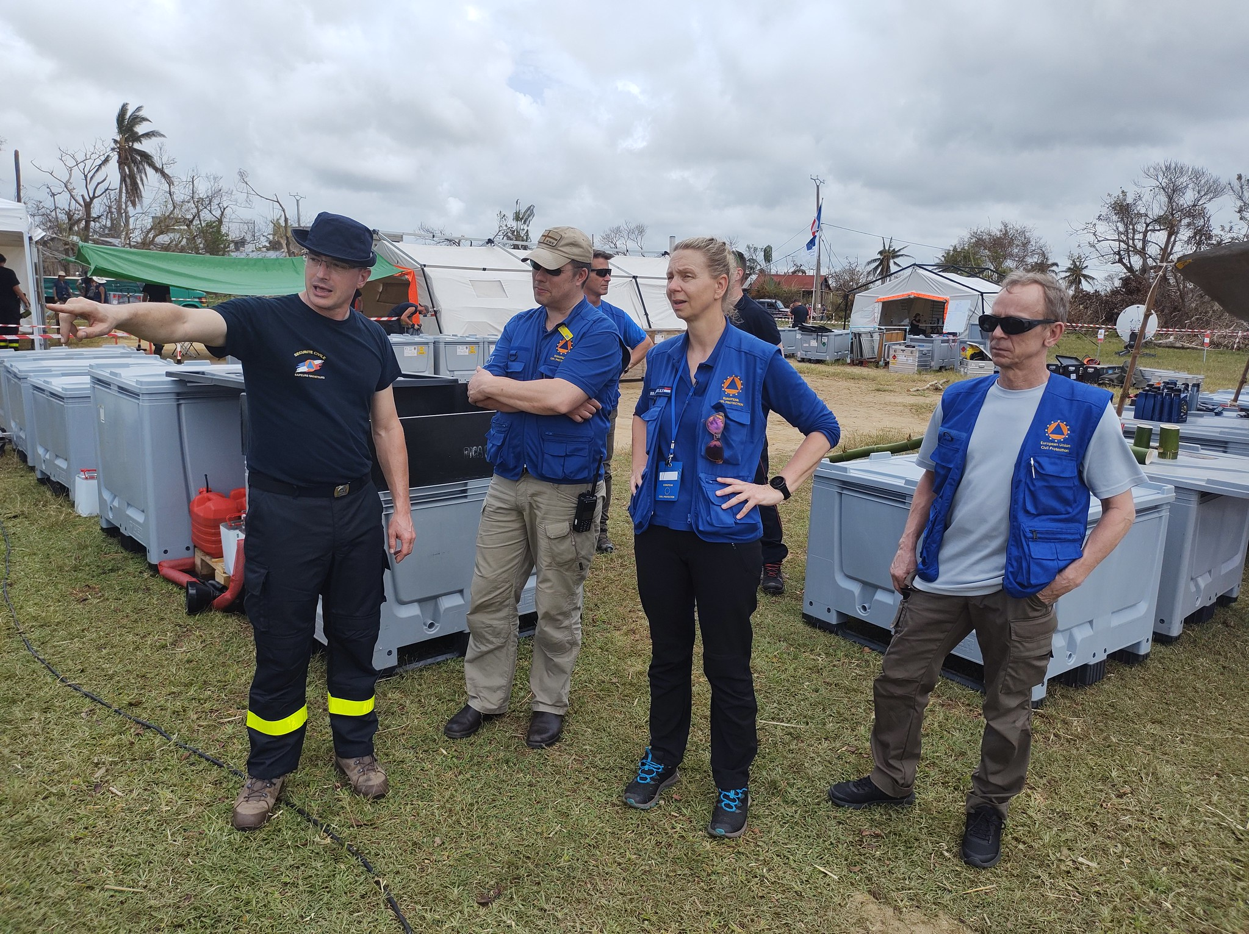
The new College

Slide 8
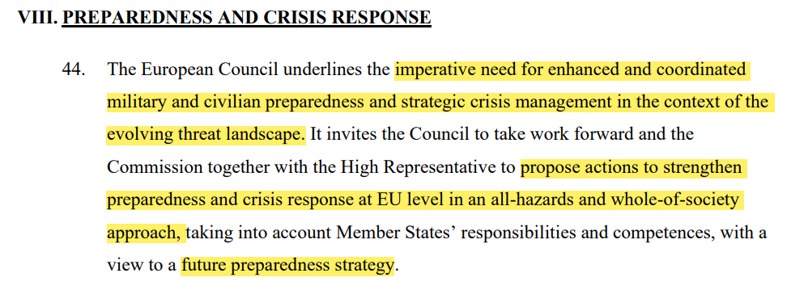
Political Steering
EUCO conclusions 21&22 March 2024

Slide 9
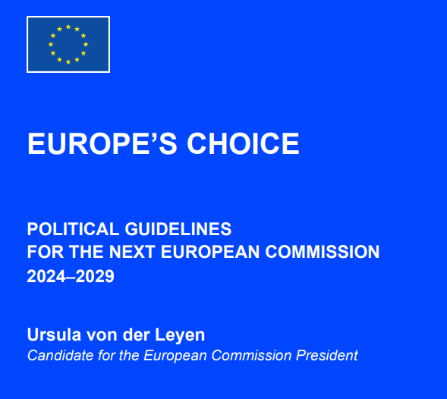
A new plan for Europe’s sustainable prosperity and competitiveness
A new era for European Defence and Security
Supporting people, strengthening our societies and our social model
Sustaining our quality of life: food security, water and nature
Protecting our democracy, upholding our
values
A global Europe: Leveraging our power
and partnerships
Notes:
A new plan for Europe’s sustainable prosperity and competitiveness
A new era for European Defence and Security
Supporting people, strengthening our societies and our social model
Sustaining our quality of life: food security, water and nature
Protecting our democracy, upholding our values
A global Europe: Leveraging our power and partnerships
Delivering together and preparing our Union for the future

Slide 10
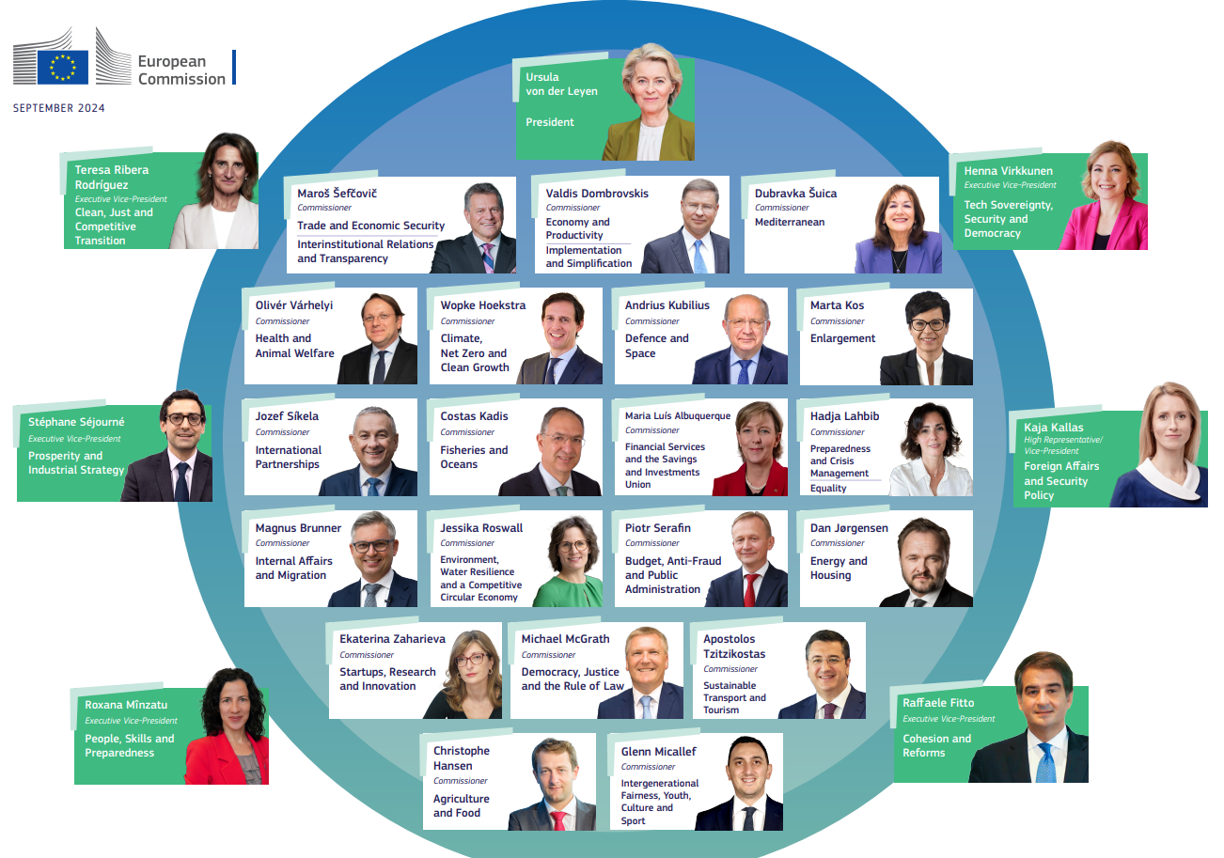

Slide 11
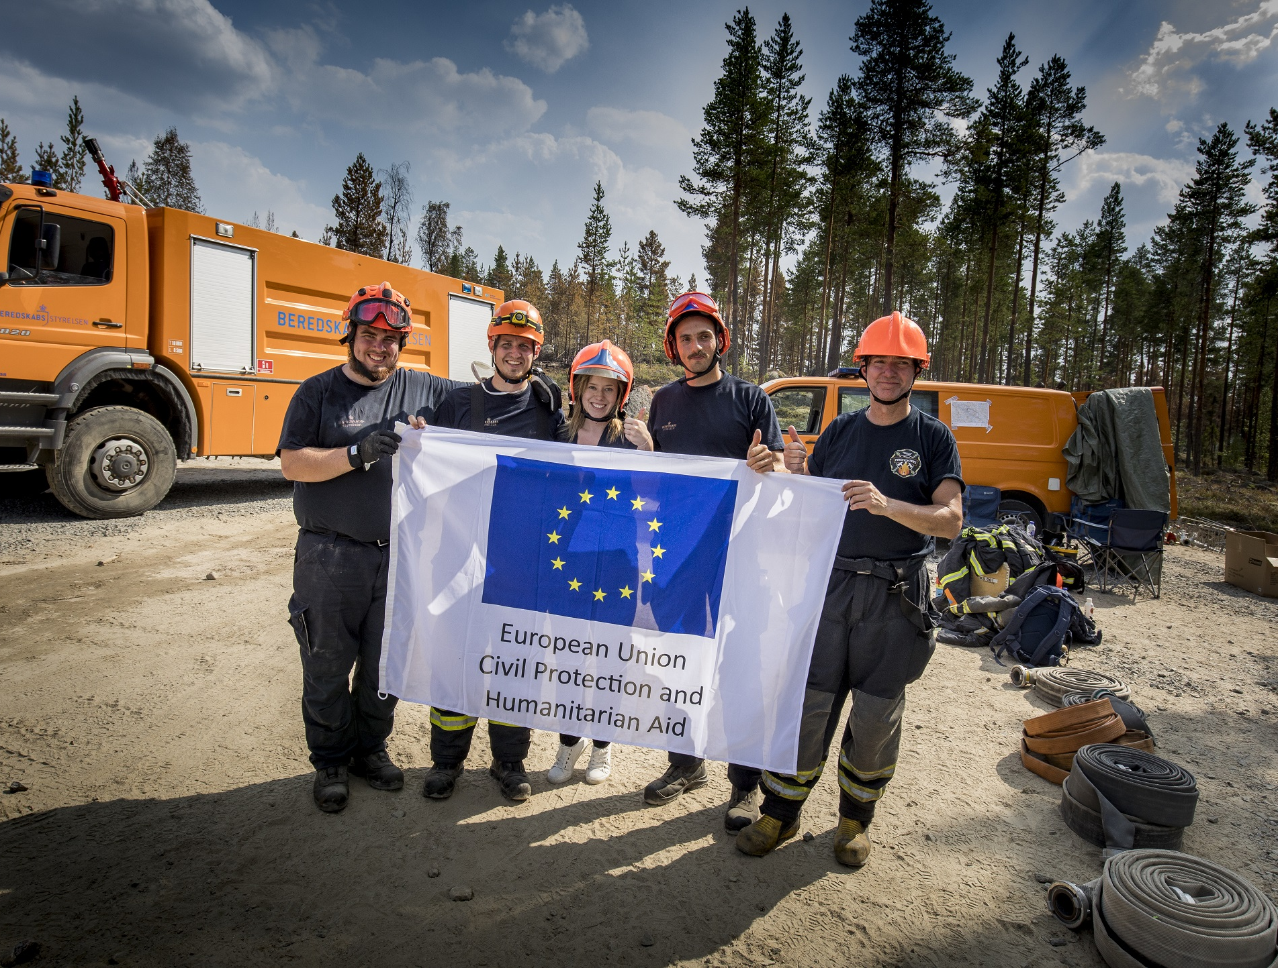
Niinistö
Safer Together

Slide 12
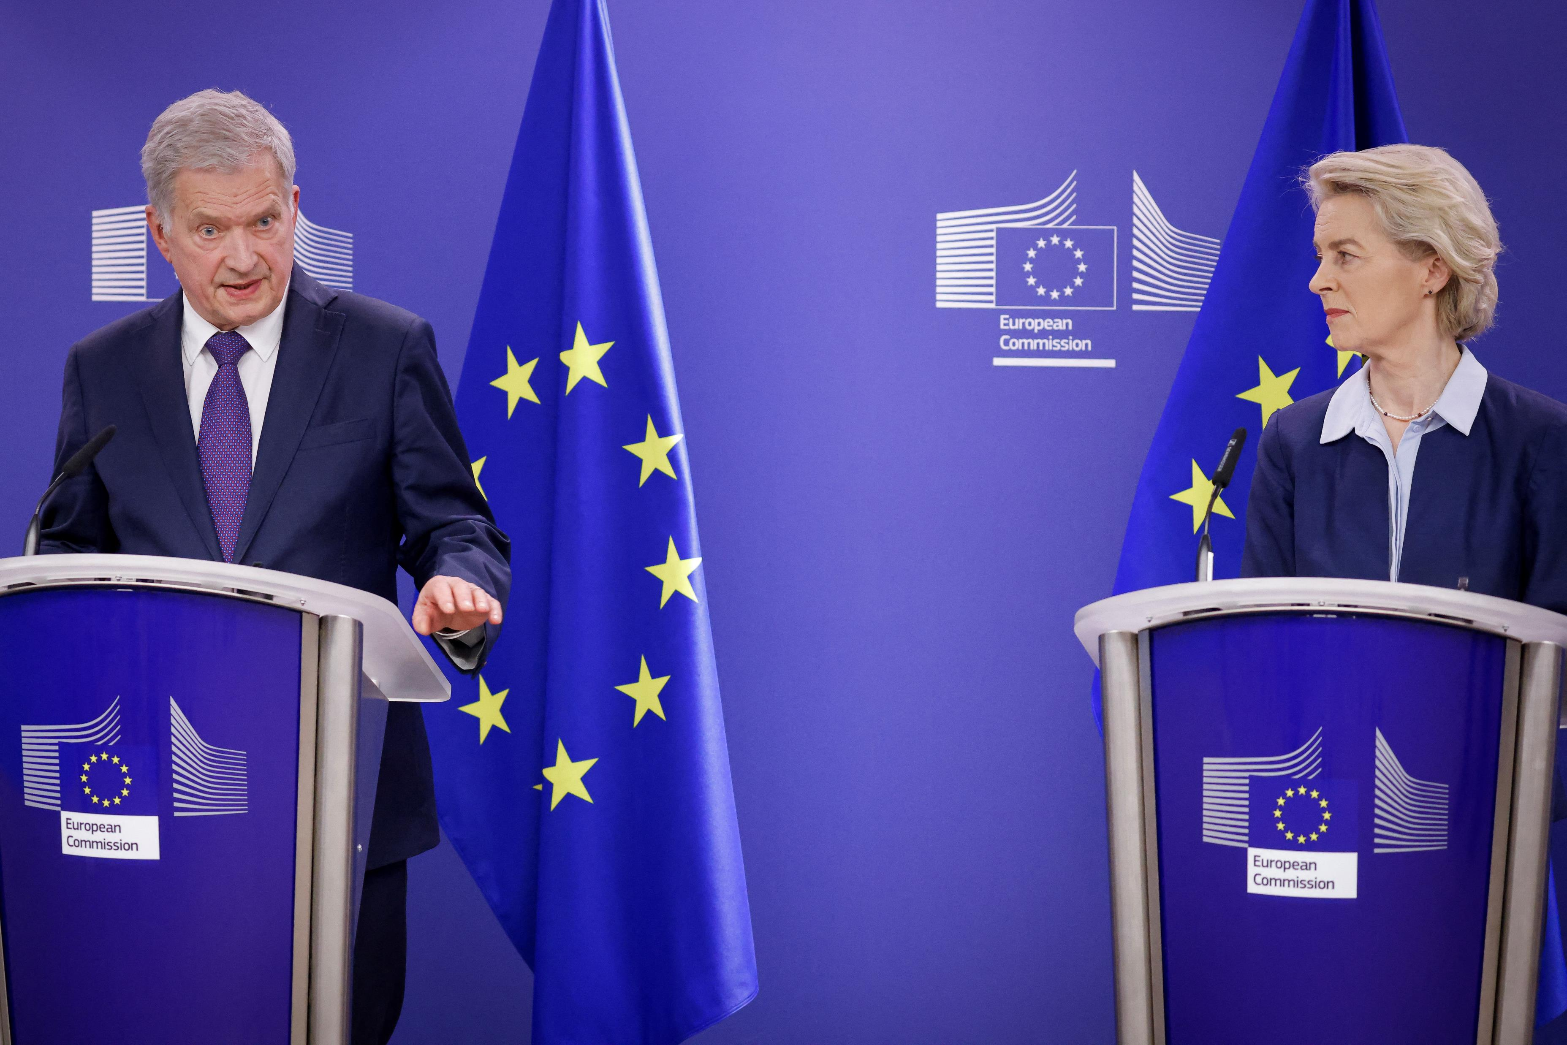
Safer Together
Strengthening Europe’s Civilian and Military Preparedness and Readiness
Thinking preparedness from an all-hazards and whole-of-society approach.
Bridging potential gaps and reinforcing synergies within the EU crisis management.
European citizens want a Europe that protects.

Slide 13
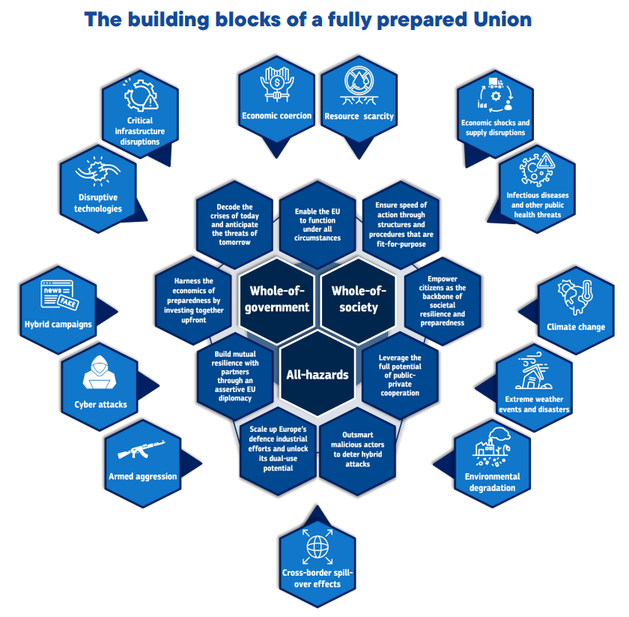

Slide 14
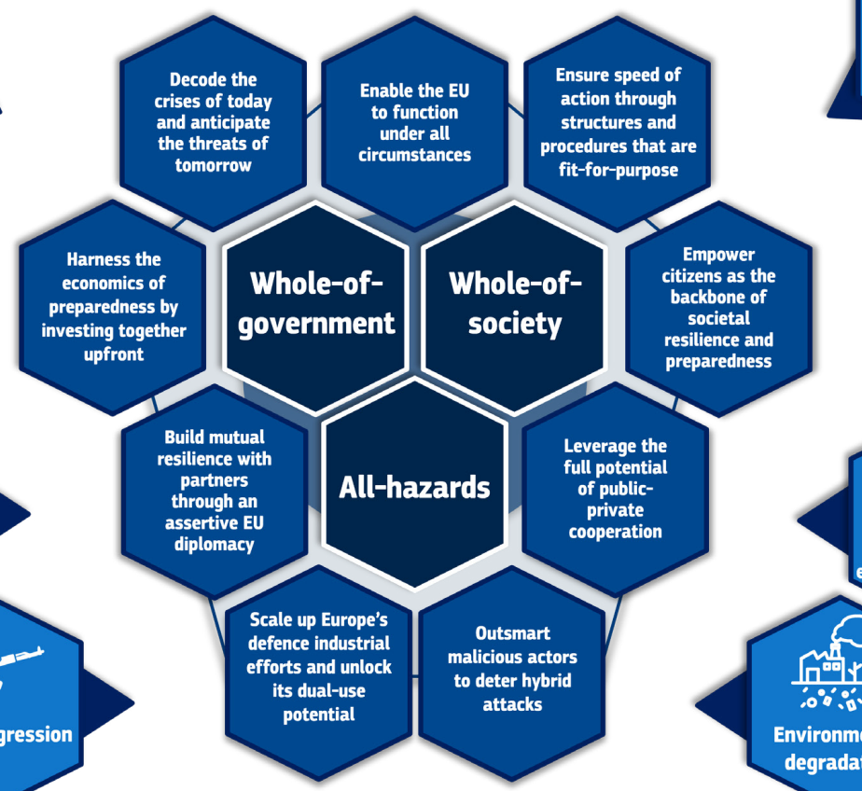

Slide 15
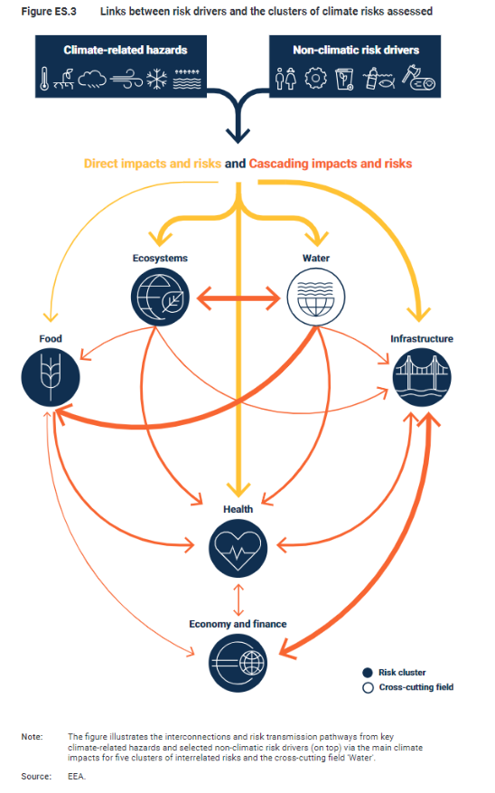

Slide 16
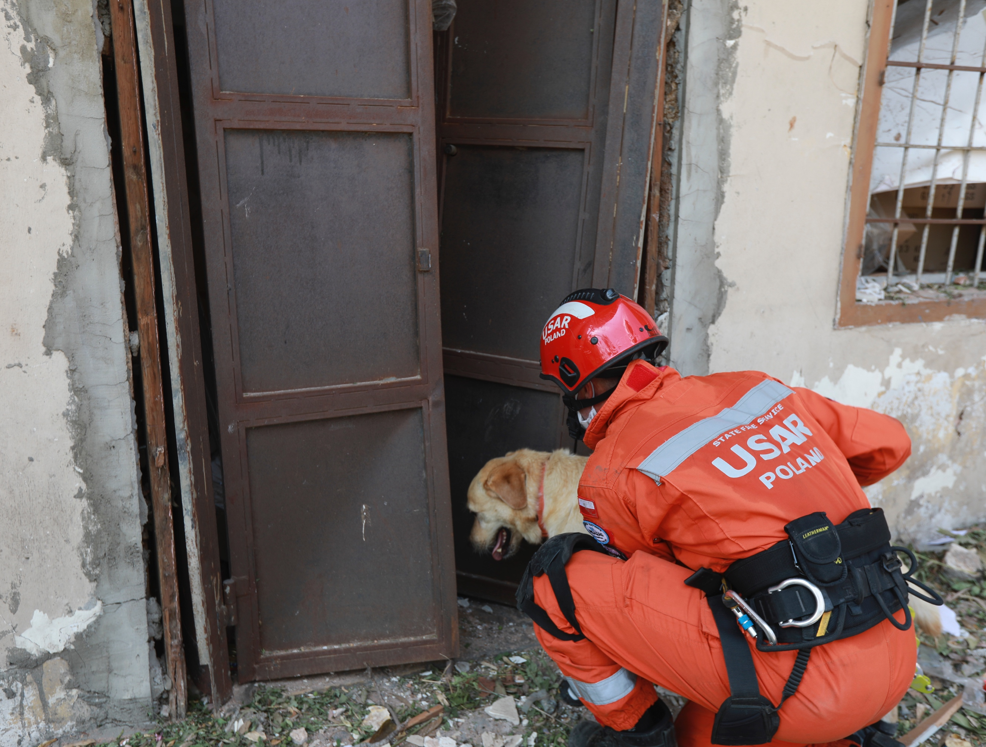
Hadja Lahbib
New Mandate

Slide 17

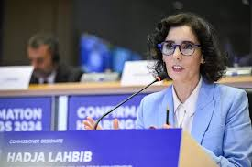
Hadja Lahbib will be the Commissioner for Preparedness and Crisis Management. This is another new portfolio which will look at resilience, preparedness and civil protection. She will be responsible for leading our efforts on crisis management and humanitarian aid. […]

Slide 18
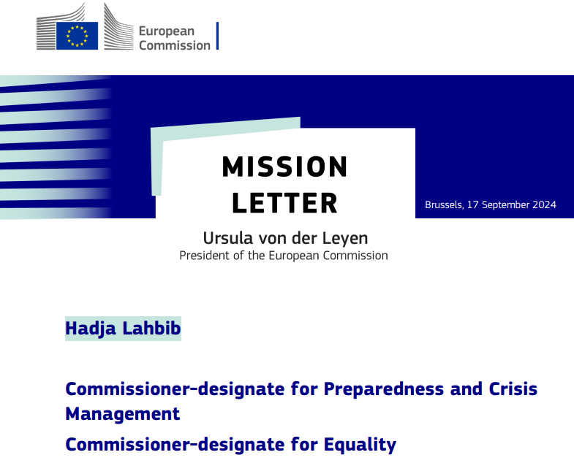
EU Preparedness Union Strategy
A culture of preparedness and resilience
EU Preparedness Law
European Civil Defence Mechanism
EU stockpiling strategy
Boost societal awareness and invest in citizens
ERCC
rescEU

Slide 19
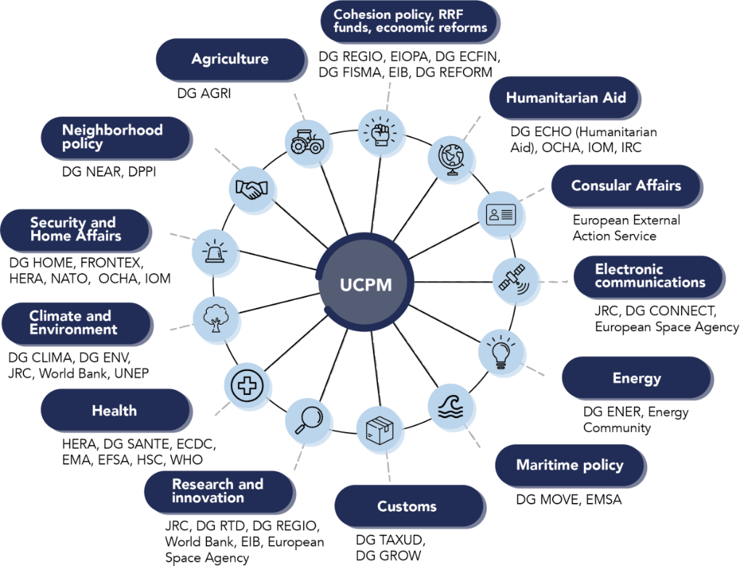

Slide 20
Thank you!

Slide 21
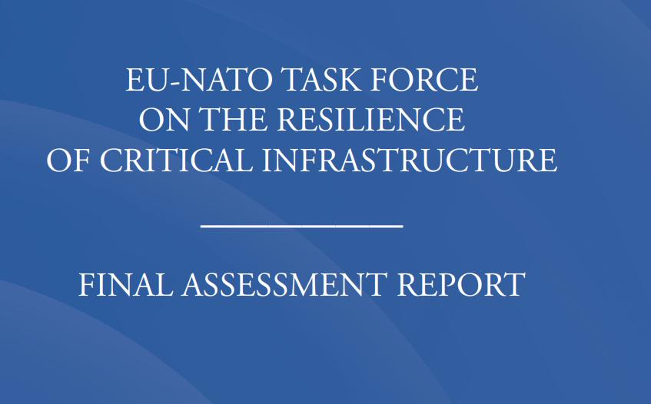

EU – NATO structured dialogue on resilience
14 recommandations on critical infrastructure -> EU and NATO are working on a common matrix for impementation.
DG ECHO is the key interlocutor at EU side for cross-sector cooperation

Slide 22
