Slide 1
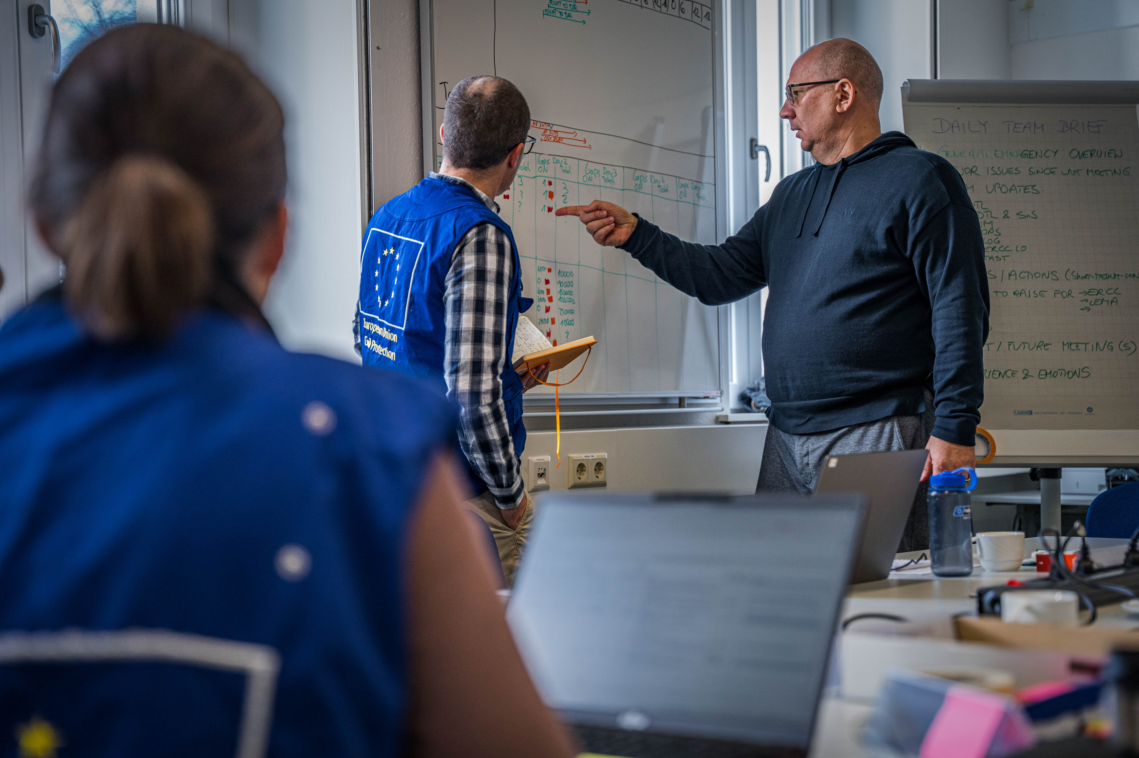
National Training Coordinators Meeting
rescEU - updates
Online, 12 November 2024

Slide 2
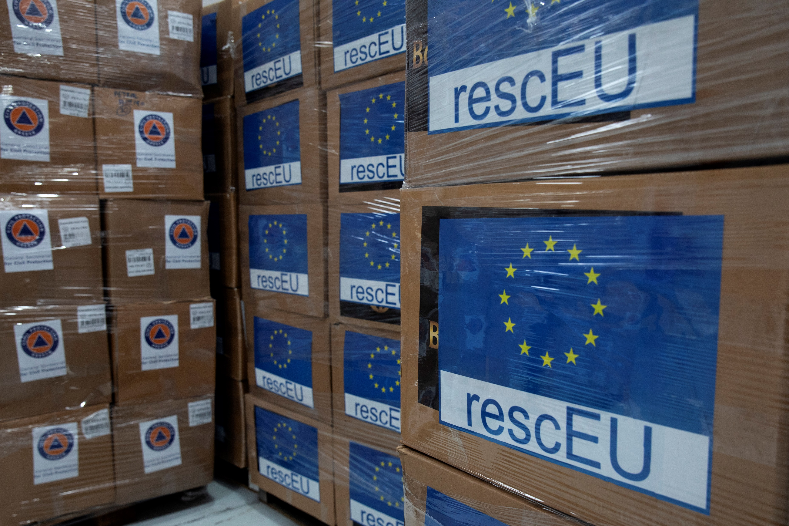
rescEU
Recap

Slide 3
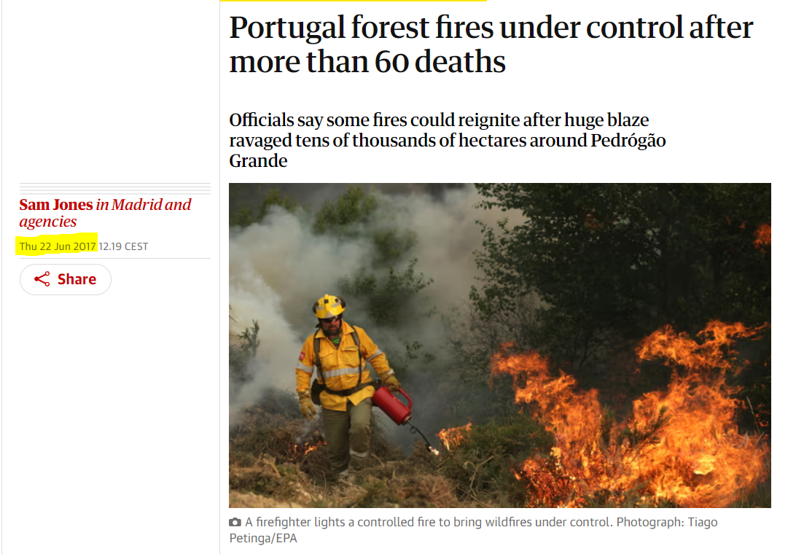

When it all started…
Legislative path:
21/03/2019 Entry into force
23/11/2017 Commission proposal
Legal base: DECISION (EU) 2019/420

Slide 4
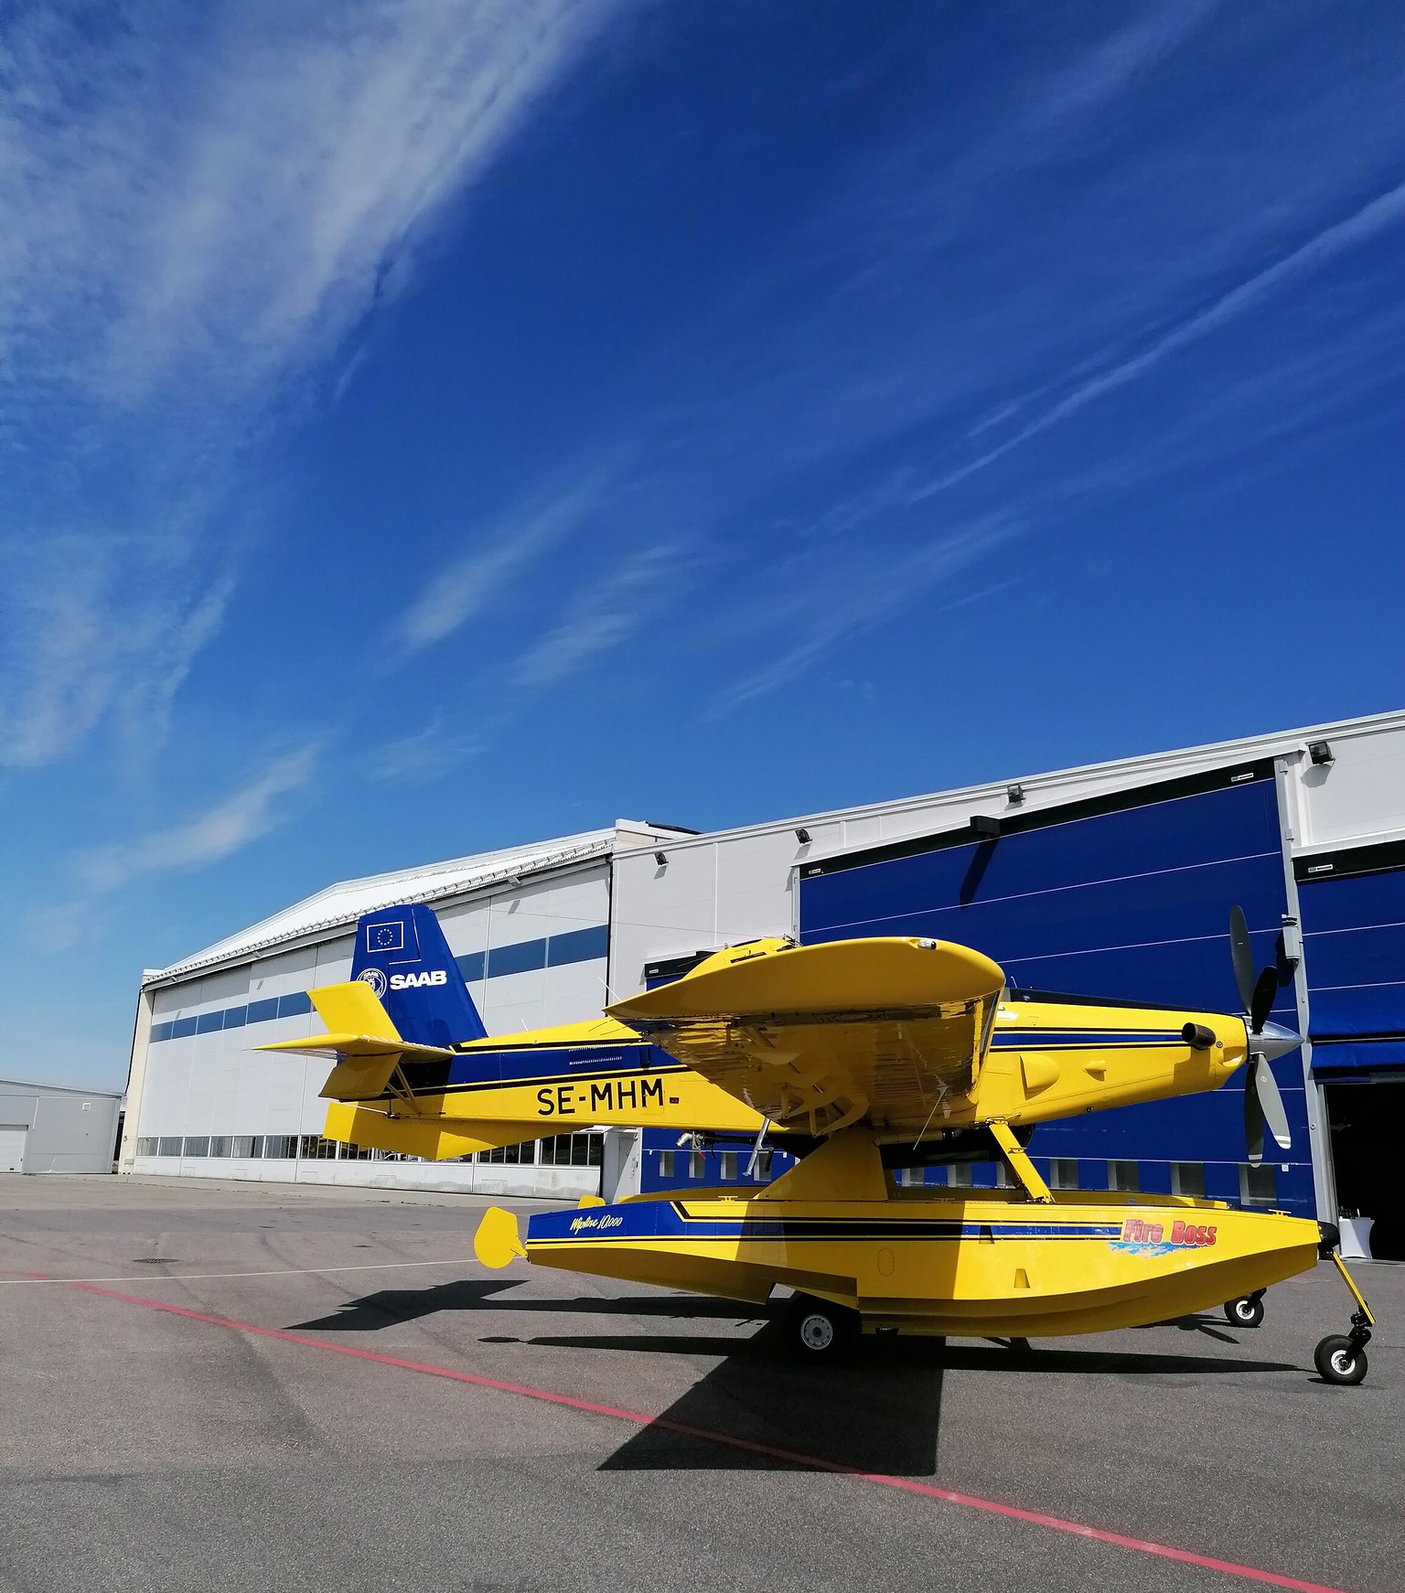
What is rescEU?
UCPM's own reserves and capabilities fully funded by EU
Clear capacity gap
Last-resort mechanism or safety-net principle
Nationally-owned capacities but with EU obligations
Decision on deployment is taken by ERCC
Possible for national purposes (two-hats regime) but they must remain available for EU obligations

Slide 5
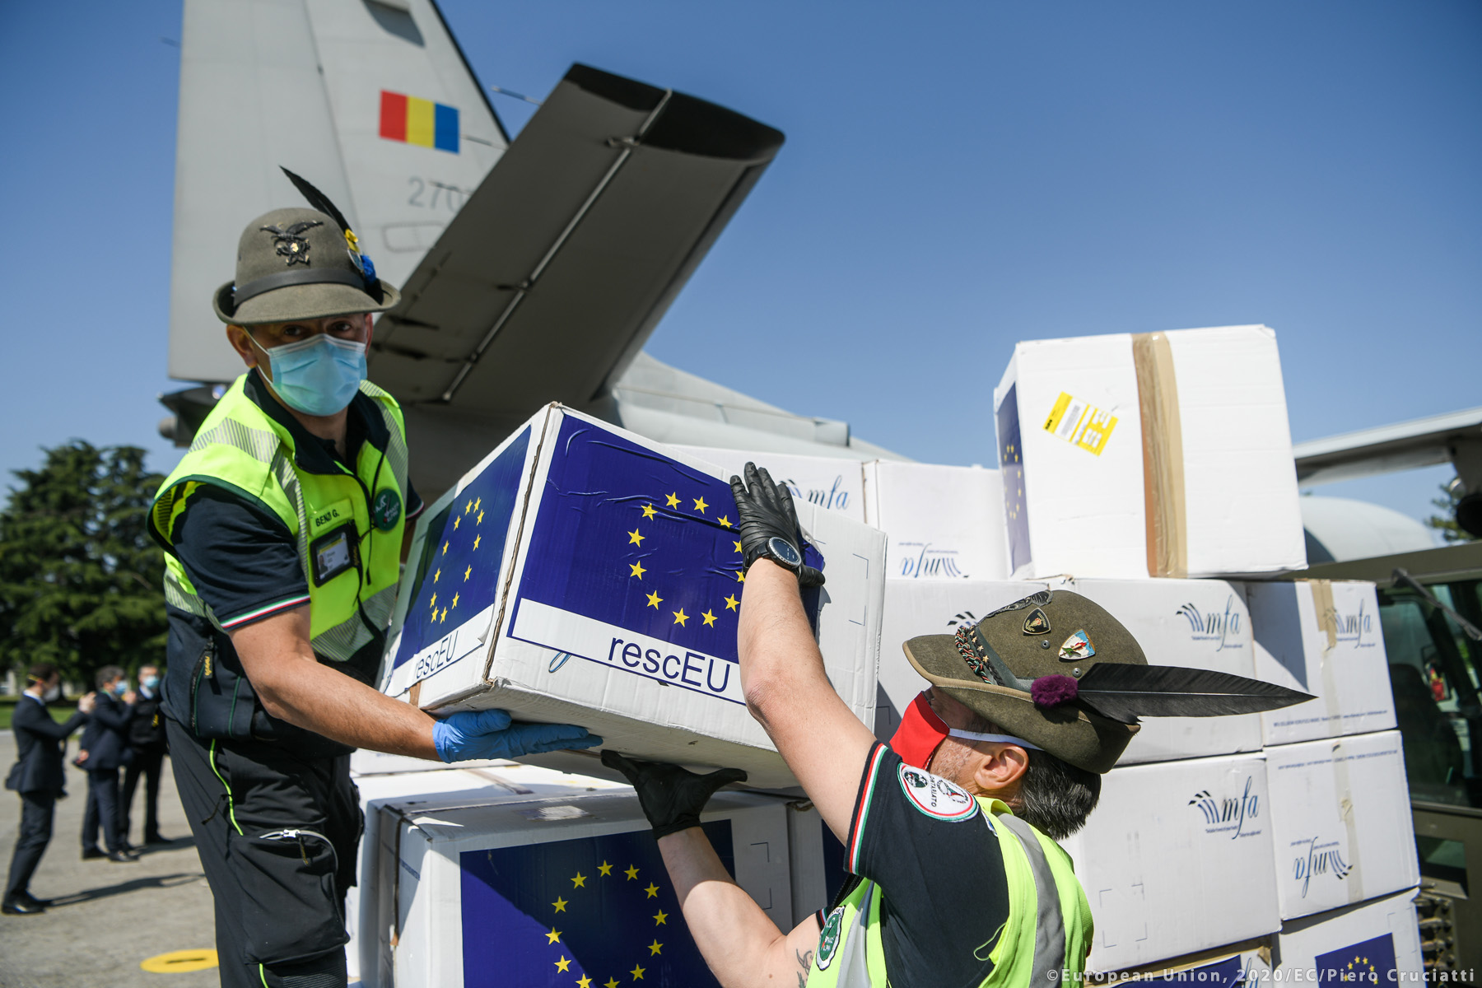
What is rescEU?
Adequate geographical distribution
Minimum quality requirements defined via EU implementing acts
Available for UCPM response operations, including in PS
Deployment outside the EU is conditional
If a disaster outside the Union could significantly affect one or more Member States or their citizens

Slide 6
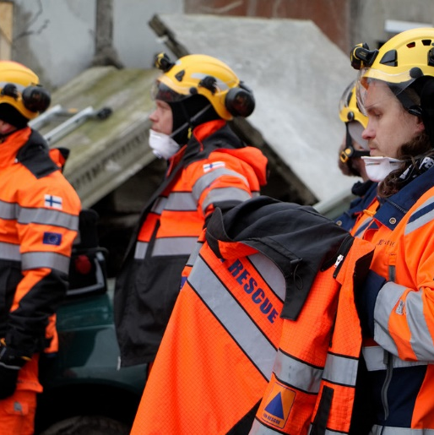
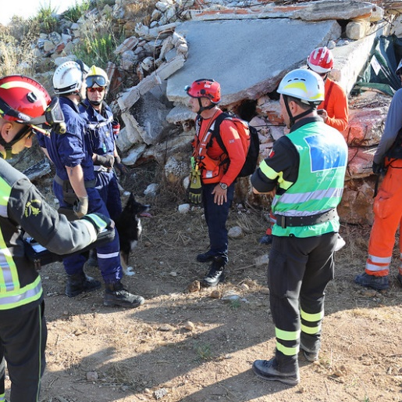
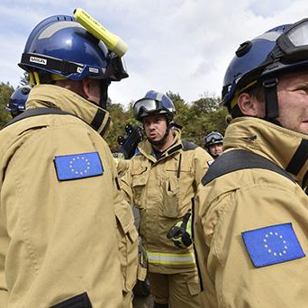

UCPM Capabilities and strategic stockpiles
NATIONAL
MUTUAL
POOL
rescEU
NATIONAL
CAPABILITIES
First response
Key role national Civil Protection
MUTUAL
ASSISTANCE
Ad hoc offers from other Member or Participating States
EUROPEAN CIVIL PROTECTION POOL
Pre-committed assets
(est. 2013)
rescEU
Safety net
(est. 2019)

Slide 7
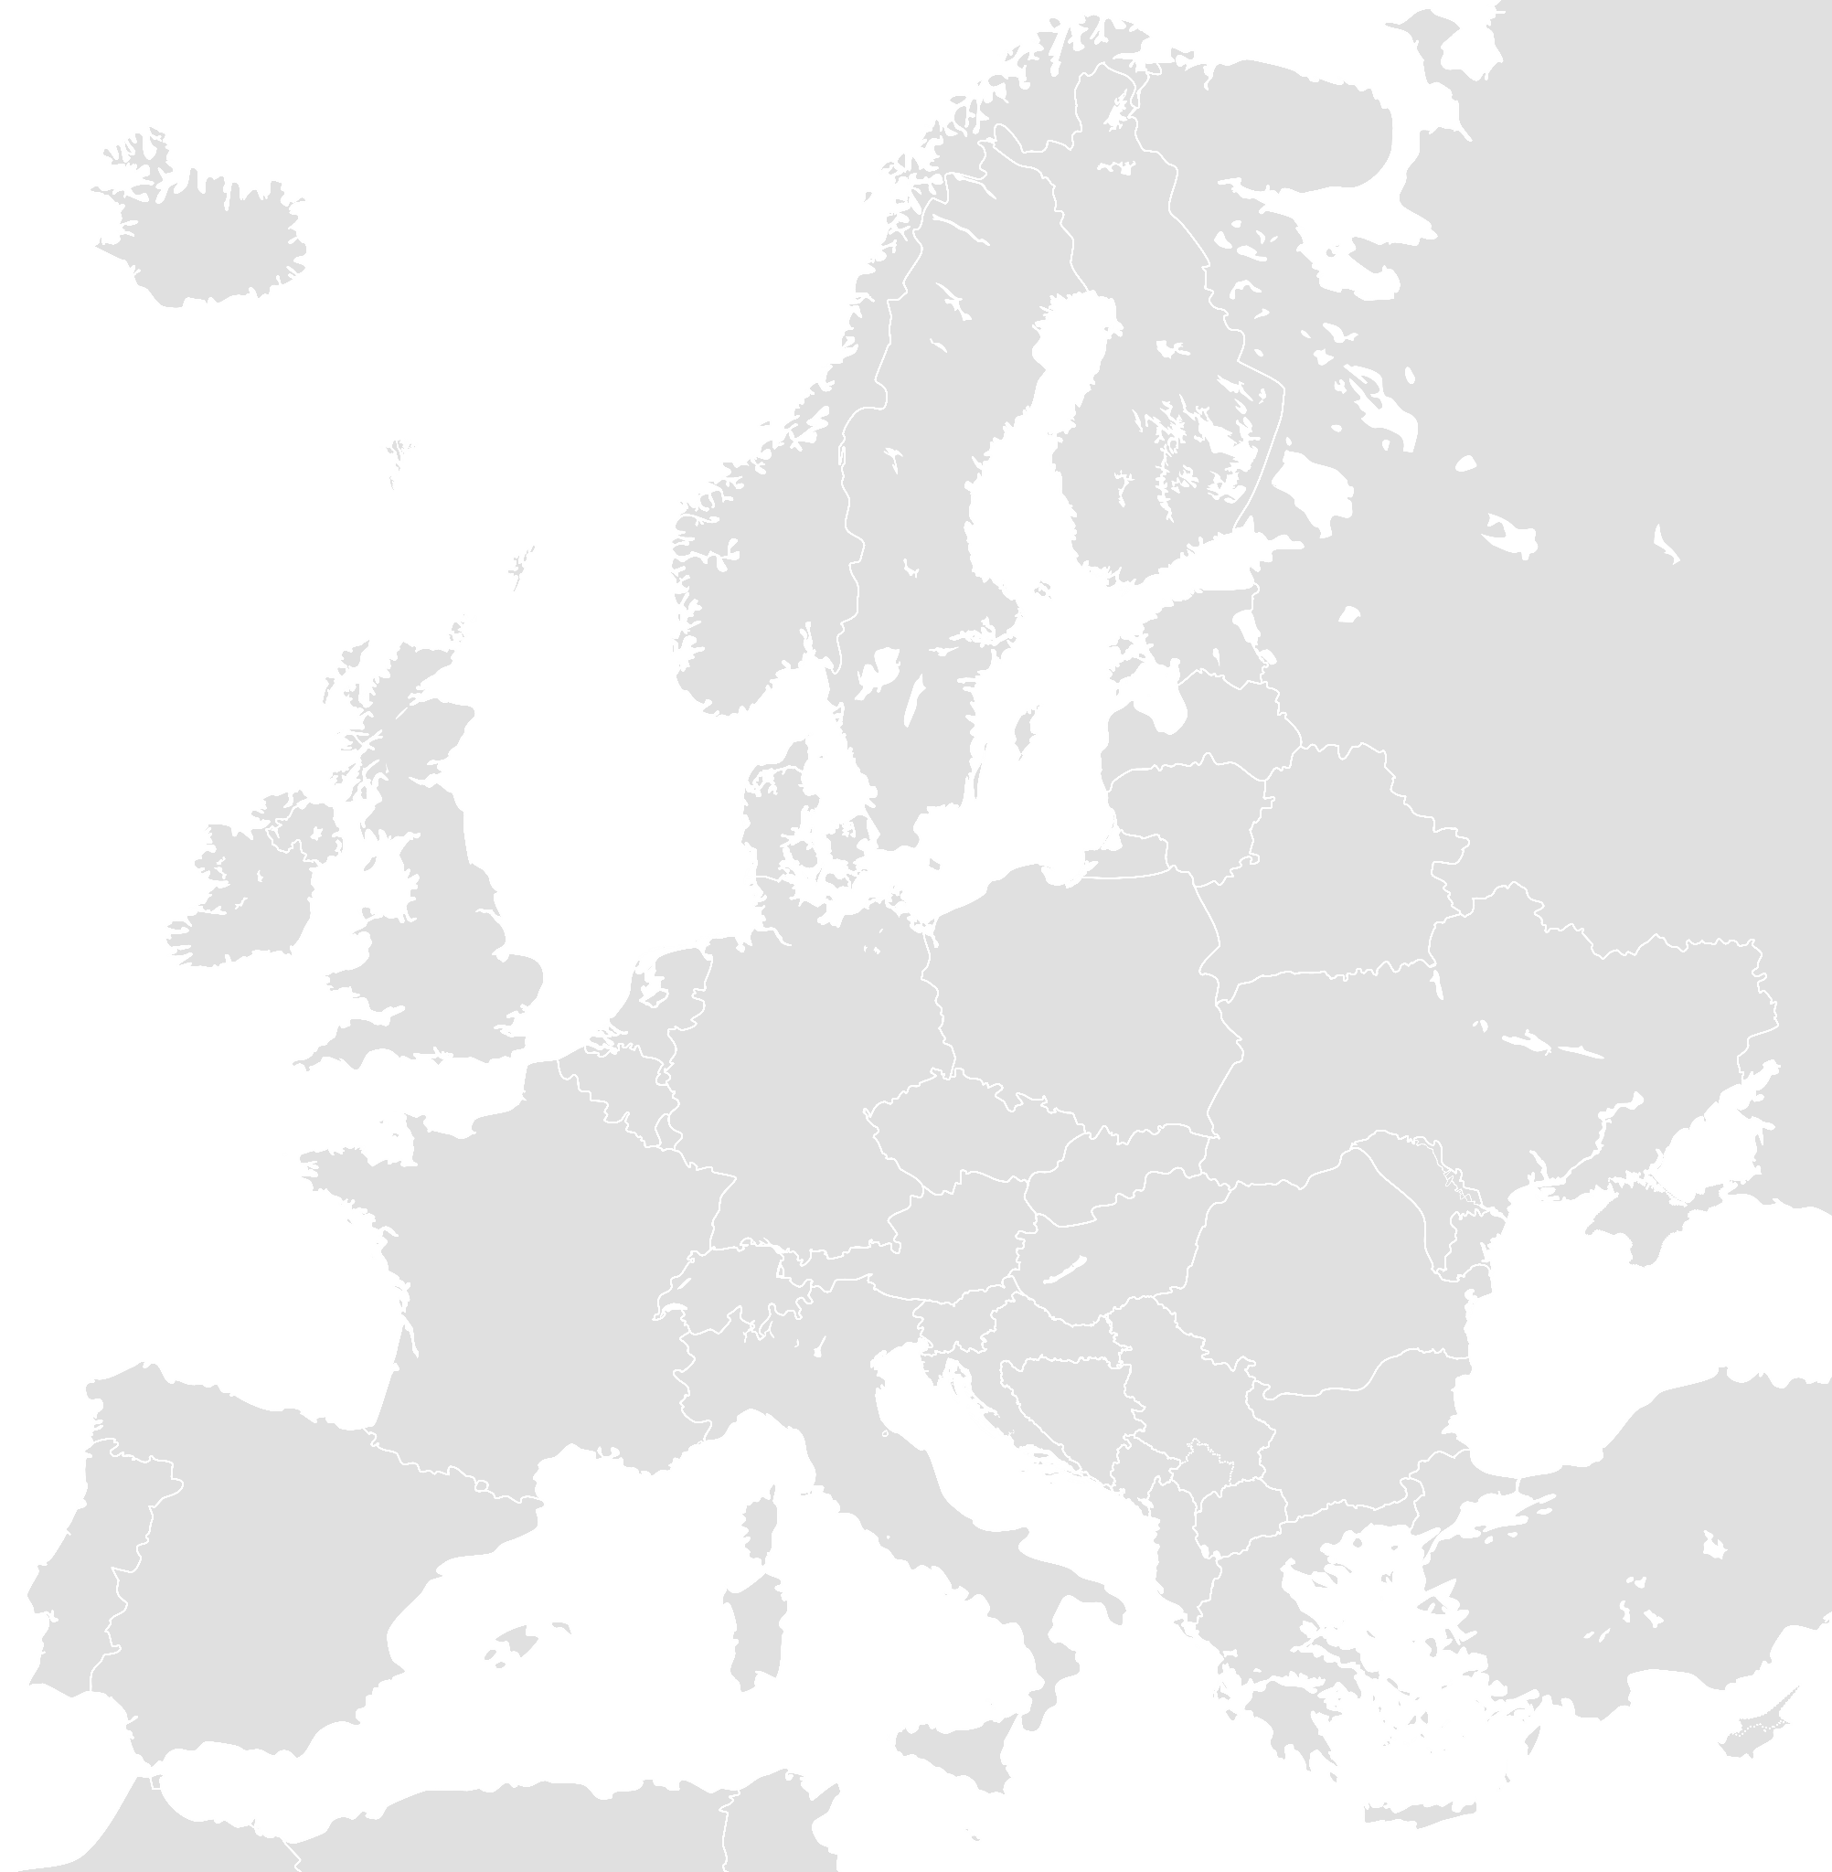















rescEU capacities
Aerial forest firefighting
Medical
CBRN
Shelter
rescEU ‘proper’
Medical
stockpiling
CBRN
stockpiling
Transport
& Logistics
rescEU ‘transition’
CBRN
decontamination
EMT-2s
Energy
MEDEVAC
CBRN detection
Mobile labs
Notes:
- rescEU is a reserve of capacities at Union level and a safety-net aiming to complement national capacities when these are overwhelmed in their response to natural and man-made disasters.
- The legal framework of rescEU is embedded in Decision No 1313/2013/EU
- All rescEU capacities (except for AFF) are further labelled as “High Impact-Low probability”
Stockpiling under rescEU (both medical and CBRN) are “Lo-Hi” capacities and are entirely (100%) financed in terms of development and deployment costs
Si l’ensemble de ses capacités sont financées grace à NextGenerationEU, les moyens aériens sont eux financés on the current EU long-term budget
Transition: National resources temporarily integrated into rescEU capabilities to be operational for the 2019 forest fire season

Slide 8
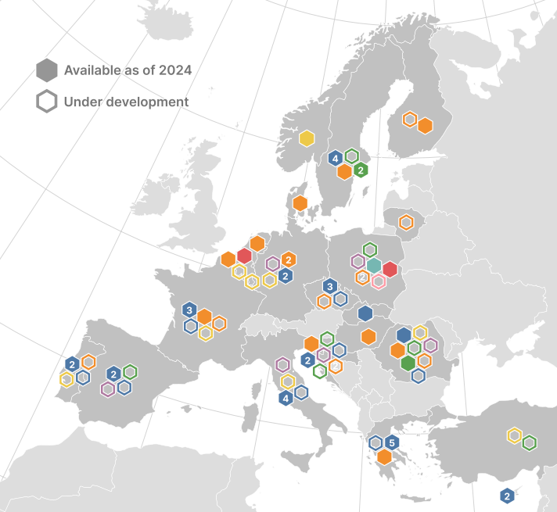
rescEU geographical distribution
31 Aerial wildfire fleet + 8 under dev.
12 Strategic stockpiles of medical and CBRN items + 10 under dev.
3 Emergency shelter + 7 under development
1 Medical capabilities + 8 under development
2 rescEU donations hubs
1 Energy
6 Chemical, Biological, Radiological and nuclear (CBRN) capabilities - under development
1 Transport and logistics - under development

Slide 9
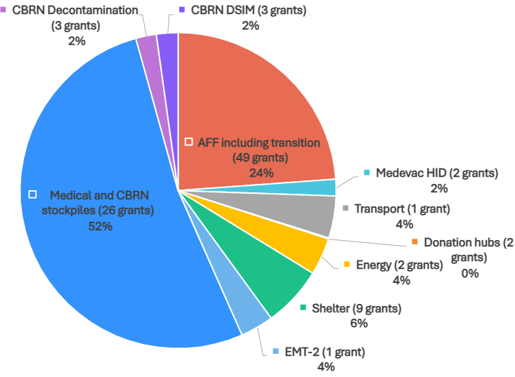
rescEU overall budget
EUR 3.159.471.021 awarded
98 grant agreements signed

Slide 10
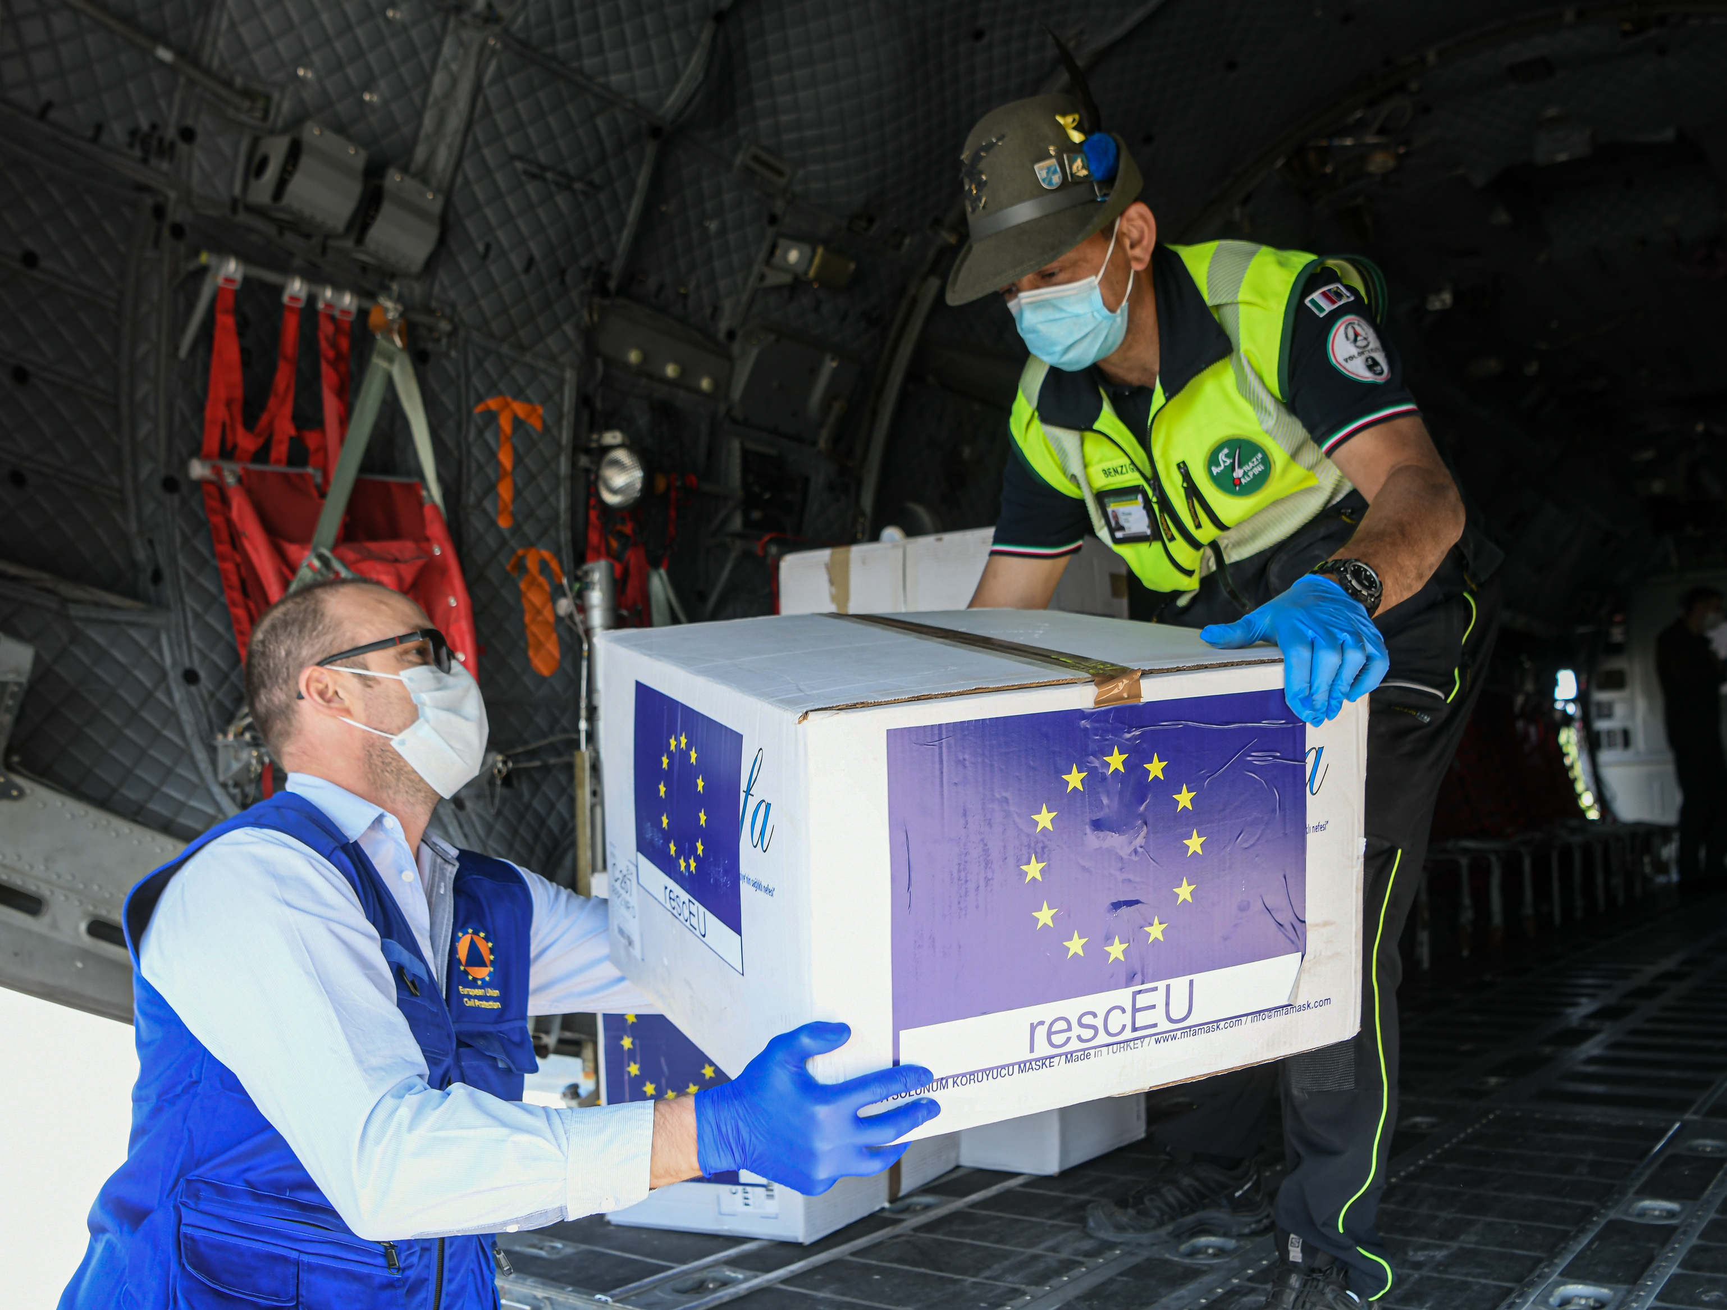
rescEU
Recent Highlights

Slide 11
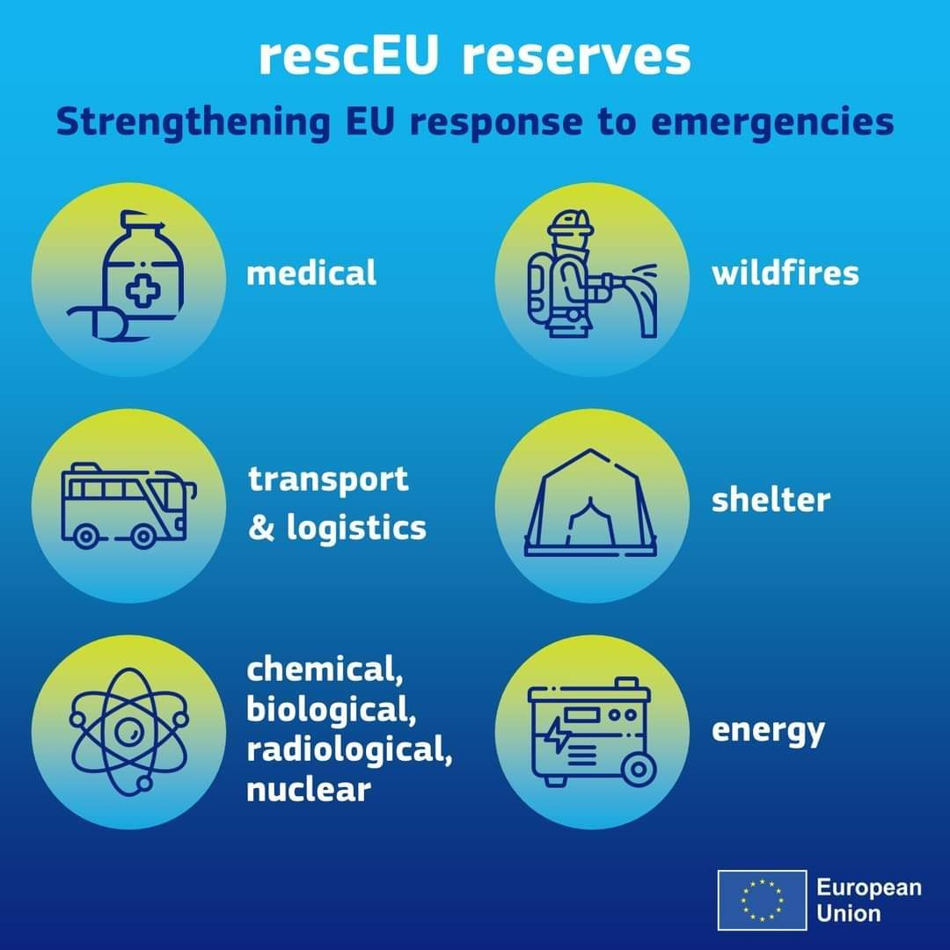

rescEU deployments in 2024
25.325.756 medical/CBRN
items
22 planes and helicopters
21.000 beds and hygiene items
26
deployments
10.800 items from the private sector
1.013 generators
2 bus
to evacuate
people
1 Medical evacuation

Slide 12
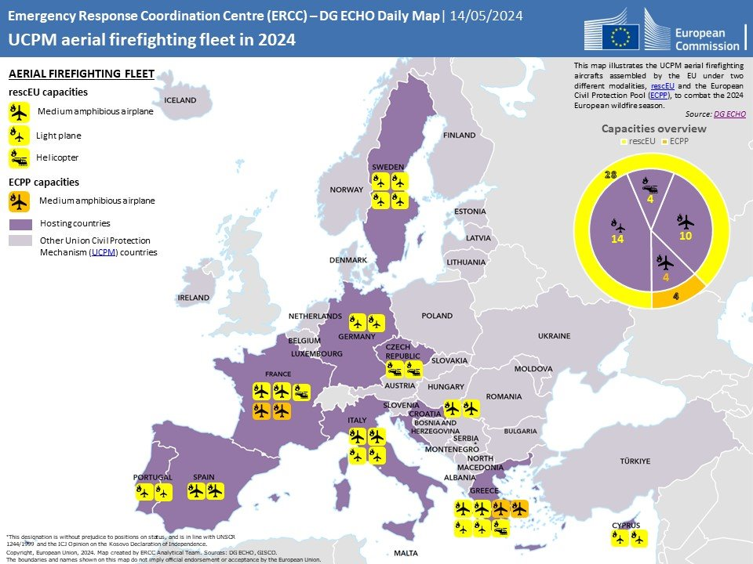

Slide 13
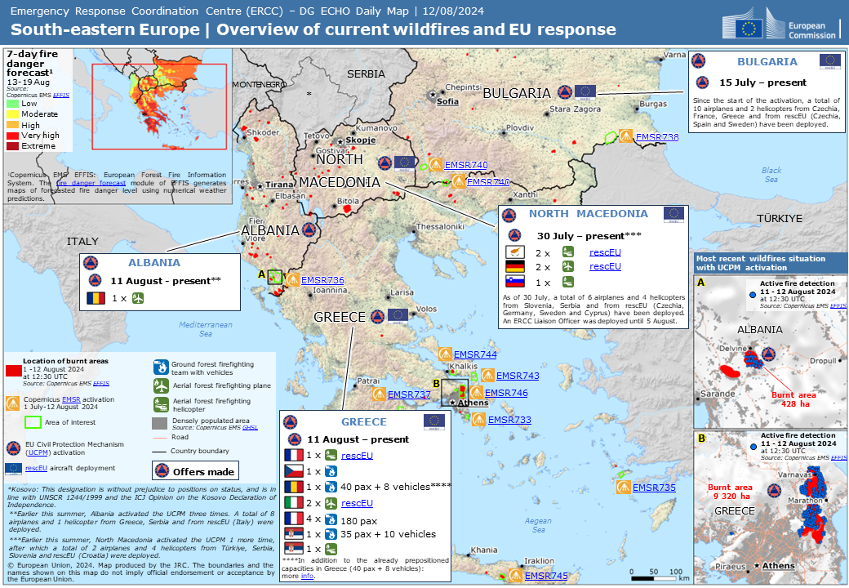
2024
wildfires in
south-eastern Europe

Slide 14
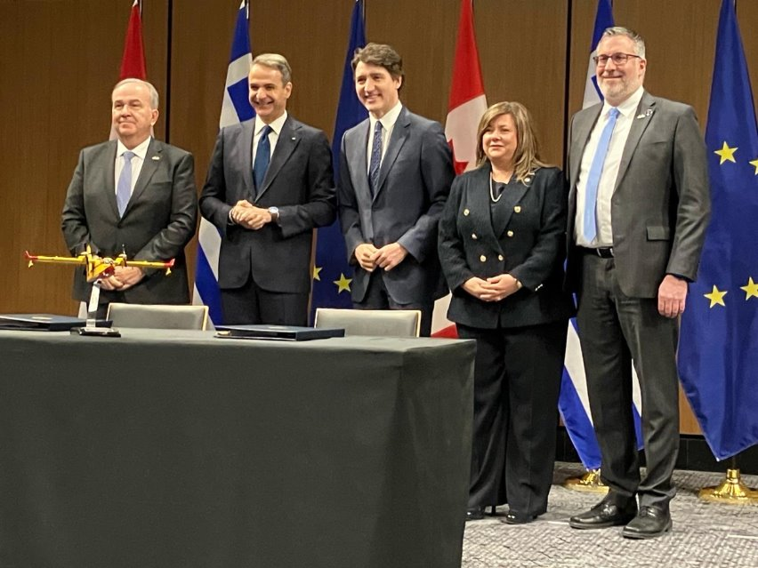
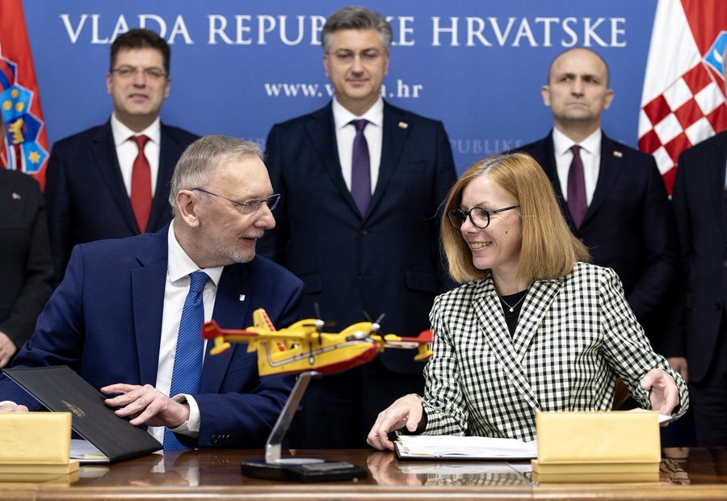
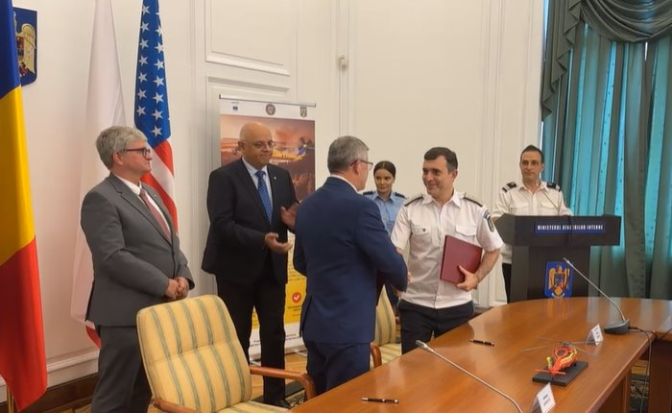
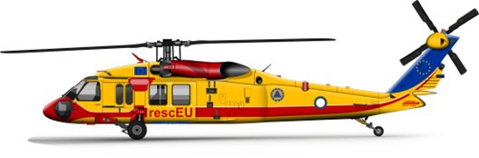
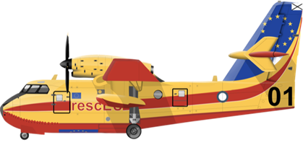
rescEU AFF permanent fleet
Signature process
Greece, 24 March 2024
Croatia, 25 March 2024
Romania, 25 June 2024

Slide 15
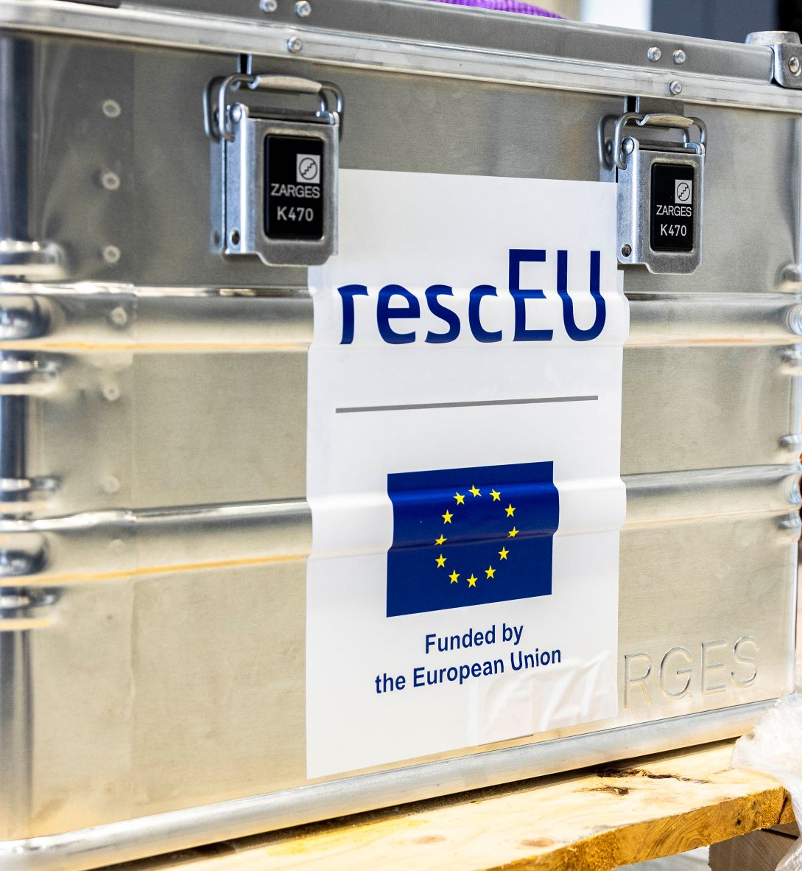

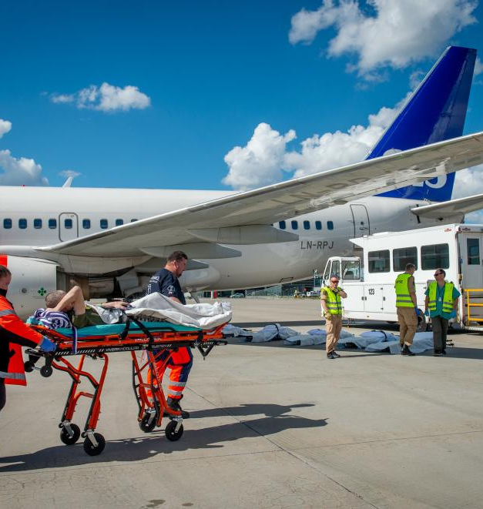
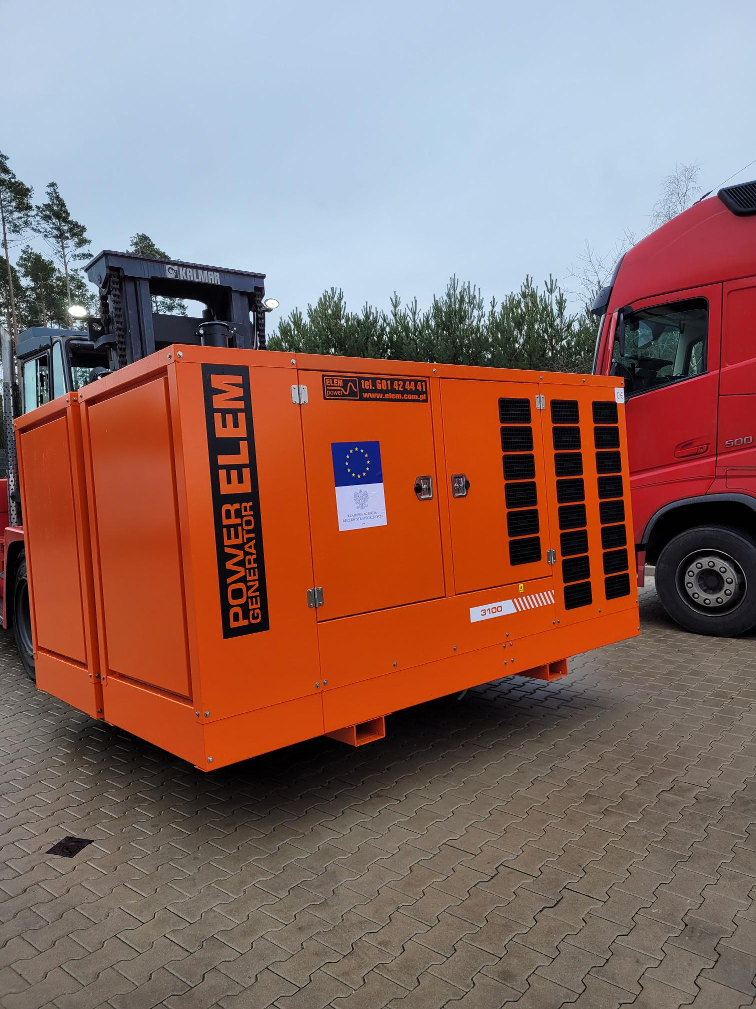
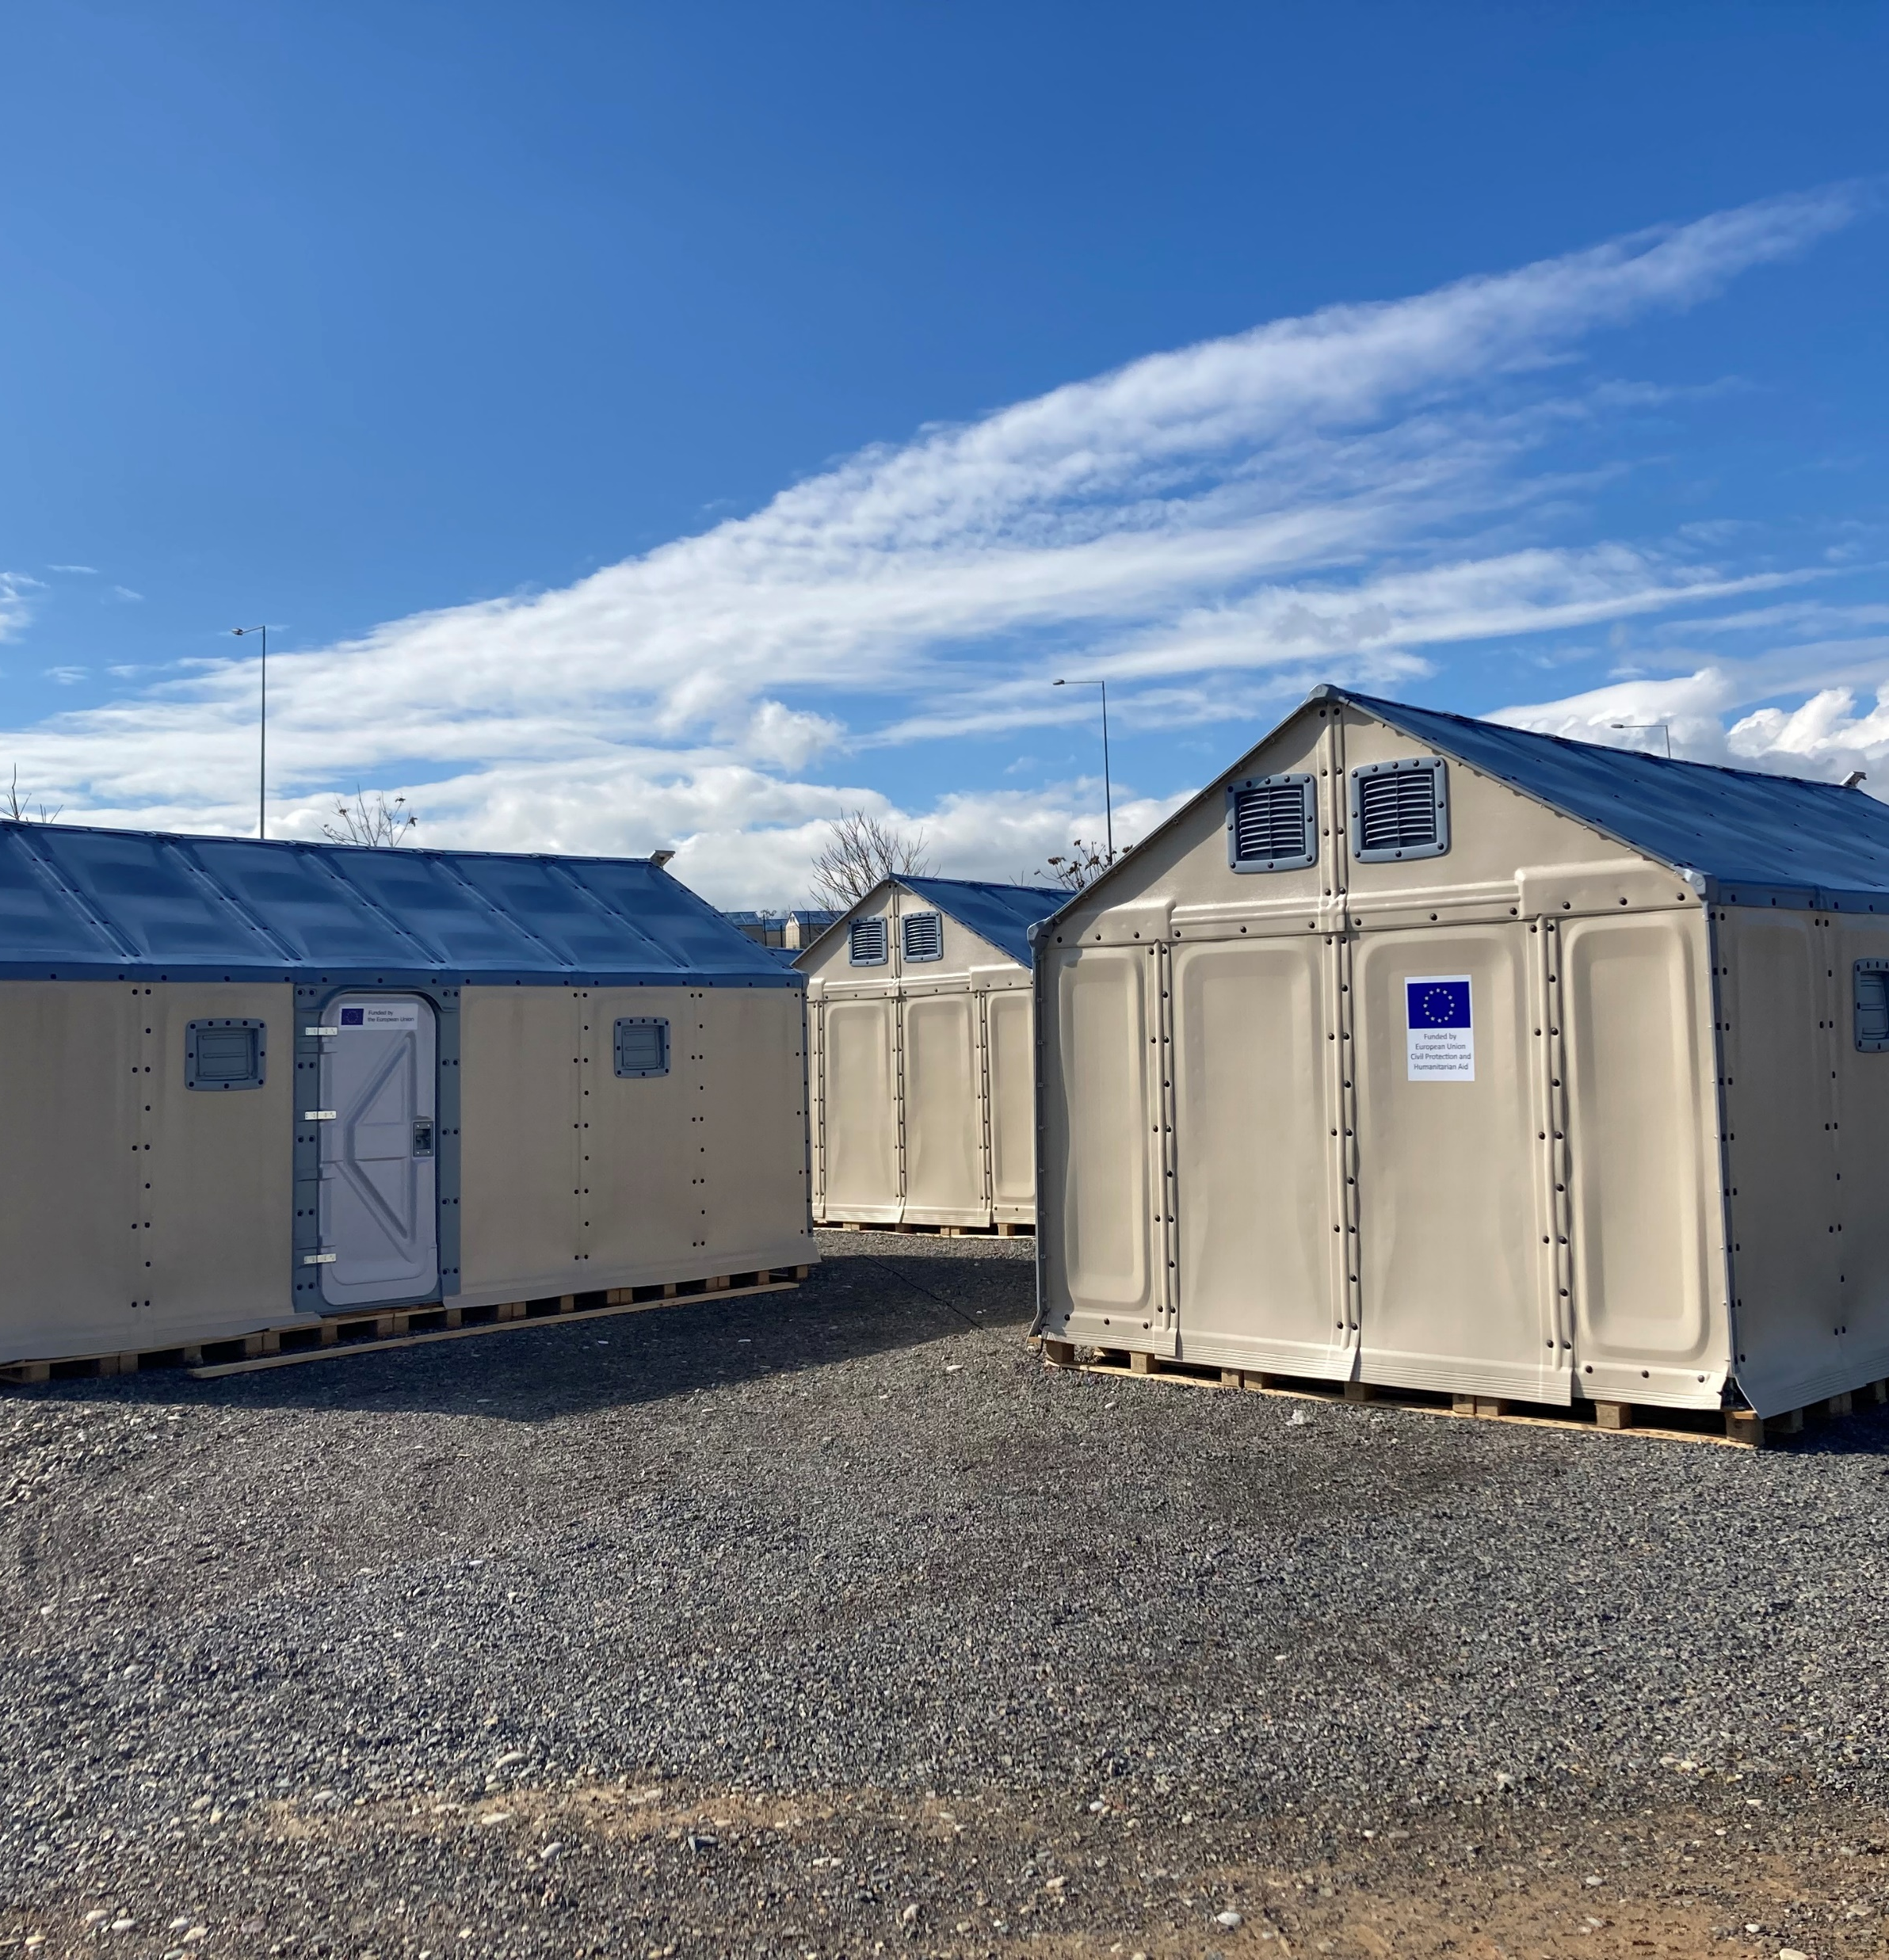
2024 rescEU response to Ukraine war
Overview
530
medical devices
rescEU CBRN and medical strategic stockpiles
5.000 beds
16.000 hygiene kits
rescEU shelter emergency capacity
© European Union
1013 generators
rescEU energy strategic reserve
10.800 items from private sector
rescEU donation scheme
1
Medical evacuation
rescEU Medevac

Slide 16

5 years of rescEU
Online campaign
To celebrate its fifth anniversary, the EU is promoting the flagship policy ‘rescEU’ with an online campaign.
Online campaign has started on 13 June for 3 weeks
The paid campaign is promoted in six Member States (Germany, Sweden, Romania, Poland, Cyprus & Spain)
Check the link here

Slide 17
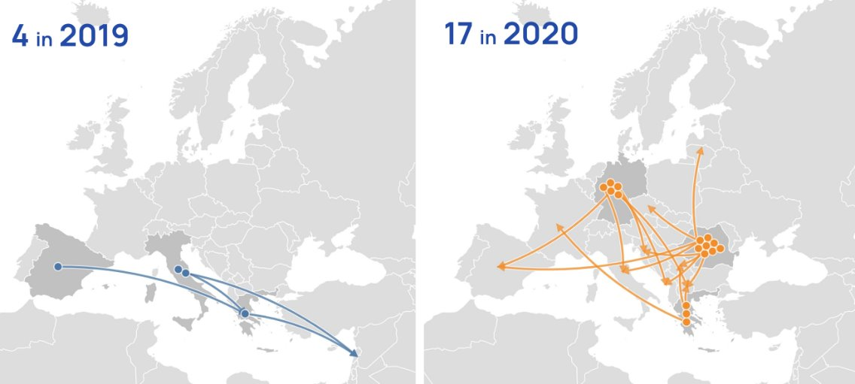
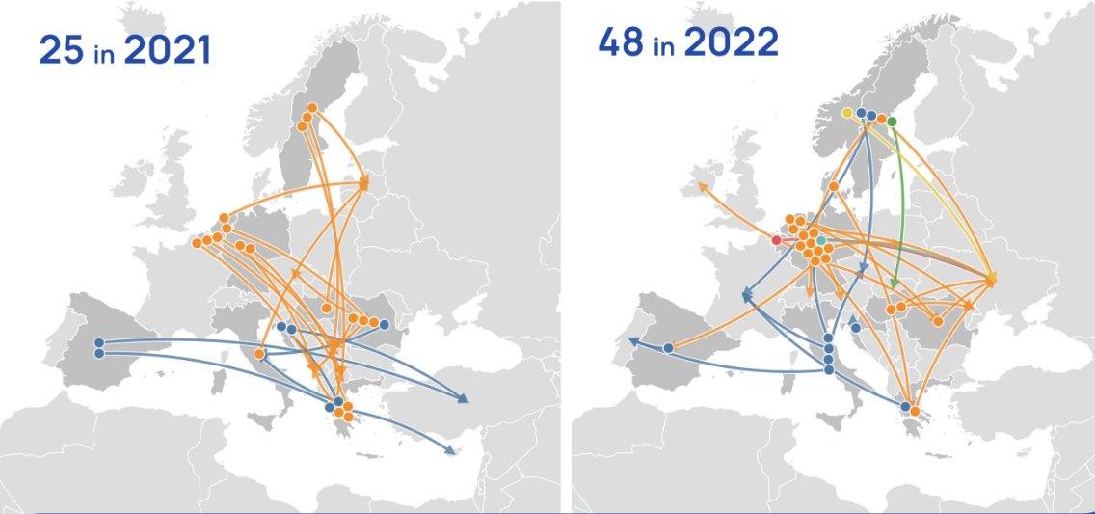
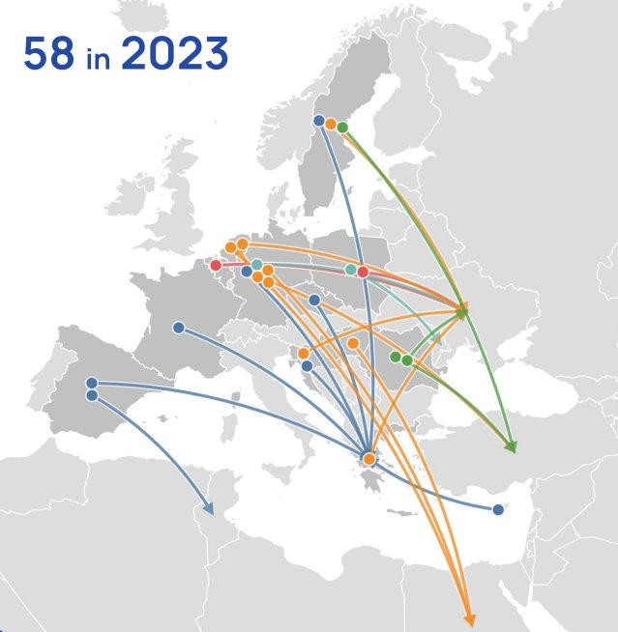
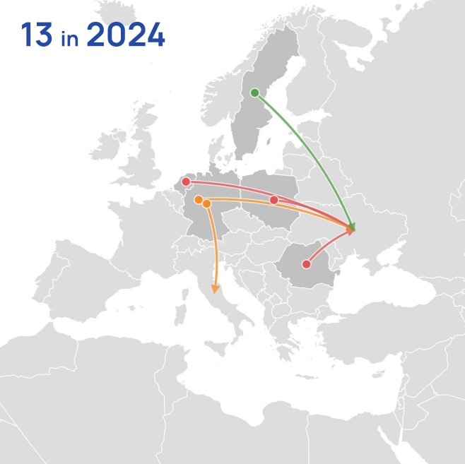
rescEU deployments over time
26

Slide 18
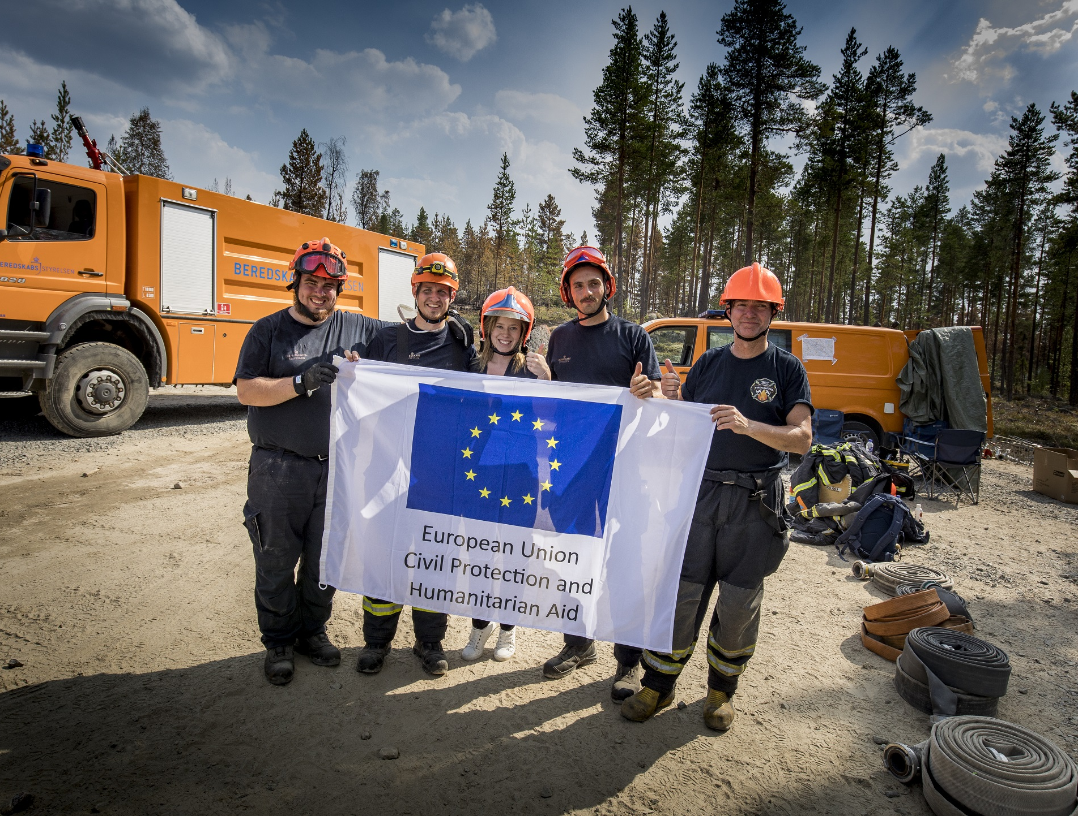
Thank you!

