Slide 1
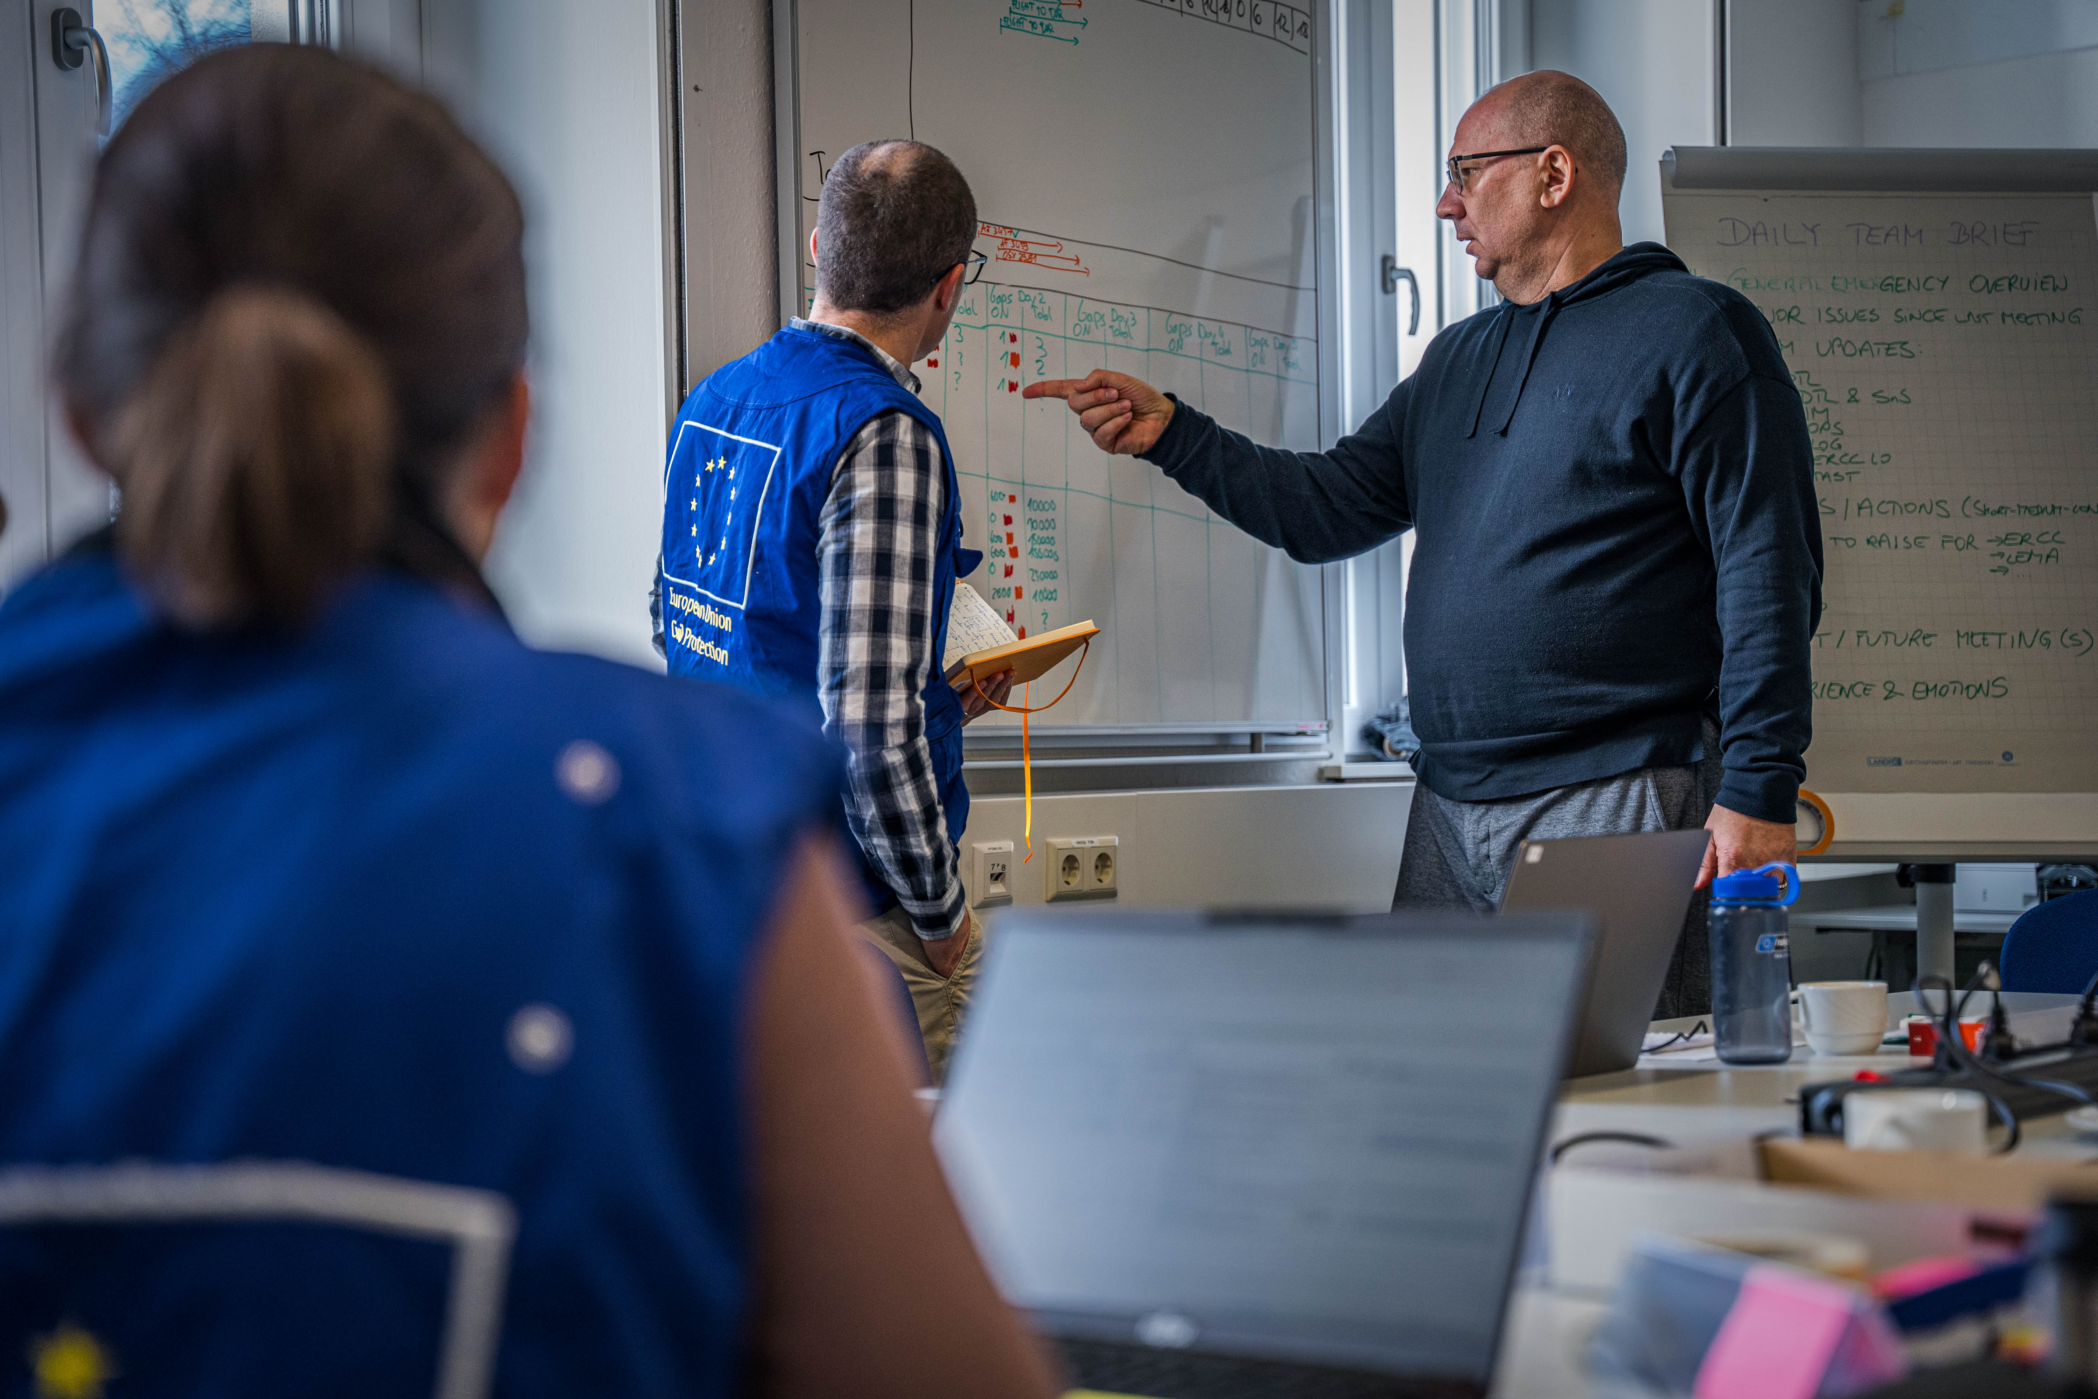
National Training Coordinators Meeting
UCPM Training, Exercises and Exchange of Experts Programmes
Online, 12 November 2024

Slide 2
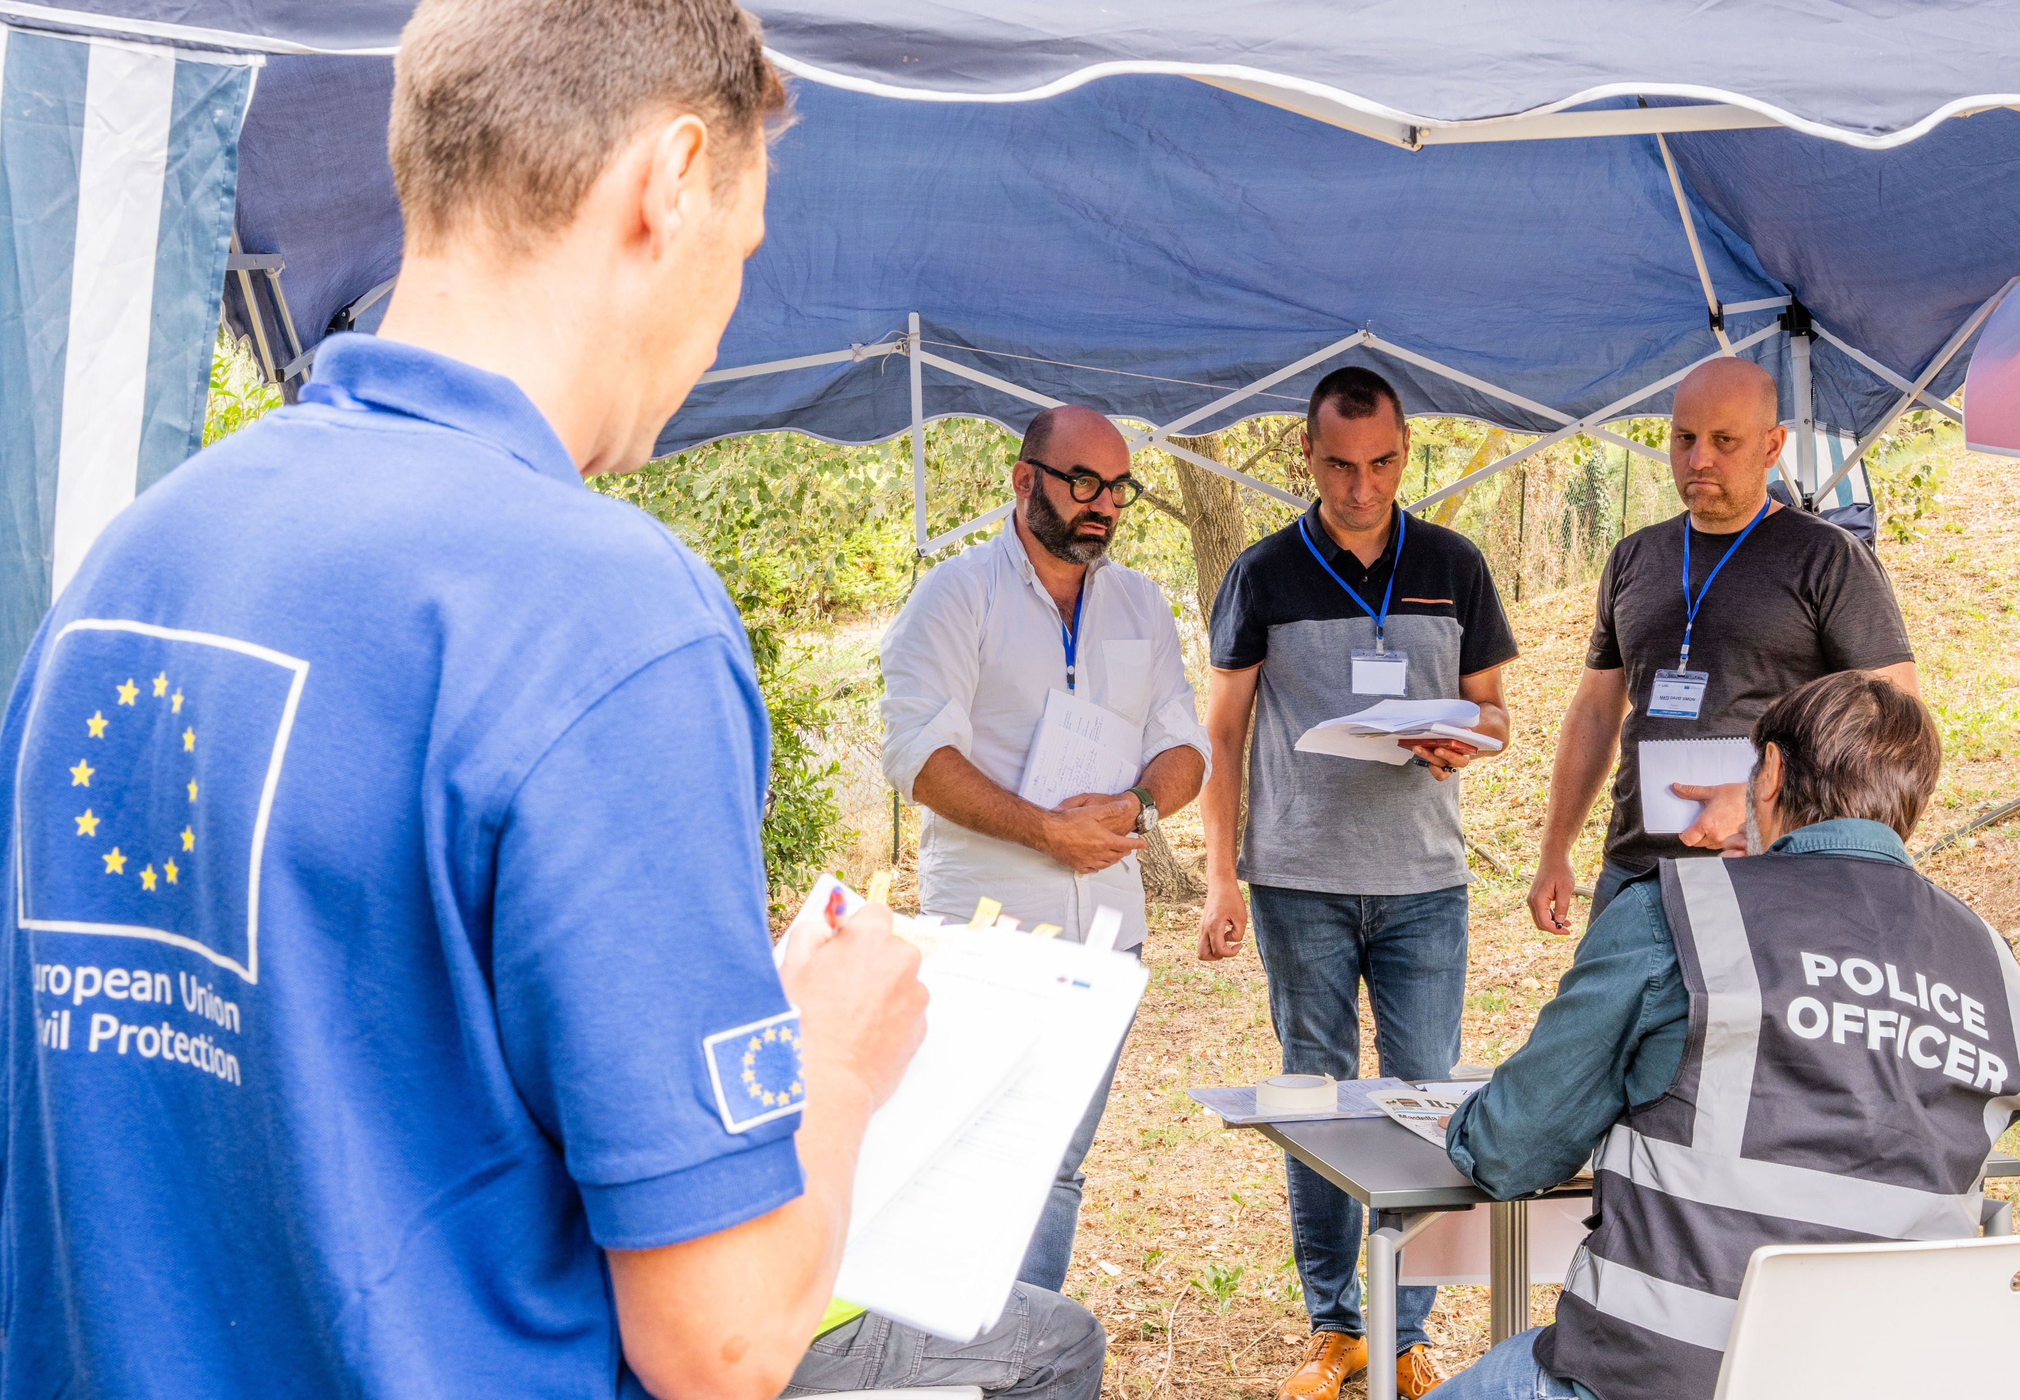
Item 1.
Training activities

Slide 3



Deployable Training Path
TLC
Total 582 - 696
1/2
Courses and participants in 2024
UMI
ODC
ODC Adv
15+14
9/11
3
4/5
IMC Adv
206+48
54
81+21
2
23
DCC
MRS
SEC online
SEC Adv
6/7
3
1
116+20
87
651
11

Slide 4
Civil protection and disaster management stakeholders
Courses and participants in 2024
Total 101
NAT
EUD
NCP
OIC
521
131
3
2
73
24

Slide 5
EC-UN Joint Courses
Total 97
Courses and participants in 2024
LRT
EMTCC
EET
1
1
UCC
1
24
1
26
24
7 MS/PS 19 UN
16 MS/PS 8 UN
23
16 MS/PS 8 UN
18 MS/PS 5 UN

Slide 6
Ad-hoc, Online, ToT, Seminars, Workshops
Courses and participants in 2024
TLs EUCP & UNDAC Teams
ToT EU MODEX coach/trainers
Online modules for NTCs
ToT lecturers/trainers
2
2/3
5
45
42
24+16
100
25 MS/PS 20 UN

Slide 7
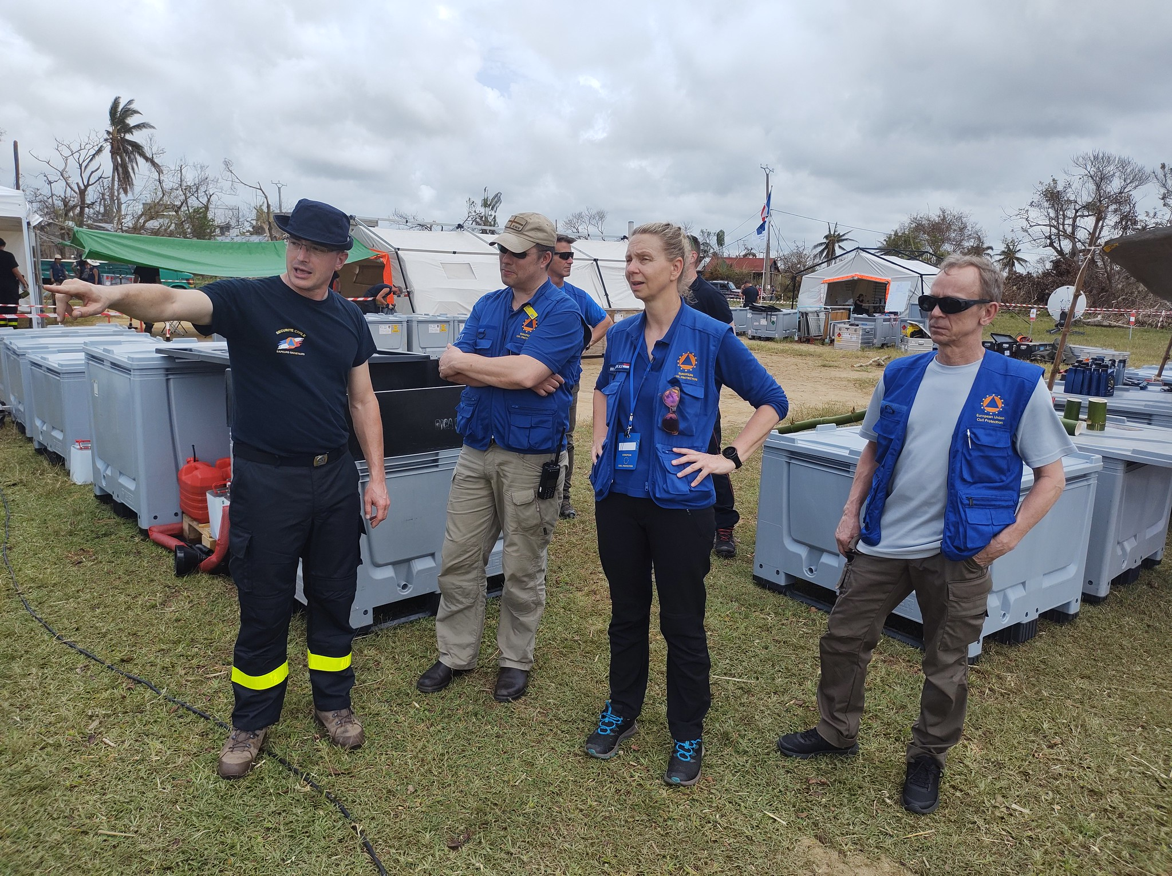
Item 2.
EU MODEX

Slide 8








Civil protection exercises: EU MODEX
EU MODEX cycle 12 – 2024 -2026
24
10
3
1
2
Flood
field exercises
Table Top
exercises
CBRN
field exercise
Forest Fire
field exercises
exercises
3
3
2
EUCPT & TAST field exercises
USAR only
field exercises
Combined USAR/Medical
field exercises

Slide 9
Civil protection exercises: EU MODEX
EU MODEX cycle 12 – Design phase
Standardised documentation
Common quality assurance, monitoring and evaluation approach
Common approach to the integration of the EUCPT & TAST into EU MODEX, including the feedback and assessment framework
2

Slide 10
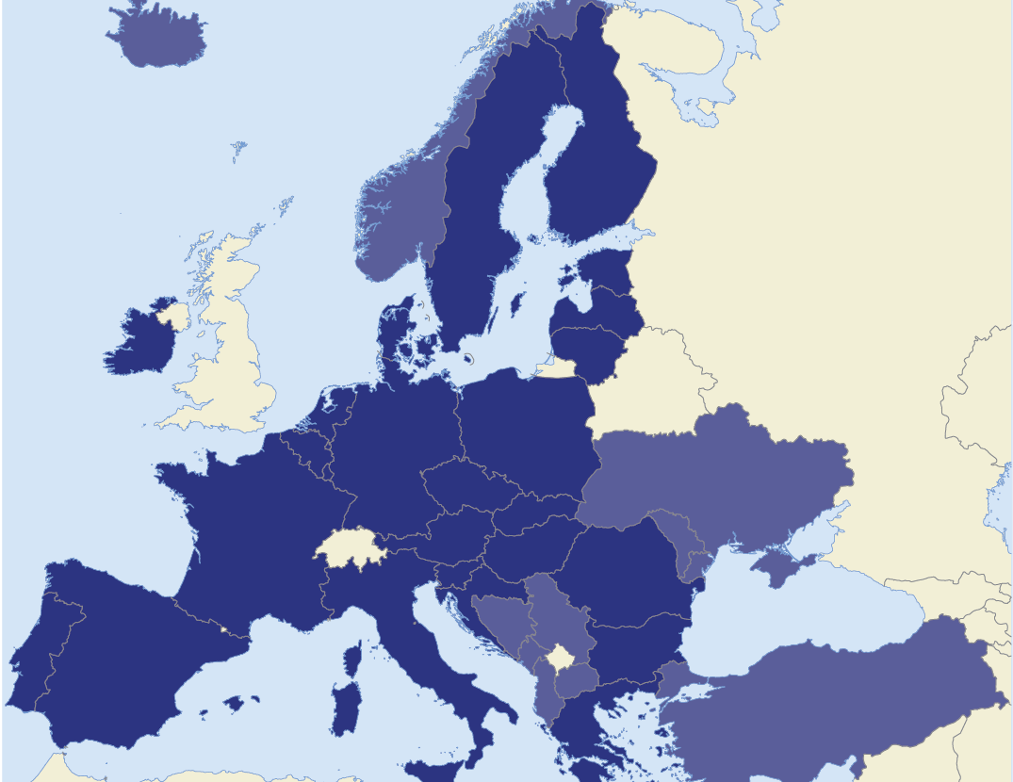


MODEX 2024
2 Table top Exercises
2 Field Exercises
Austria – FX1
119- 22 November
Slovenia – TTX1
7-11 October
Portugal – TTX2
25-29 November
Italy – FX1
17 - 21 October

Slide 11


MODEX 2025
4 Table top Exercises
8 Field Exercises
Ireland FX1
24 -28 March
Latvia – FX4
9-12 September
EUCPT
& TAST
Poland – FX3
20-23 May
Belgium – TTX4
5-9 May
Germany – TTX3
22-26 February
Austria – FX4
14-18 October
Slovenia – TTX5
2-6 June
Croatia – TTX6
6-10 October
Portugal – FX2
27-31 January
Bulgaria – FX3
13-16 May
Italy – FX2
8-11 April
Spain FX2
22-27 Sept
EUCPT
& TAST

Slide 12
MODEX 2026
4 Table top Exercises
4 Field Exercises
Denmark – FX5
23-26 January
Belgium – TTX9
1-5 June
Germany – TTX8
13-17 April
Switzerland – FX6
9-6 October
Moldova – FX6
16-19 June
Portugal – TTX7
23-27 February
Slovenia – TTX10
28 Sept-2 Oct
Portugal – FX5
5-9 May

Slide 13

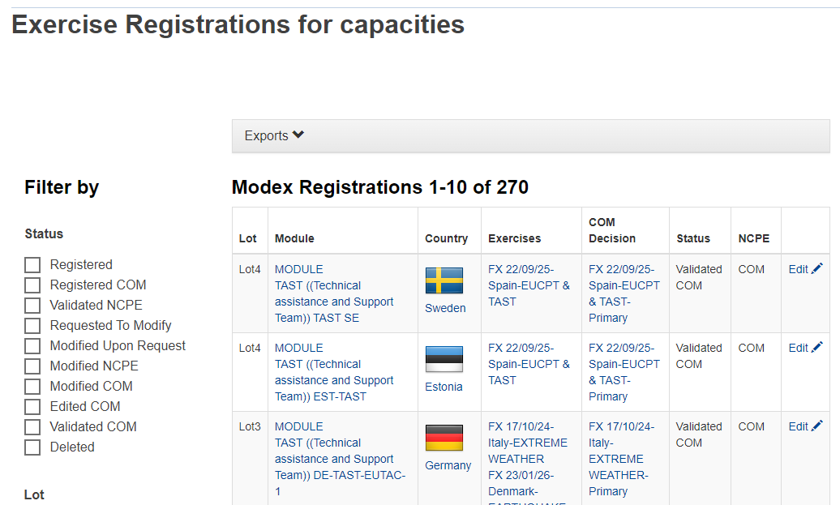
Online Registration Tool
ORT in use for EU MODEX Cycle 12
Module, ORC, TAST
One registration period at the beginning of the cycle
Selection: primary and reserve list

Slide 14
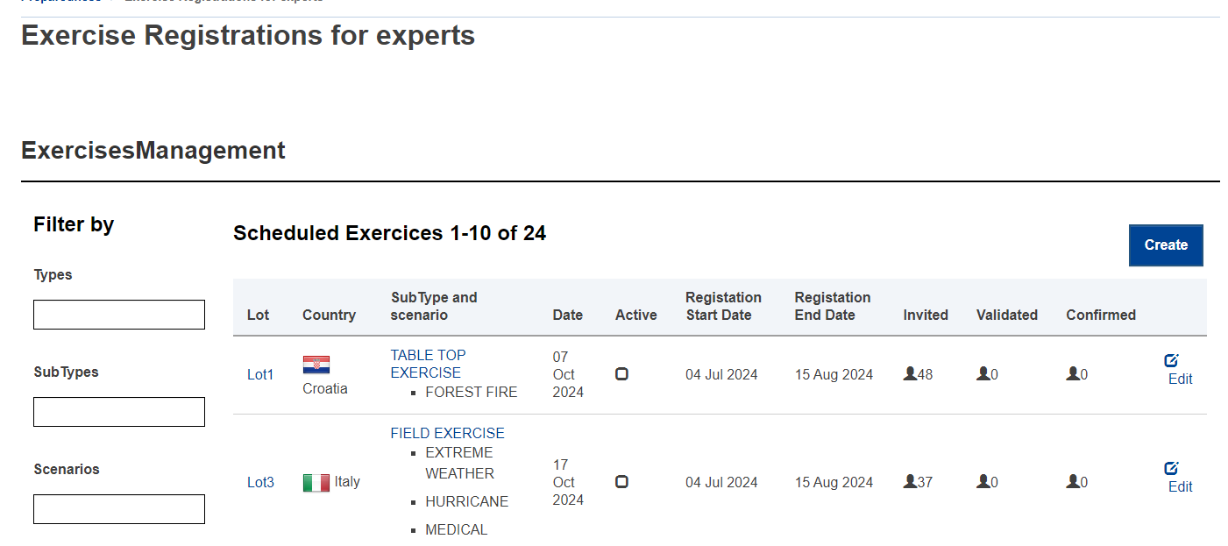
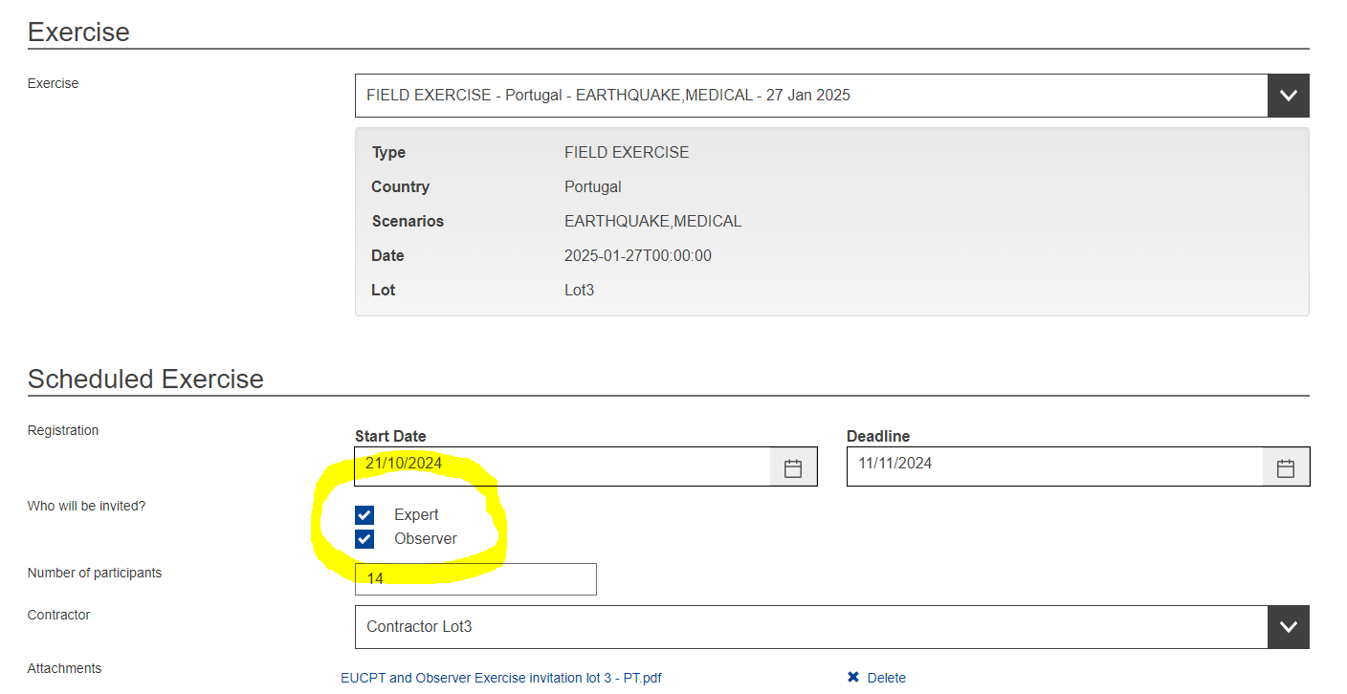
Online Registration Tool
ORT in use for EU MODEX Cycle 12
EUCPT experts and observers
Separate registration period for each exercise
Launch: at least 14 weeks before each exercise
Similar to training courses registration

Slide 15
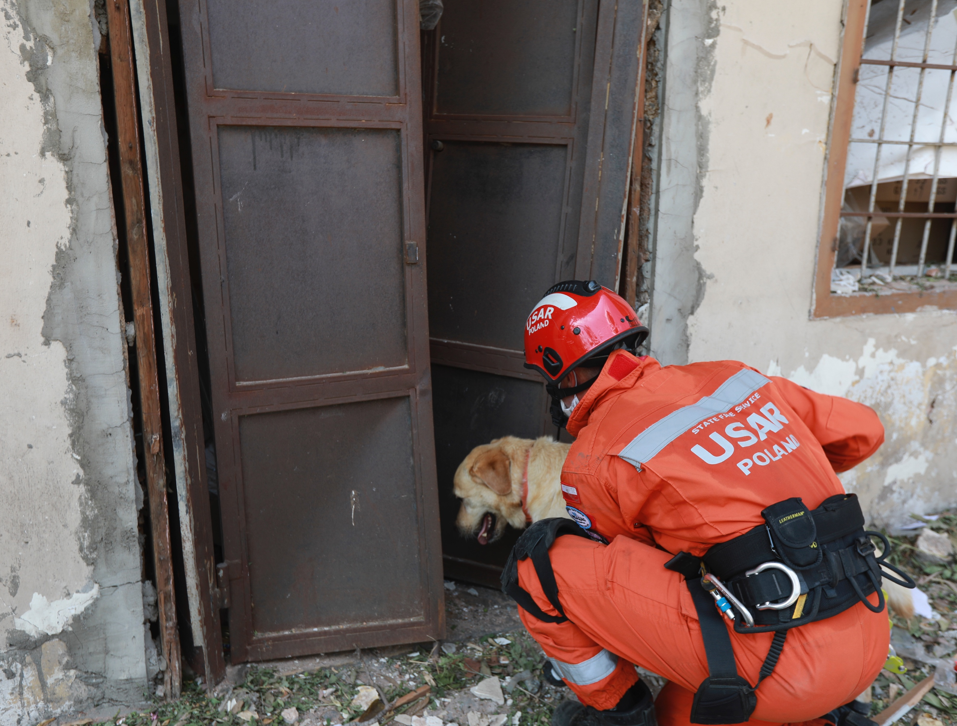
Item 3.
Full-Scale Exercises

Slide 16
Civil protection exercises: Full-scale
2023 KAPP Call
2024 - 2025
Germany - MAGNITUDE
25-26 October 2024
Albania - FLOODNORTHALB
7-11 April 2025

Slide 17
Civil protection exercises: Full-scale
2024 KAPP Call
2025 - 2026
CROSSFLOOD
RO – UA - MD
DEMONAX
CYPRUS

Slide 18
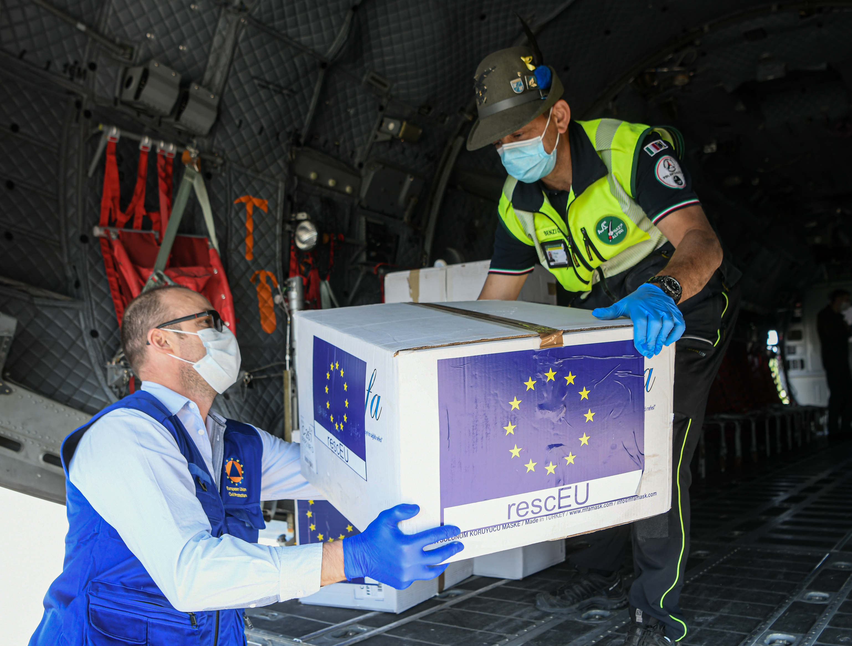
Item 4.
Other civil protection exercises

Slide 19
Other civil protection exercises
HNS TTX
Plug- in Exercises
UNDER PROCUREMENT

Slide 20
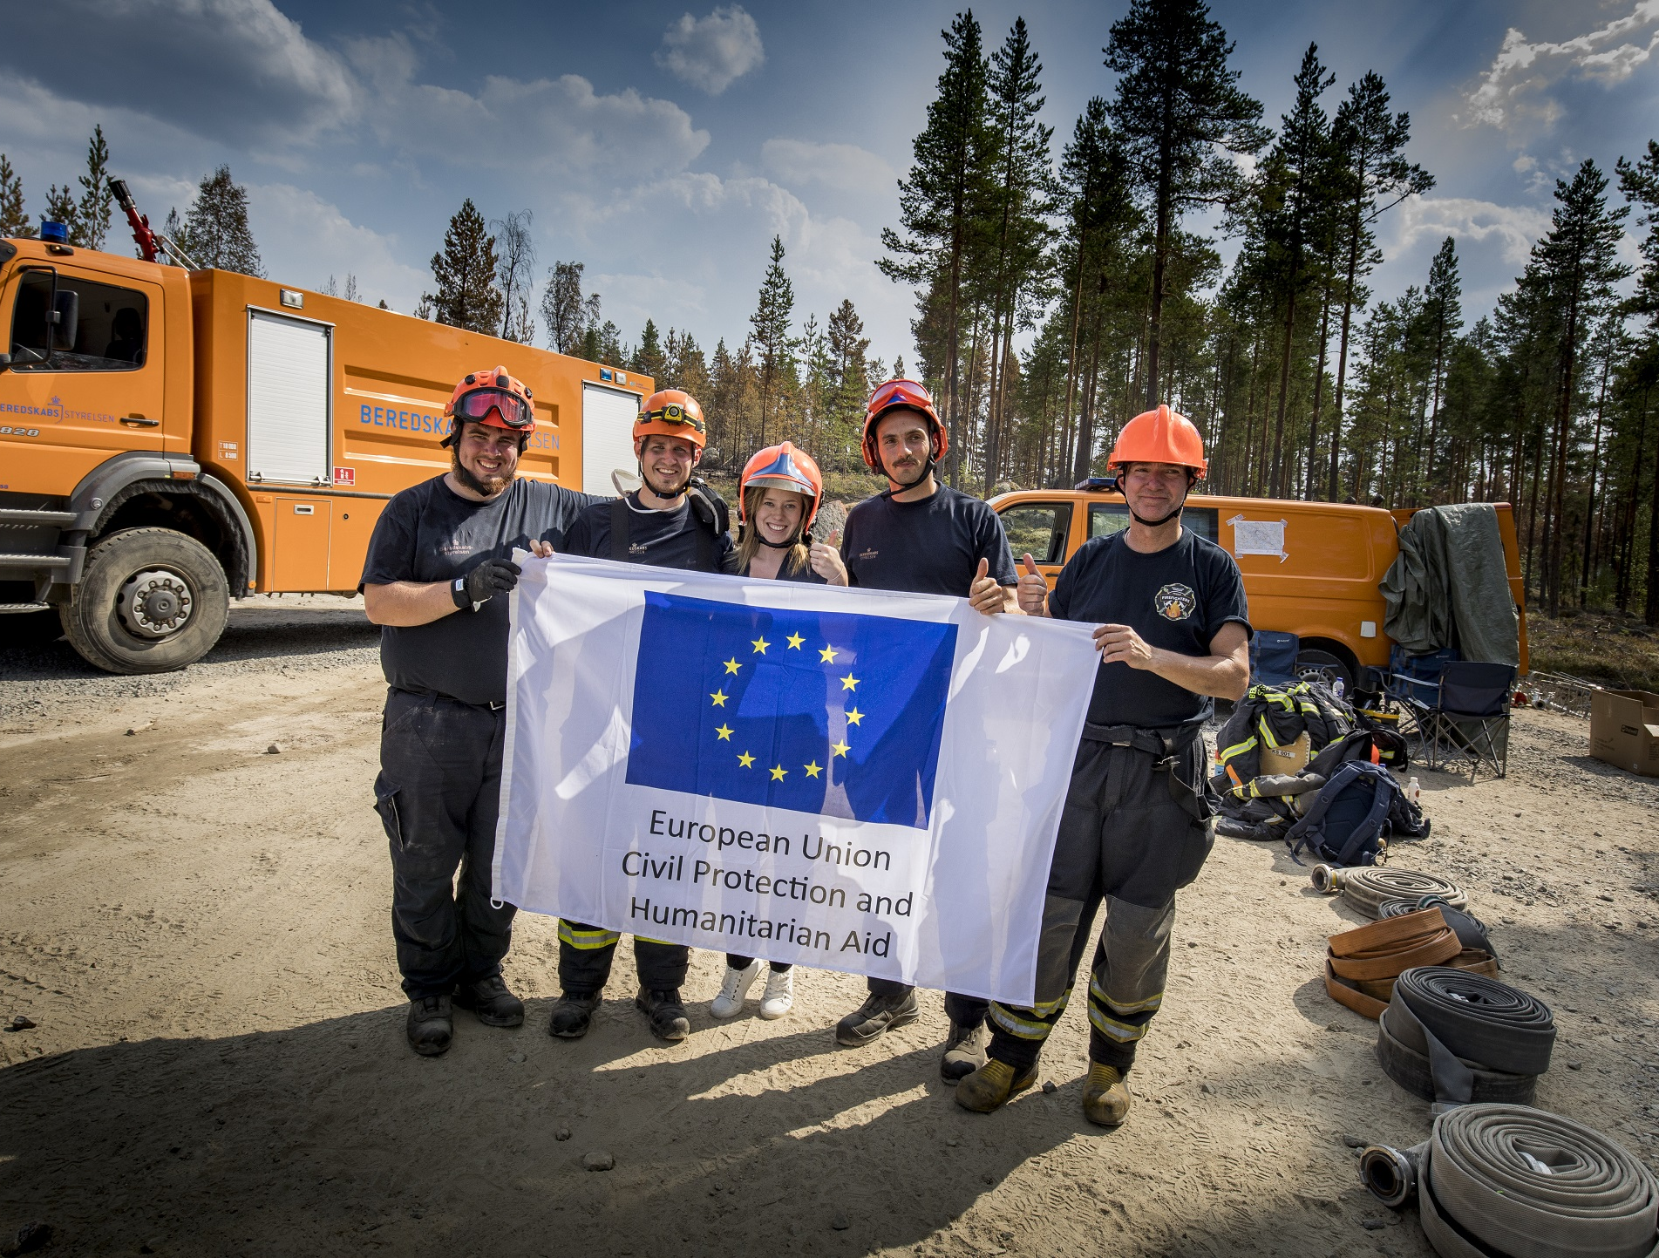
Item 5.
Exchange of Experts Programme

Slide 21

2024 Exchanges
185 experts | 32 countries | 27 exchanges

Slide 22
2024 Exchanges
25 host organisations | 17 countries | 27 exchanges

Slide 23

2024 Exchanges
25 host organisations | 17 countries | 27 exchanges

