Slide 1


Meeting of NTC
27 November 2024 (Budapest)
PA & E Framework – Brief Overview
Lot 1

Slide 2
PA & E FRAMEWORK
PA & A Purpose
Purpose:
Aligns training outcomes with participant development.
Ensures participants meet learning objectives and develop deployment-ready skills.
Key Principles:
Transparent, fair, and participative processes.
Focused on both formative (improving learning) and summative (certification of achievement) assessments.
Foundation:
Built on UCPM’s 2021 evidence-based policy for training and evaluation.

Slide 3
PA & E FRAMEWORK
PA & A – Assessment/Evaluation
Assessment:
Definition: Ongoing process to provide feedback and enhance learning.
Types:
Formative: Identifies needs for improvement.
Continual: Daily observation and feedback.
Scenario-Based: Simulates real-world tasks for experiential learning.
Peer-to-Peer: Encourages collaboration and mutual learning too.
Evaluation:
Definition: Summative process determining participant readiness and progress.
Focus on skills, knowledge, and attitude development.

Slide 4
PA & E FRAMEWORK
PA & A – Structured Approach
Structured Approach:
Pre-course self-assessment to identify learning gaps.
Daily reflective journals to enhance self-awareness and track progress.
End-of-course evaluation reports for participant feedback and guidance.
Thresholds for Success:
Core learning objectives: ≥90%.
Other objectives: ≥70%.
People skills (soft skills) & English proficiency: Yes/No criteria.
Ongoing Support:
Daily, individual coaching and feedback to ensure skill acquisition.
Opportunities for improvement during the course is key.

Slide 5
PA & E FRAMEWORK
PA & A - Impact
Key Stakeholders:
Course Directors & Trainers: Guide, observe, and assess participants.
National Training Coordinators (NTCs): Facilitate participant preparation and selection.
Tools:
Reflective Journals.
Assessment forms (self-assessment, individual evaluation).
Online and in-person knowledge testing.
Impact:
Ensures participant growth along the training pathway.
Builds a comprehensive performance history to guide future courses and deployments.

Slide 6
PA & E FRAMEWORK
PA & A Procedures
Three different concepts for the documentation
UMI
No Assessment Form for most participants
Only standard Evaluation Form in MS Word
Extended Evaluation Form in MS Word for participants with a clear challenge in Behaviour/English
DCC, ODC, IMC ADV & SEC ADV
MS Forms solution as Assessment Form
Evaluation Form reduced to two pages in MS Word
ODC ADV & TLC
Optional MS Form or MS Excel when preferred (Flexible)
Evaluation Form reduced size to three pages in MS Word
MS Power BI supported

Slide 7
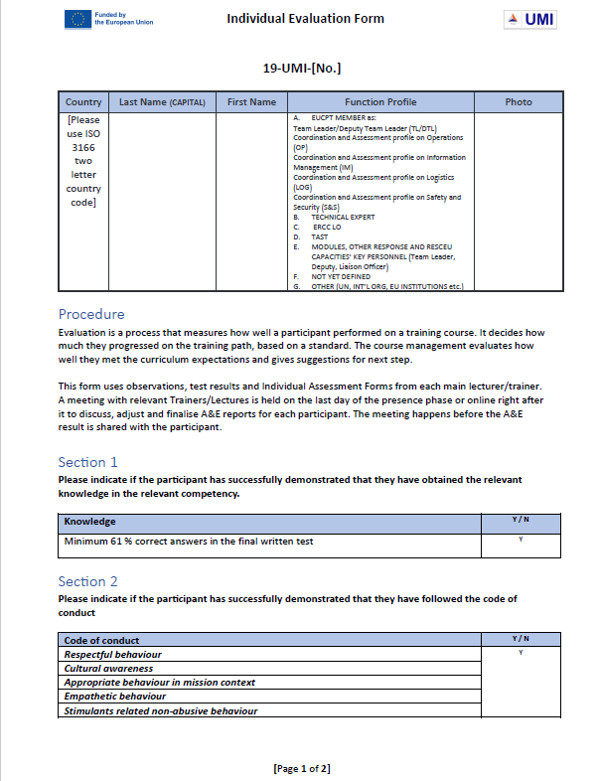
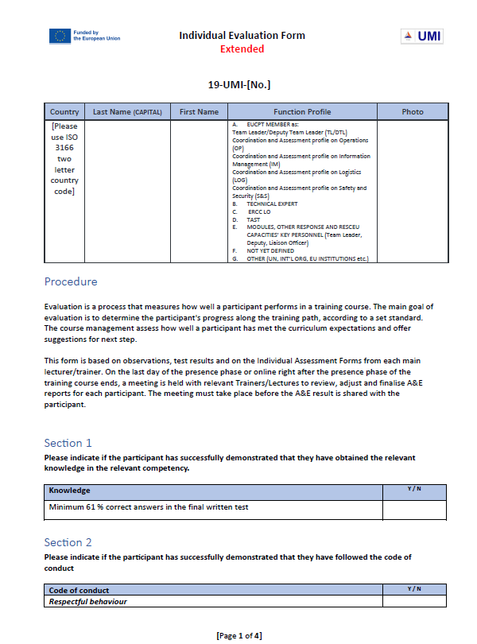
PA & E FRAMEWORK
UMI Concept
No Performance Assessment Form for most participants
Standard Evaluation Form in Microsoft Word
Extended Evaluation Form in Microsoft Word for participants with a clear challenge in Behaviour/English
Pre-filled Standard Evaluation Form
Extended Evaluation Form

Slide 8
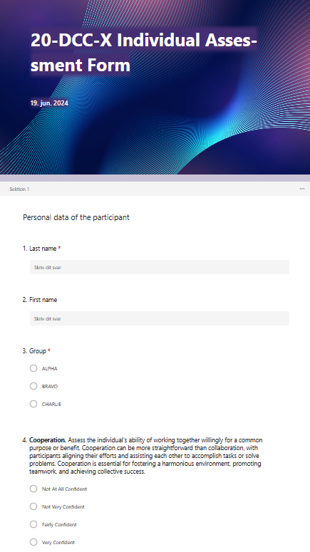
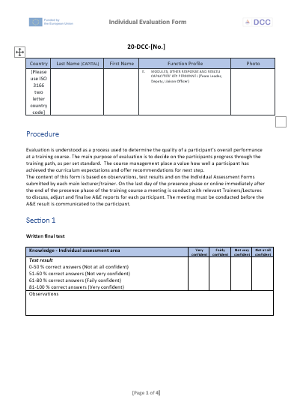
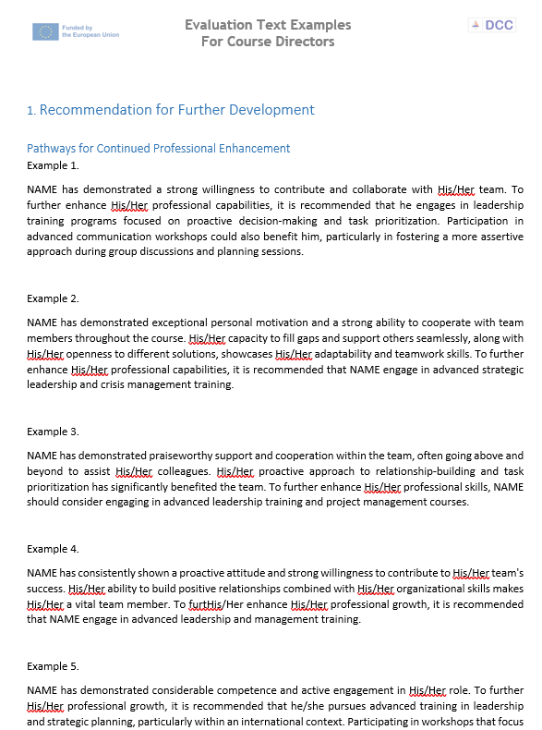
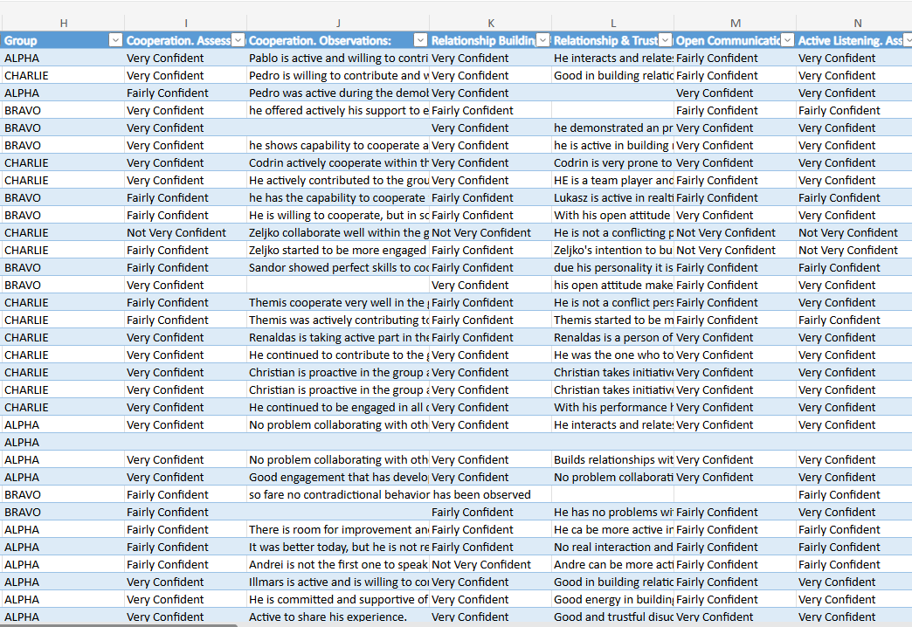
PA & E FRAMEWORK
DCC, ODC, IMC ADV & SEC ADV Concept
Microsoft Forms solution as Assessment Form
Evaluation Form - Tailormade in Microsoft Word
Electronic Assessment Form
Online Excel Assessment Form overview
Two pages Evaluation Form & Inspirations Document in Word

Slide 9
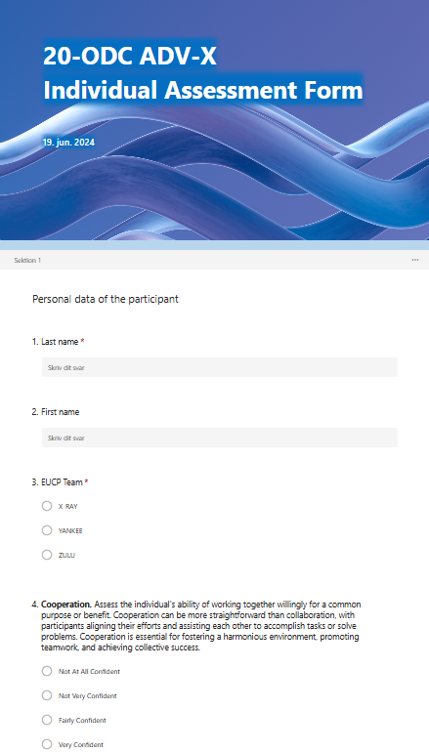
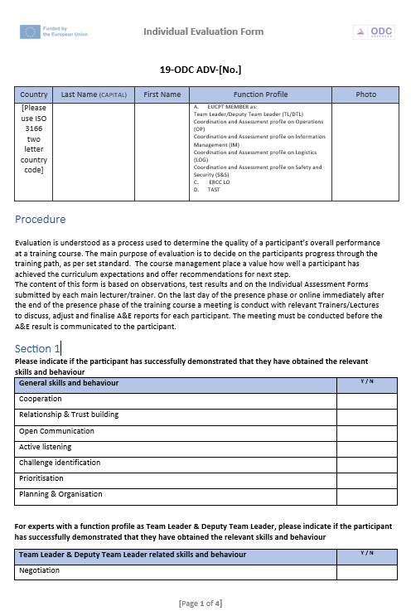
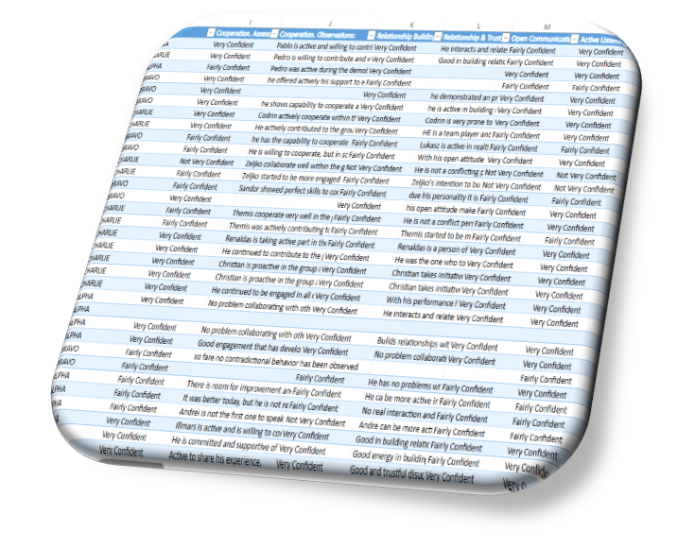

PA & E FRAMEWORK
ODC ADV & TLC Concept
Microsoft Forms flexible solution included Microsoft Excel when preferred
Evaluation Form - Tailormade in Microsoft Word
Microsoft Power BI (Business Intelligence) supported analysis tool for evaluation
Optional use of MS Form or MS Excel
Power BI supported
Three pages Evaluation Form

