Slide 1
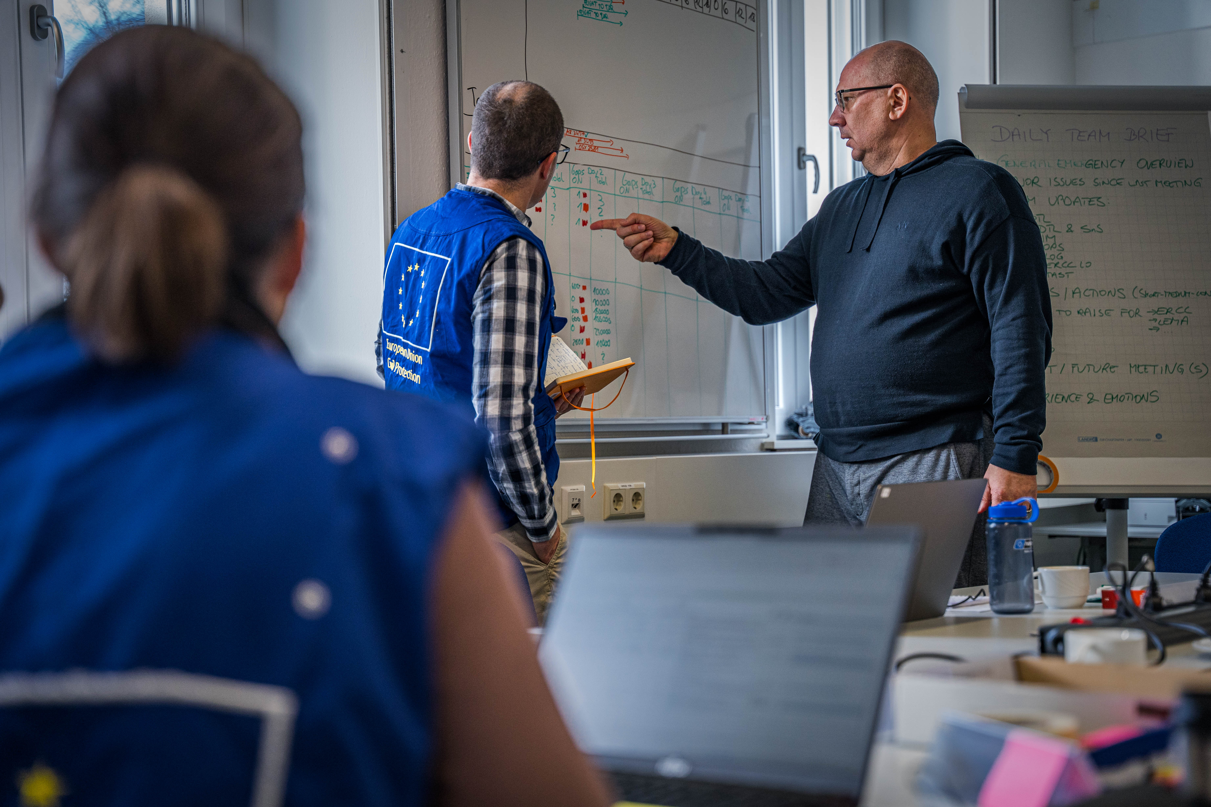
National Training Coordinators Meeting
Participant Performance & Recommendations’ Follow-up
Budapest, 25-28 November 2024

Slide 2
Group Discussion

Slide 3
Group Discussion
3 rounds of conversation in a group of 7-8 persons
3 questions, last question decide on 3 action points (1 per post-it).
‘Group spokesperson’, flipcharts, post-its

Slide 4
QUESTION 1:
What are the current challenges that I, as NTC, face to address the feedback on participant’s performance?
(20min)

Slide 5
QUESTION 2:
How do I, as NTC, ensure that the recommendations are followed-up on?
(20min)

Slide 6
QUESTION 3:
From the common experiences that we have identified, what are the 3 most important challenges and 3 key actions to address feedback and follow-up on recommendations?
Capture one per post-it provided.
(15min)

