Slide 1
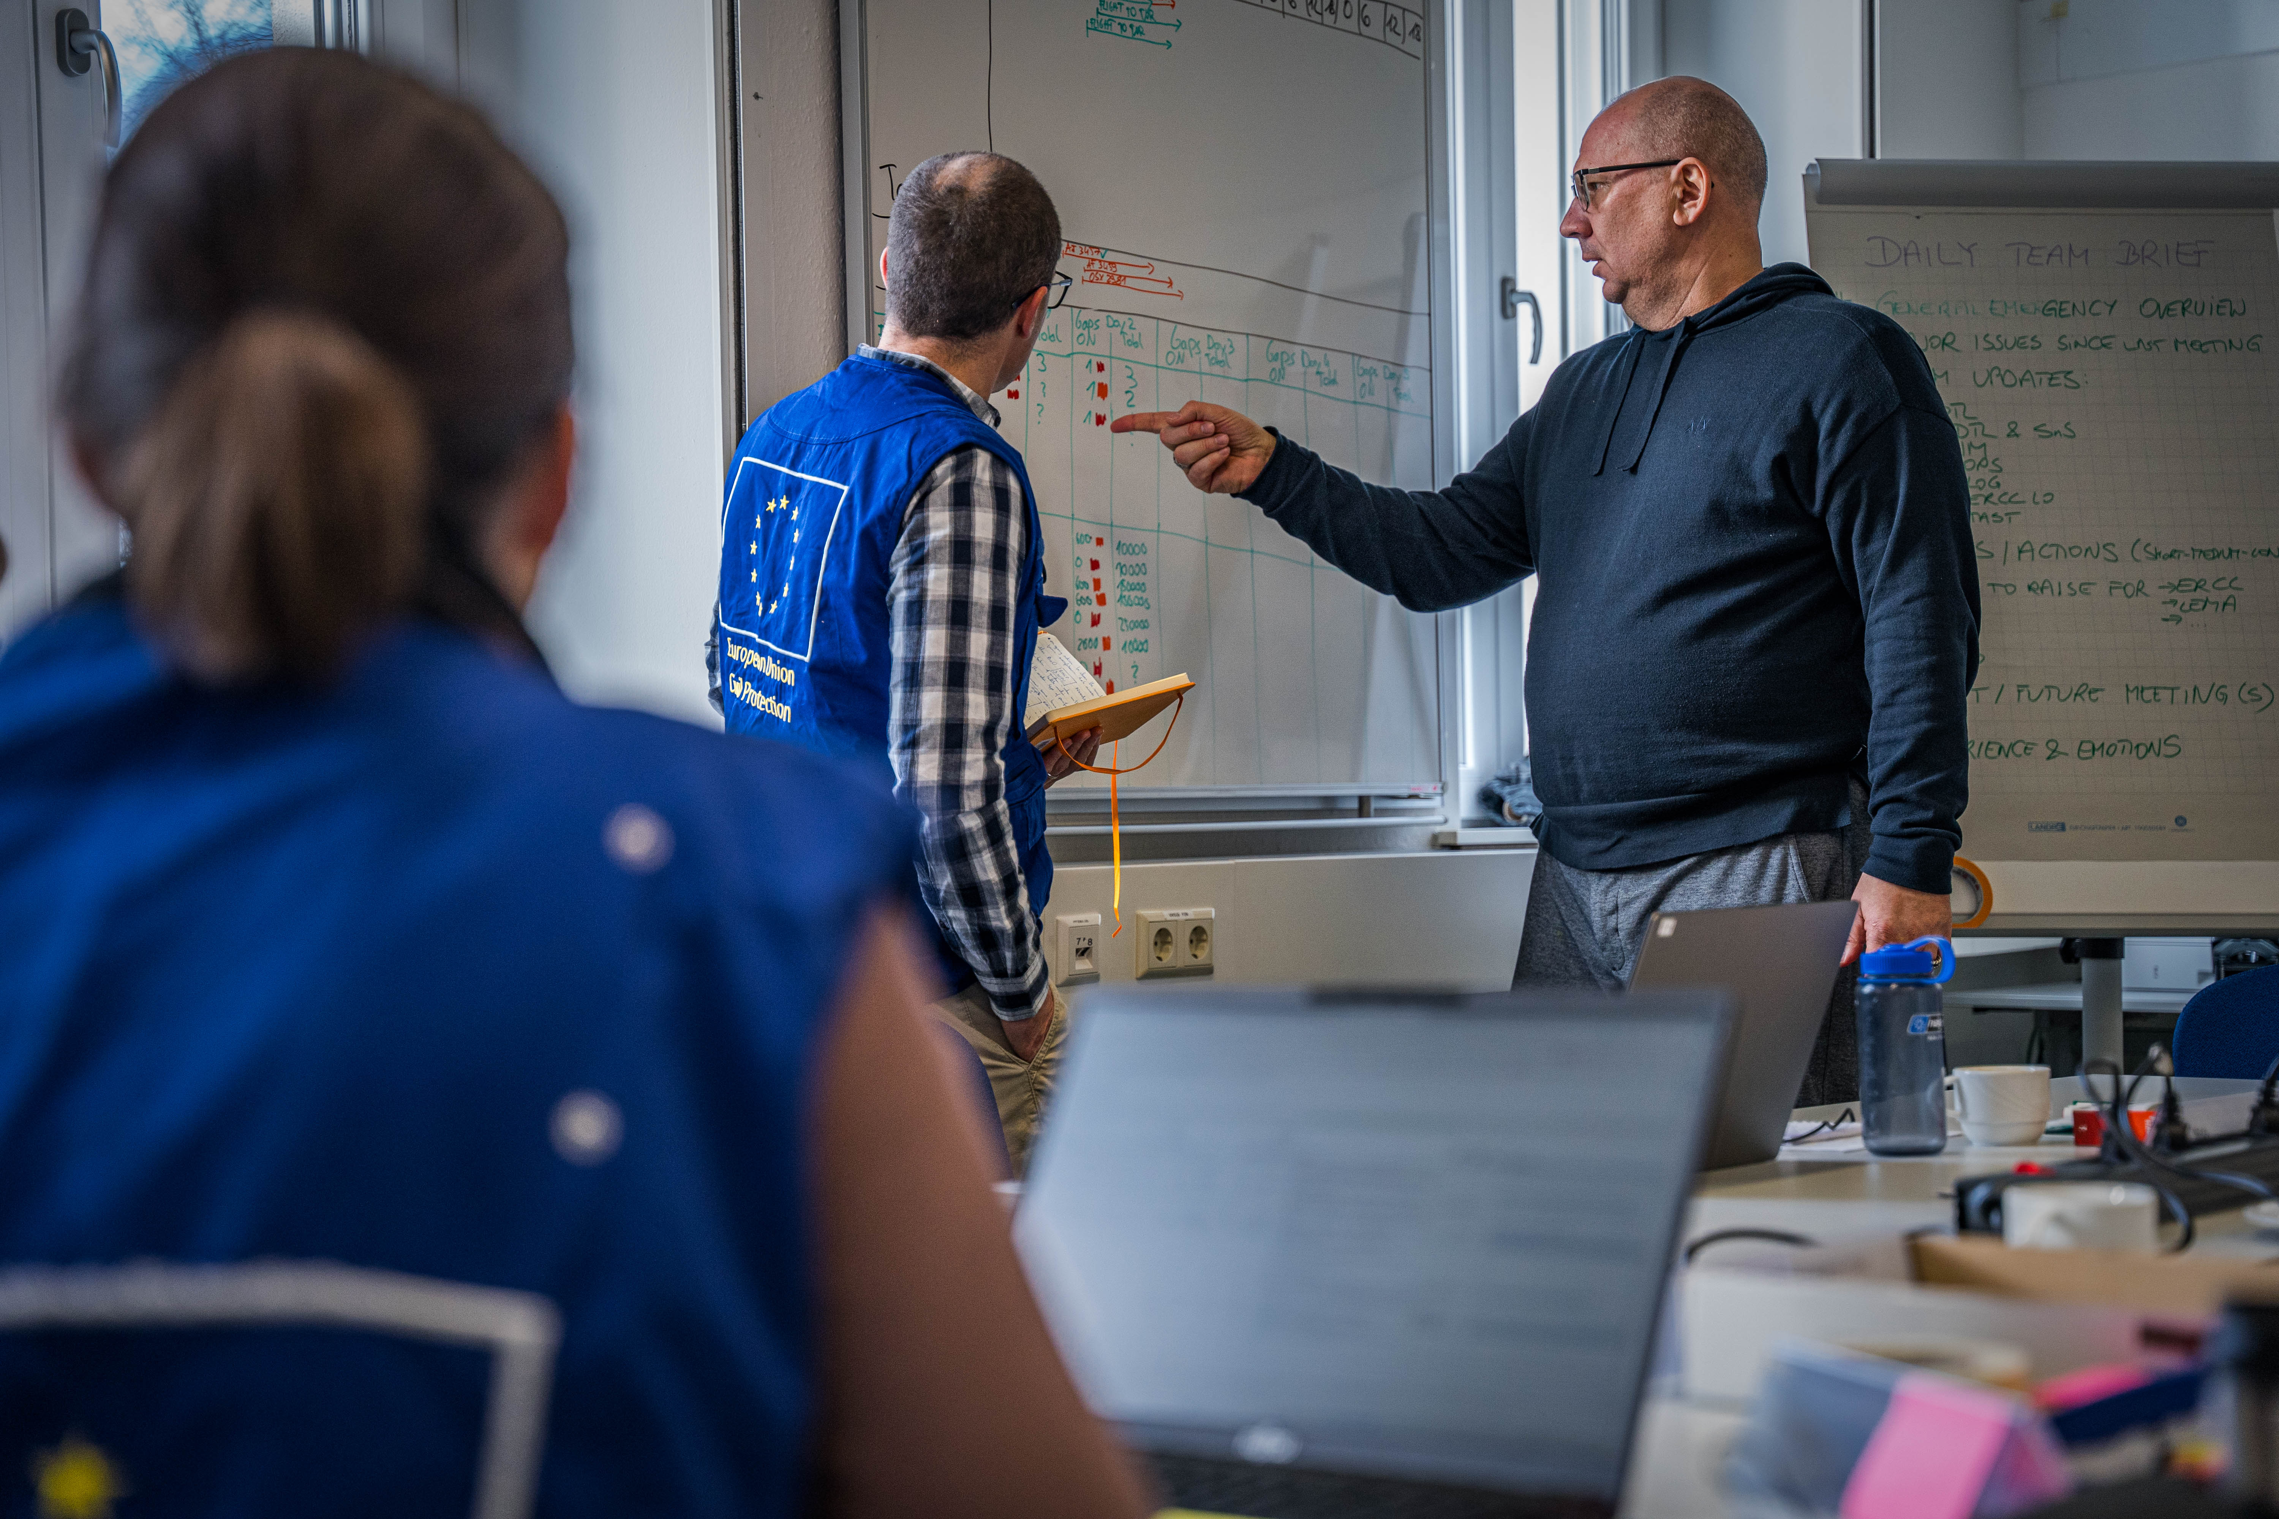
National Training Coordinators Meeting
Diversity & Inclusion
Budapest, 25-28 November 2024

Slide 2
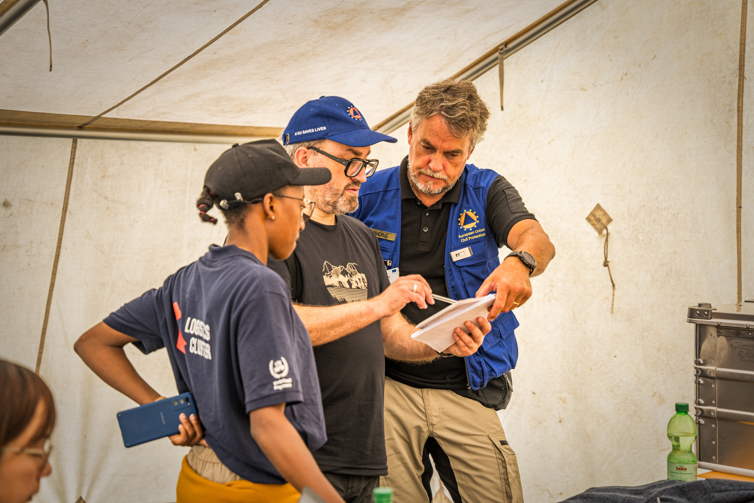
National Training Coordinators Meeting
Diversity & Inclusion
Budapest, 25-28 November 2024
Notes:
Original picture of the template replaced by another one showing more diversity,

Slide 3
Diversity and inclusion
Content
Diversity and inclusion - European Union
Diversity and inclusion - UCPM
Diversity and inclusion - DG ECHO
Group discussions
Notes:
We have to address the Diversity and Inclusion topic because
It matters for the European union
It matters for DG ECHO
And it matters within the framework of the UCPM
We will fist address these three parts and then, we will continue this session with group discussions, to get your views on this Diversity and inclusion topic

Slide 4
A few definitions
Diversity: Refers to the differences found in people, covering a range of features, backgrounds or personal characteristics, including but not limited to sex, race or ethnicity, colour, gender, language, religion or belief, political or any other opinion, disability, socioeconomic background, geographical origin, cognitive makeup, age and sexual orientation.
Diversity
Equality
Inclusion
Notes:
Some definitions to be on the same page,
Focus on 3 terms that will come back regularly in the presentation

Slide 5
A few definitions
Inclusion: Feeling by individuals that their uniqueness is accepted, valued, and welcomed and that they can bring their full selves to the workplace, leading to an experience of feeling included and belonging to the group. This means actively involving all team members’ ideas, knowledge, experiences, perspectives, approaches, and styles to achieve the maximum benefit to the organisation.
Diversity
Equality
Inclusion

Slide 6
A few definitions
Diversity
Equality
Inclusion
Equality: Providing the same resources and treatment to everyone, treating everyone in the same way regardless of their individual or particular needs.
Notes:
Definitions from the “Commission Diversity and inclusion in the workplace Action plan 2023 – 2024”

Slide 7
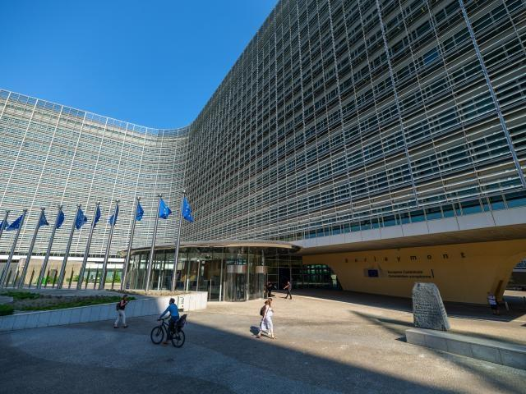

Diversity and inclusion
European Union

Slide 8
Diversity and Inclusion in the agenda of the European Union
Treaty on the Functioning of the European Union
Article 8 : ”In all its activities, the Union shall aim to eliminate inequalities, and to promote equality, between men and women.”
Article 10: ”In defining and implementing its policies and activities, the Union shall aim to combat discrimination based on sex, racial or ethnic origin, religion or belief, disability, age or sexual orientation”
President Von der Leyen’s commitment to achieving a Union of Equality
Hadja Lahbib’s portfolio:
Preparedness and Crisis Management
Equality
Notes:
The concept of equality is deeply rooted in the European Union's (EU) legal framework. the word "equality" is mentioned in many key EU legal texts
Article 8 of the Treaty on the functioning of the European Union says “In all its activities, the Union shall aim to eliminate inequalities, and to promote equality, between men and women.”
Article 10 says “In defining and implementing its policies and activities, the Union shall aim to combat discrimination based on sex, racial or ethnic origin, religion or belief, disability, age or sexual orientation”
In the last years, President von der Leyen Commission’s has strived to achieve a Union of Equality in order to give the same opportunities to people who share the same aspirations.
The new Commissioner Hadja Lahbib in charge of Preparedness and Crisis Management will also be in charge of equality, which includes topics such as the Roadmap for Women’s right, anti-racism strategy, strategy for the rights of persons with disabilities and more.
In front of the Parliament, on 6/11 during her hearing, Commissioner Lahbib said amongst others things:

Slide 9
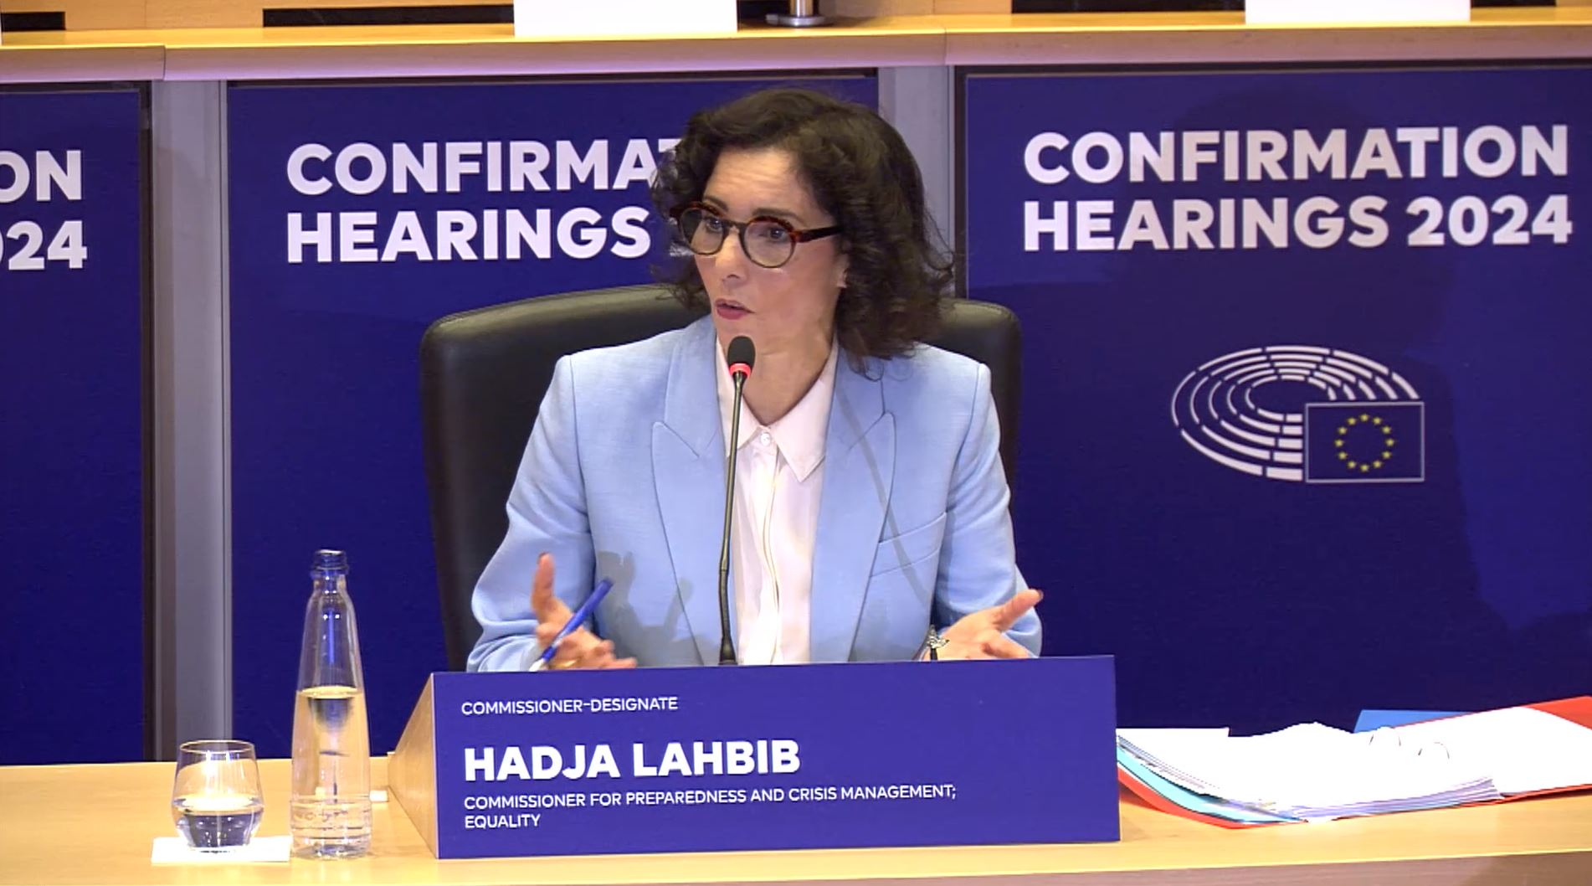
Diversity and Inclusion in the agenda of the European Union
“Building a fairer and more inclusive Union free from discrimination will be a Team Europe effort. I will therefore work closely with all Commissioners to mainstream equality and non-discrimination in all EU policies with the help of the task force on equality.”
Extract from Hearing of HADJA LAHBIB – Commissioner for Preparedness and Crisis Management; Equality – 06/11/24
Notes:
The full hearing of the Commissioner is available online as well as her mission letter

Slide 10
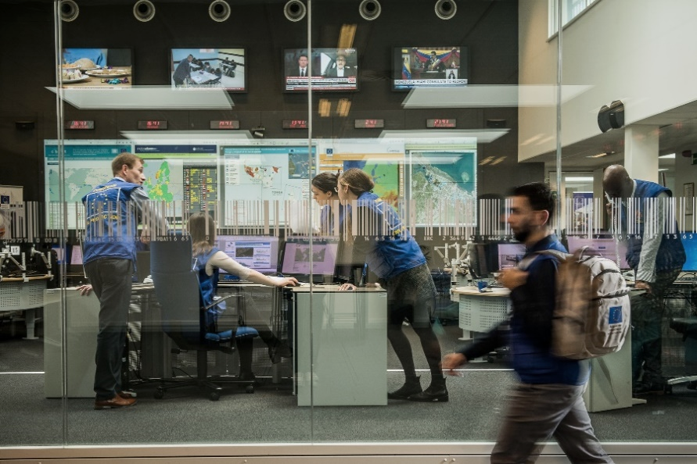
Diversity and inclusion
DG ECHO

Slide 11

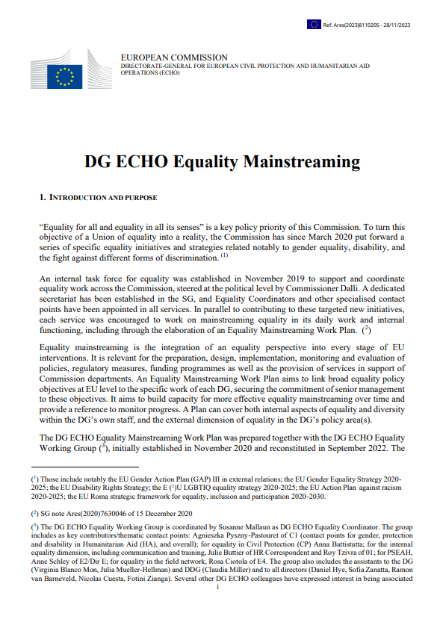
Diversity and Inclusion at DG ECHO
DG ECHO Equality Coordinator
DG ECHO Equality Plan
DG ECHO Equality Working Group

Slide 12
Diversity and Inclusion at DG ECHO
DG ECHO Equality Coordinator
DG ECHO Equality Plan
Last update
November 2023
Content
Activities to promote
inclusion, diversity and equality
Civil Protection
Humanitarian Aid
DG ECHO
DG ECHO Equality Working Group

Slide 13

Diversity and inclusion
UCPKN – Training, Exercises & Exchange of Experts
Notes:
Now we will see how Diversity and inclusion is addressed with in the UCPM

Slide 14
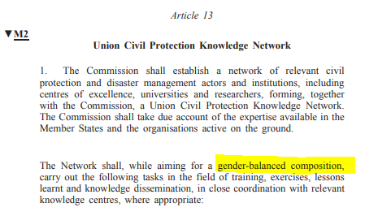
Diversity and inclusion in UCPKN – Training, Exercises & Exchange of Experts
Article 13 of 2019 amendment of Decision No 1313/2013/EU, on a Union Civil Protection Mechanism
Notes:
Article 13 of 2019 amendment of Decision No 1313/2013/EU, makes a clear reference to promoting a gender-balanced participation in the establishment and the functioning of the Union Civil Protection Knowledge Network.
This law is part of the overall Commission priority of a Union of Equality mentioned at the beginning of my presentation.

Slide 15
Diversity and inclusion in UCPKN – Training, Exercises & Exchange of Experts
Notes:
Event though diversity goes beyond gender, we will focus on the data that we have which relate to the F/M,
From 2017, up until today, we are observing the following trend in the proportion of female registering in training courses : slight increase of female but the percentage always stays around 20%

Slide 16
Diversity and inclusion in UCPKN – Training, Exercises & Exchange of Experts
Notes:
Proportion of female participants in training courses is the same,

Slide 17
Diversity and inclusion in UCPKN – Training, Exercises & Exchange of Experts
Notes:
For EU MODEX, we only have figures relating to the participation of experts, we do not have data on the female representation in modules,
Striking year is 2020 when more female attended TTX exercises compared to male, According to our data, there were 7 female and 5 male attending a TTX,

Slide 18
Diversity and inclusion in UCPKN – Training, Exercises & Exchange of Experts
Notes:
If we look at the participation in the field exercises, the trend is similar, there is an increase between 2017 and 2023 in the participation of female but the participation remains around 20%, far from gender balance,

Slide 19
Diversity and inclusion in UCPKN – Training, Exercises & Exchange of Experts
Notes:
We also have figures on the participation in the exchange of experts programme.
The participation of female is also low compared to male,

Slide 20
Diversity and inclusion in UCPKN – Training, Exercises & Exchange of Experts
DG ECHO
  Online module on Cultural sensitivity and Gender
  Selection of participants to exercises
National Training Coordinators
  Identification of participants to training
  Gender balance among lecturers, trainers, role players for training
  Diversity and Inclusion lessons to be included in training courses
  Selection of participants in training courses
Training Organisers
Notes:
Now regarding Diversity and inclusion, in the UCPM and in particular in the TEX programme, we all have a role to play to improve the situation as it is a shared responsibility.
ECHO
Has developed an online module on Cultural sensitivity and Gender many years ago that was recently updated in collaboration with a HA gender expert. One of the learning objectives is: “- give practical examples of how EUCP Teams or EUCP Team members can be aware of potential issues and positively contribute to a mission while being aware of and reacting to gender, cultural or protection related scenarios”.
The selection of candidates to participate in EU MODEX exercises lies with DG ECHO. We systematically select all the nominated women, yet in practice we face an under-representation of women.
National training coordinators:
Are in charge of identifying the best candidates for a training
Training organisers
Contractors should “strive to reach a gender balance among lecturers, trainers and role-players".
Lessons on cultural diversity and general inclusion and related team-work and other soft skills and competences have been introduced throughout the Training Programme at different levels (e.g. Safety and Security Modules covers specific section for female experts).
The selection of candidates to participate in training courses is done by the contractors who are instructed to ensure a balance not only in terms of nationality but also gender.

Slide 21
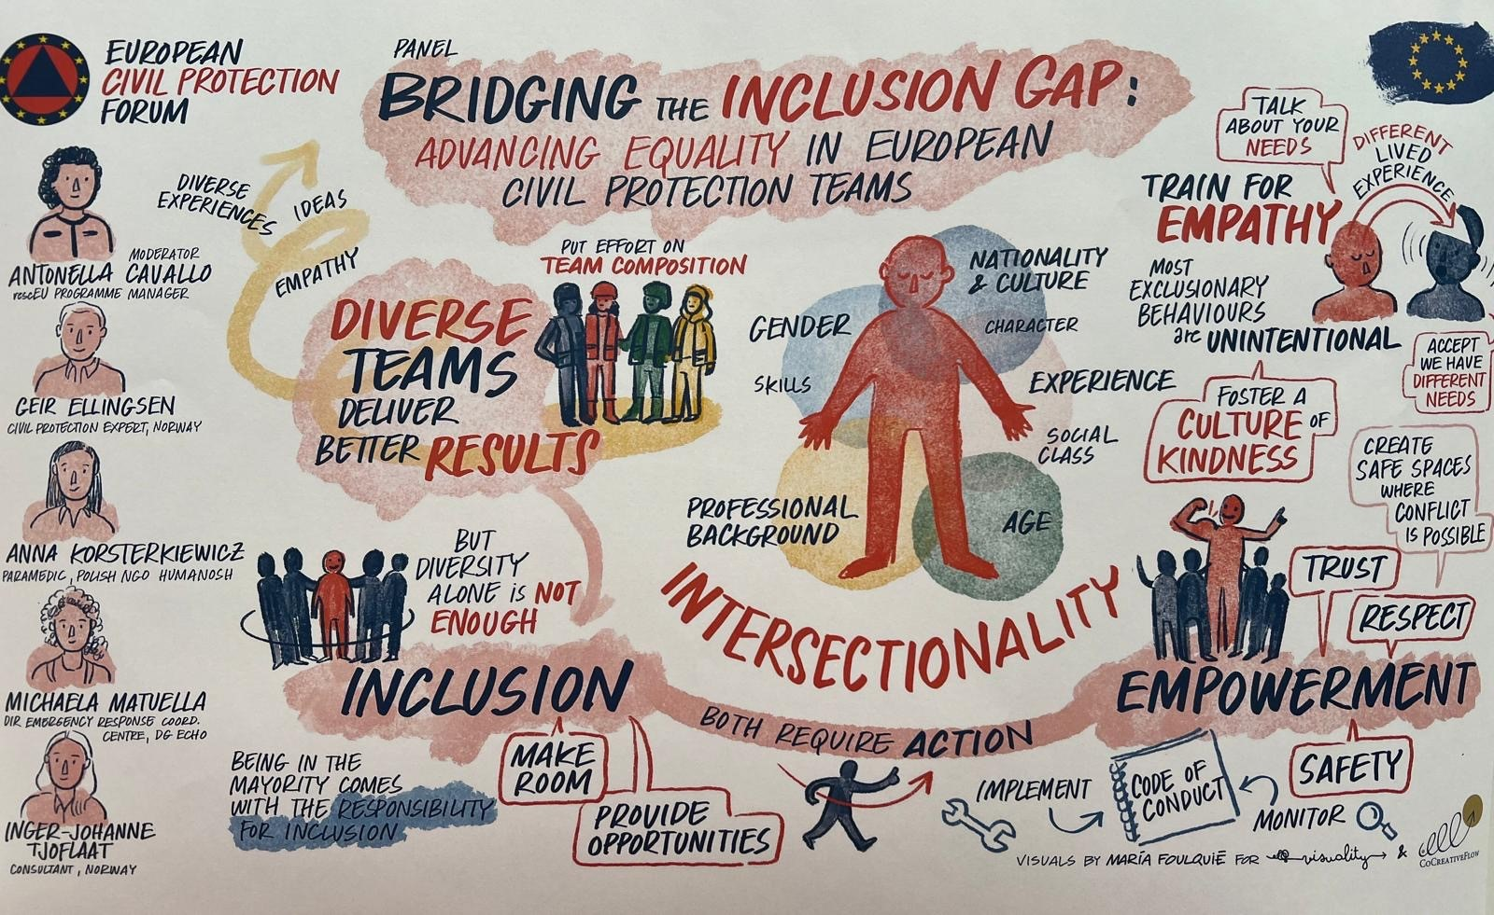
Diversity and inclusion at CP forum 2024
Notes:
Our world is changing and Diversity and inclusion is now becoming a priority, as highlighted by the ERCC Director Michela Matuella at the CPF Session during the workshop on « bridging the inclusion gap: advancing equality in European Civil Protection Teams ».
We recommend you to read the conclusions of the session available on the UCP KN platform

Slide 22
Diversity and Inclusion
Groups discussion

Slide 23
Group Discussion
Form groups of 3 persons (Triads) – 3 rounds
  Discuss Question 1
  Discuss Question 2
  Select 2 suggestions to share in plenary
“Triad” principles:
  1 speaker (3 min per person) & 2 listeners (listening actively & asking sub-questions)
  Self-timekeeping

Slide 24
QUESTION 1:
What is my understanding of diversity and inclusion?
(9 min – 3 min/person)
Notes:
I think we should chose

Slide 25
QUESTION 2:
What is the best way for me, as NTC, to ensure diversity and inclusion in the UCPM training programme in my country?
(9 min – 3 min/person)

Slide 26
QUESTION 3:
Based on your exchanges:
Identify 2 ways to foster diversity and inclusion in the UCPM training programme in your countries.
Write down 1 suggestion per post-it.
(5 min)

Slide 27
Plenary Discussion

