Slide 1
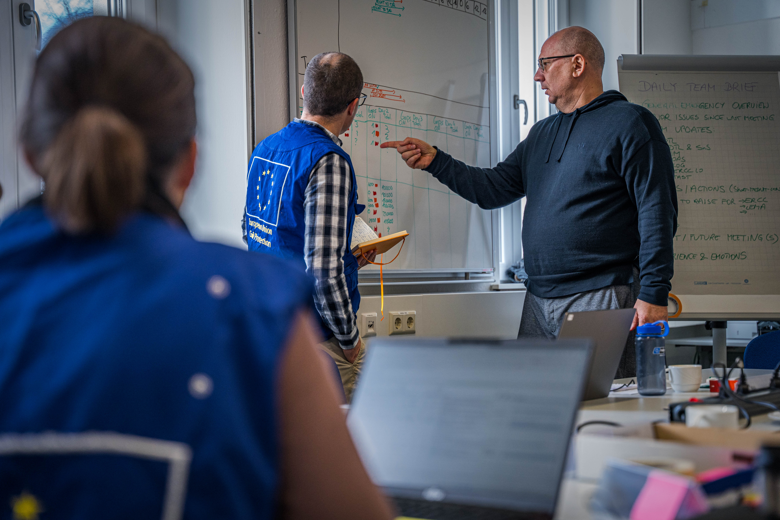
National Training Coordinators Meeting
Wrap-up & Closing
Budapest, 25-28 November 2024

Slide 2
Wrap-up & Closing
Mr. Márton ÁBRAHÁM
Hungarian Presidency of the Council of the European Union
Deputy Head of Department

Slide 3

Thank you!

