Slide 1
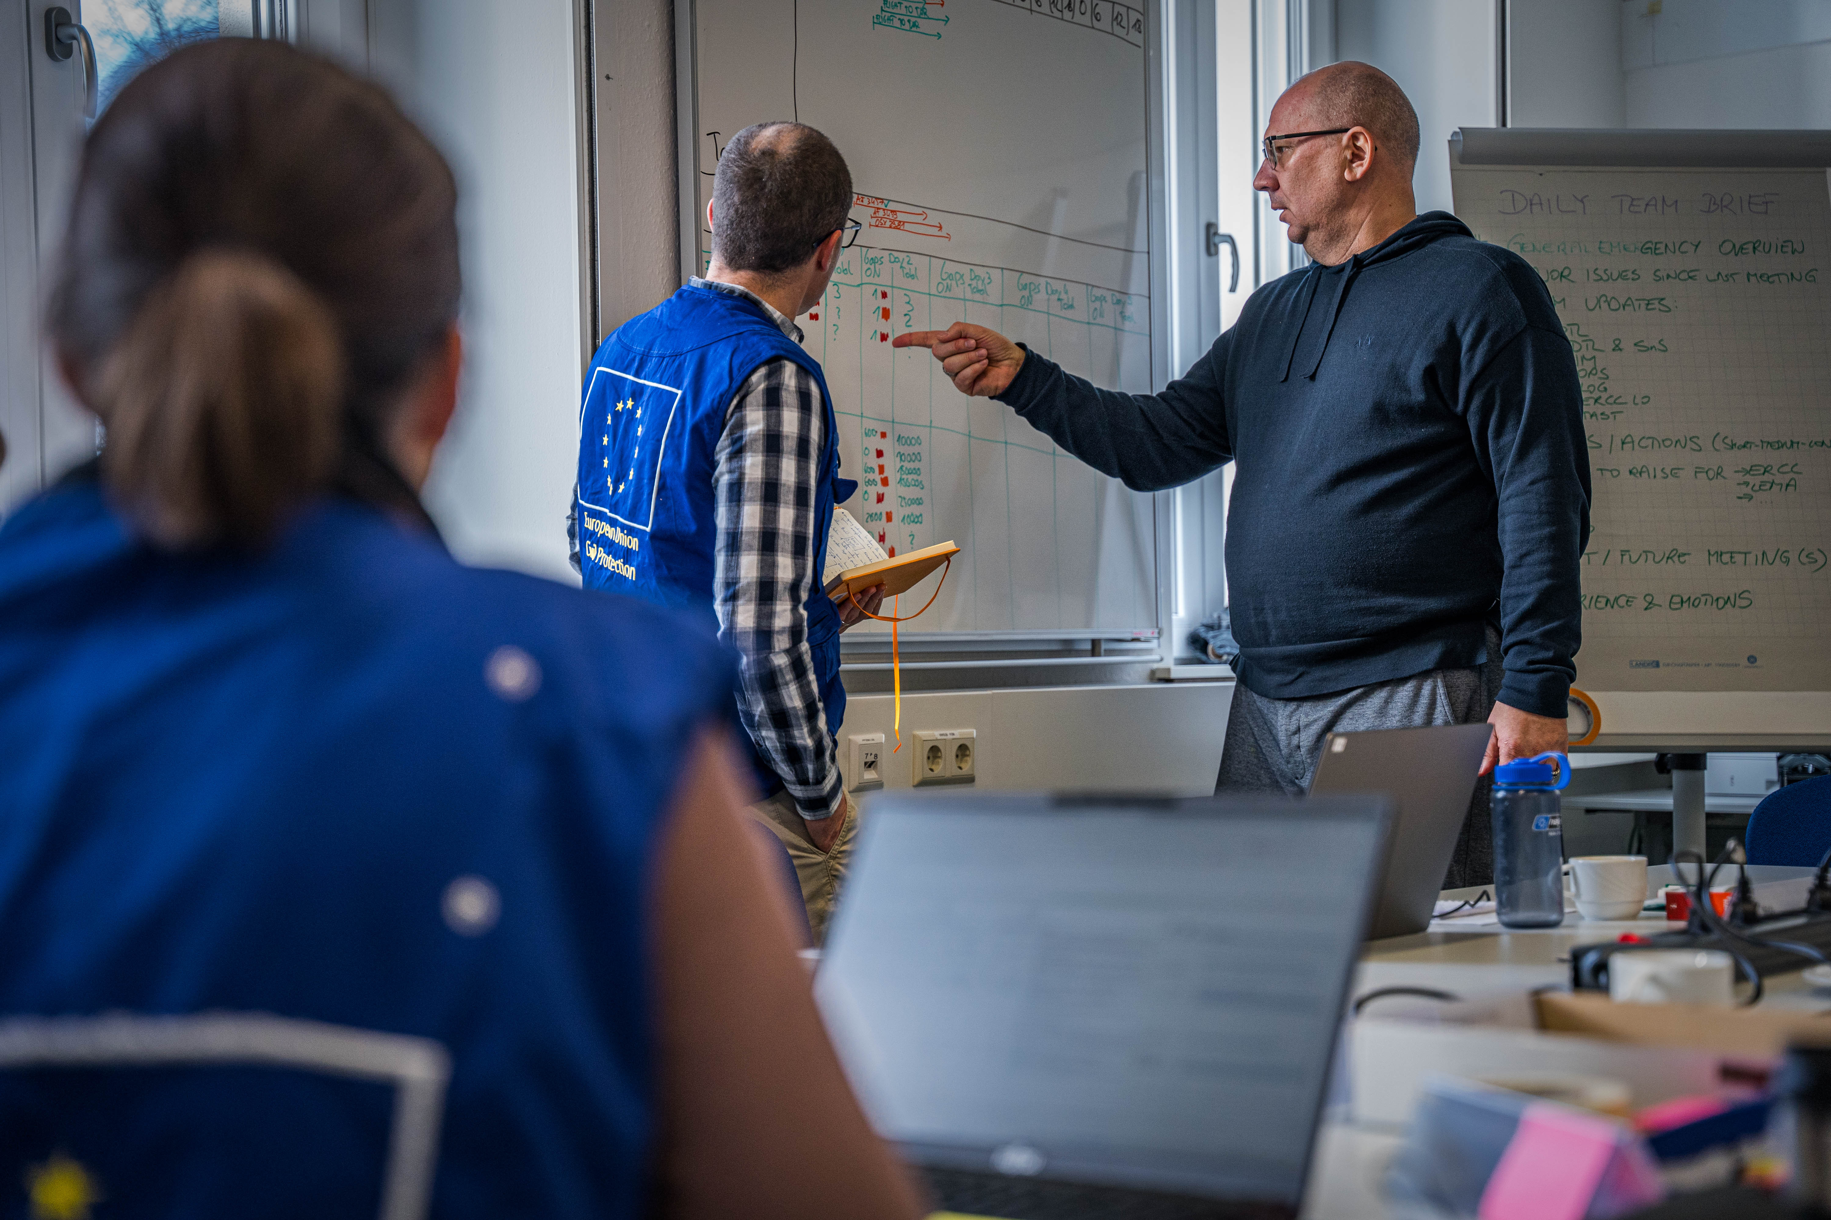
National Training Coordinators Meeting
Budapest, 25-28 November 2024

Slide 2
Opening address
Brigadier General Dr. Balázs Bognár, Hungarian Presidency of the Council of the European Union
Director of the Vas County Disaster Management

Slide 3
Opening address
Mr. Marco Panigalli, European Commission
Head of Unit for Civil Protection Emergency Response Capabilities, Directorate-General for European Civil Protection and Humanitarian Aid Operations

Slide 4

Agenda & supporting documents (for NTCs)
https://civil-protection-knowledge-network.europa.eu/groups/national-training-coordinators

