Slide 1
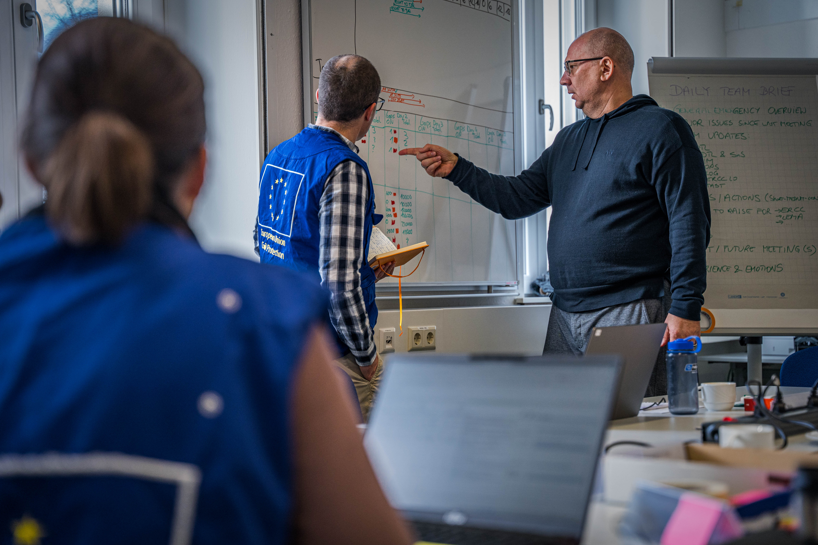
National Training Coordinators Meeting
NTC Role & Community
Budapest, 25-28 November 2024

Slide 2
Group Discussion

Slide 3
Group Discussion
Discuss QUESTION 1 in a group of max 9 pax – choose your group!
Time: 15 minutes

Slide 4
QUESTION 1:
What does it mean to me to be a National Training Coordinator?

Slide 5
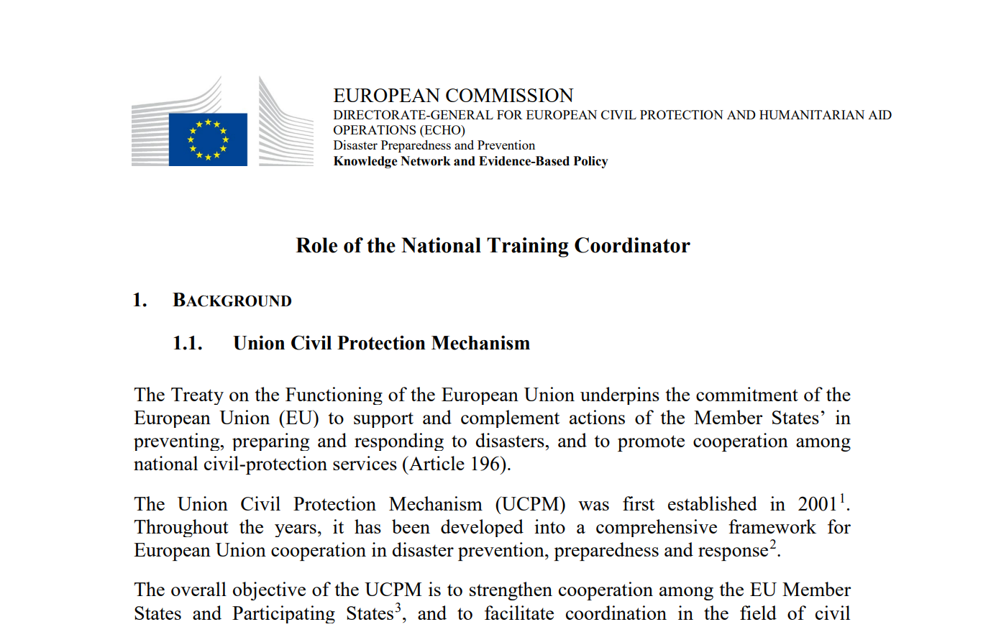
Role of the National Training Coordinator
Notes:
Main reference document
(presented to the CPC in June 2022)
Distribute a copy of the document to everyone (also available on the UCPKN NTC Discussion Group)
(needs a little update on UCPM PS)

Slide 6

Main duties and responsibilities of NTC
NTC Online Module on EU Academy
Notes:
NTC Role simplified & explained in the NTC online module on EU Academy
a) mention the support/tools that are already available for NTCs (ORT, NTC module, catalogue, the discussion group on the platform)
b) encourage and remind them to follow the module and submit their feedback (investigate how many completed it and share our data)
c) indicate where the relevant document repository is within the module- show them the way to find it
This online module is a common standard for international learning and self-paced progress
Quiz! (pop-corn style: shout out if you know the answer)

Slide 7
Group Discussions
Discuss QUESTION 2 in a group of max 9 pax – choose your group!
Time: 20 minutes
Prepare a 2 min pitch (use flipchart) → Spokesperson
Timekeeper

Slide 8
QUESTION 2:
What actions would I propose to help each other in performing our role as NTC?

