Slide 1
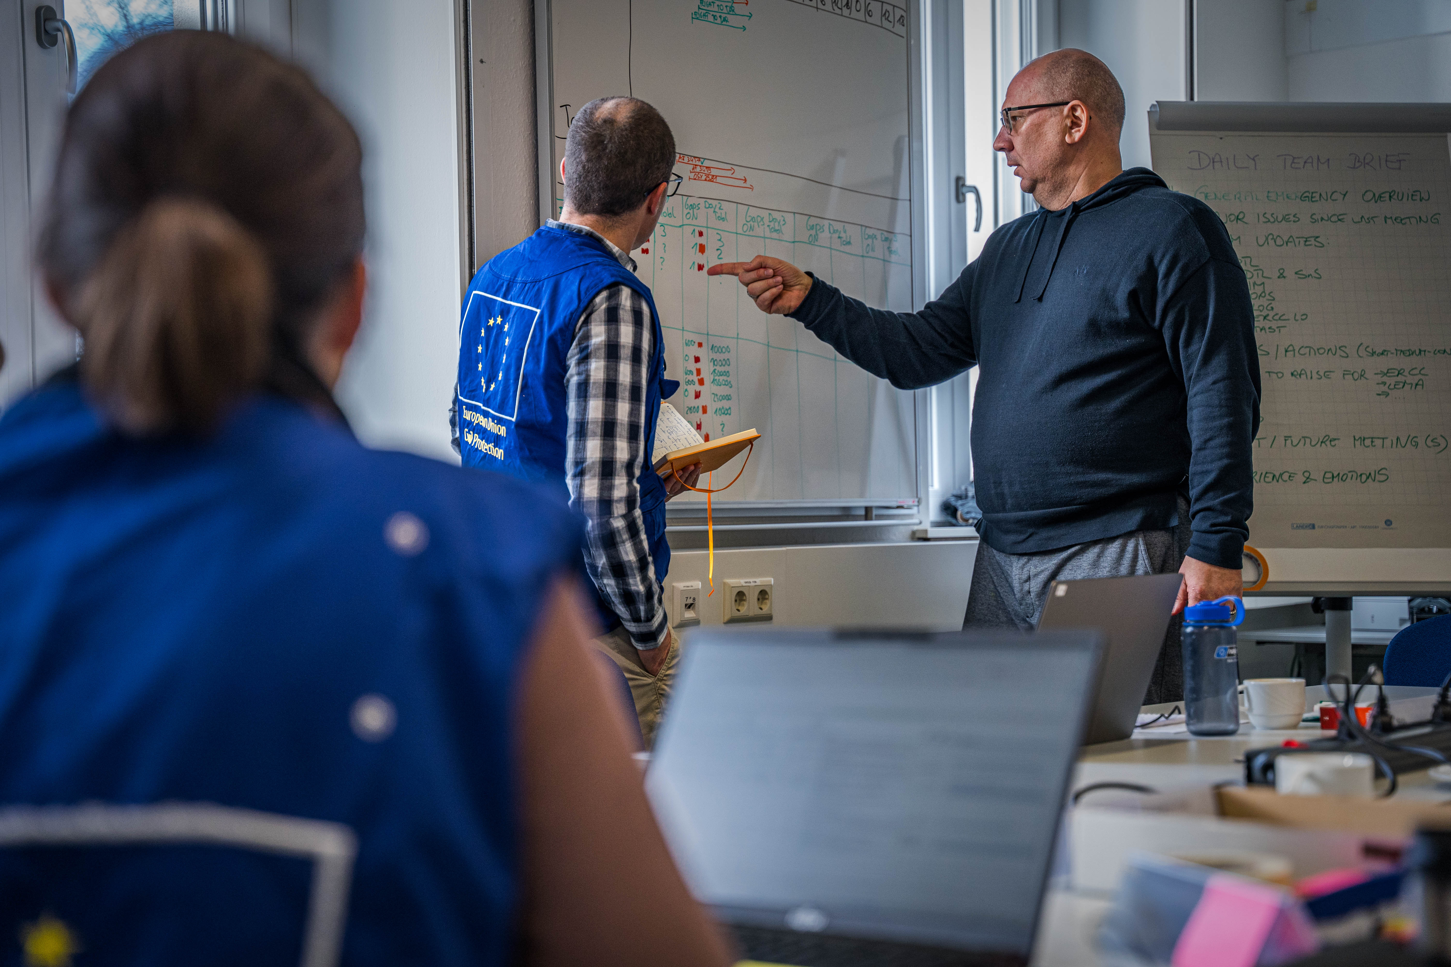
National Training Coordinators Meeting
Identifying & selecting participants
Budapest, 25-28 November 2024

Slide 2
“Never have I ever…”

Slide 3
“Never have I ever…”
As an NTC, sent a participant to a training course who did not speak English

Slide 4
“Never have I ever…”
Fell asleep during a European Commission presentation

Slide 5
“Never have I ever…”
Participated in a training course / exercise, because I wanted to travel and visit a new country

Slide 6
Group Discussion

Slide 7
Group Discussions
World Café:
3 twenty-minute rounds of conversation in a group of max five NTCs
3 questions
Last question decide on 3 key learning points / 1 per card
‘Group Host’, flipchart papers, 3 cards

Slide 8
QUESTION 1:
What has been your experience in identifying and nominating candidates for UCPM training courses?
Consider in the discussion:
How have you identified training candidates keeping in mind the courses’ selection criteria?
What has been your experience with the training placement allocation system in different courses?

Slide 9
QUESTION 2:
What has been your experience in identifying and nominating candidates for UCPM training courses?
Consider in the discussion:
How have you identified training candidates keeping in mind the courses’ selection criteria?
What has been your experience with the training placement allocation system in different courses?

Slide 10
QUESTION 3:
How have you addressed any challenges that you faced in these processes?
Share 3 solutions to the main challenges and write them on post-its (one per post-it).

