Slide 1


National Training Coordinators Meeting
LOT 1
Copenhagen, 7-10 October 2025

Slide 2
1. LOT 1 Presentation Overview
Implementation overview
Number of delivered courses
Quota absorption by countries
Participants’ selection procedure and training placements allocation
Implementation of participant’s performance assessment and evaluation framework
Collaboration with NTCs on nominations / selection procedure & any lessons identified
Few general outputs & lessons identified in relation to NTCs from courses that already took place
Monitoring & Evaluation
Main considerations to manage and implement the Training Programme in the coming year

Slide 3
1. Implementation overview
Contract Implementation: timeline, process & deliverables
21st cycle courses running as planned
Consortium management: collaboration, communication, consistency, quality control
Administrative procedures now established and applied by all partners with success, ensuring consistency in the organisation and implementation of courses
Curriculum revised and integrated with new module on Diversity & Inclusion
Course Director Meetings established as a important communication/collaboration tool
BOP online (1/Cycle) and in person (1/Cycle) assure communication with all partners
Quality control being implemented at all levels trough lessons learned and feedback from participants, partners, EU Commission and training courses staff

Slide 4
1. 21° Cycle overview
Course curricula revised
Inclusion & Diversity Lesson integrated in all courses
D&I Working Group
PAE working Group
Management of EU Academy & online modules in progress
Courses already implemented: 2 UMI; 1 DCC; 1 ODC ADV; 1 TLC

Slide 5
2. Number of delivered courses
19° and 20° Cycle data
20 UMI, 12 DCC, 8 ODC, 6 ODC ADV, 4 IMC ADV, 4 SEC ADV, & 4 TLC courses delivered in a blended format
SEC Online –1972 participants completed the online course​
A total of 1119 participants attended and completed courses

Slide 6
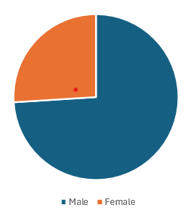
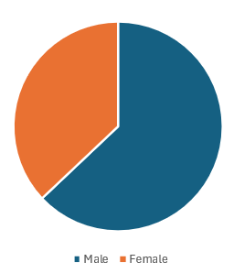
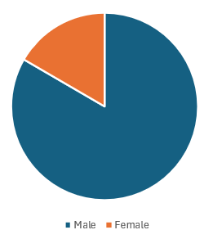
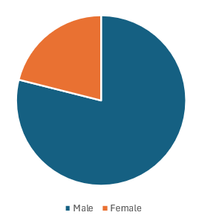
2. 19° and 20° Cycle Gender balance
Training staff
In the 19th Cycle, out of 77 staff 20 are female (26 %)
In the the 20 Cycle, 30 out of 81 staff were female (37.5 %) which is an improvement over the 19 cycle which was 26%.
Participants
In the 19 cycle out of 566 experts who attended courses, 90 were female (16.2% )
In the 20 cycle out of 563 of whom 444 were male and 119 female (21%).

Slide 7
3. 19° and 20° Cycle N. of participants by country
Country | UMI | ODC | ODC ADV | Country | UMI | ODC | ODC ADV | Country | UMI | ODC | ODC ADV
Albania | 10 | 2 | 0 | Hungary | 11 | 6 | 3 | Poland | 22 | 5 | 6
Austria | 12 | 6 | 5 | Iceland | 0 | 0 | 0 | Portugal | 15 | 9 | 7
Belgium | 14 | 3 | 4 | IFRC | 2 | 0 | 0 | Romania | 20 | 7 | 5
Bosnia and Herzegovina | 6 | 2 | 0 | Ireland | 8 | 3 | 4 | Serbia | 12 | 1 | 1
Bulgaria | 11 | 4 | 4 | Italy | 39 | 5 | 7 | Slovakia | 7 | 3 | 2
Croatia | 8 | 4 | 2 | Kosovo | 3 | 0 | 0 | Slovenia | 8 | 4 | 3
Cyprus | 7 | 2 | 2 | Latvia | 5 | 2 | 2 | Spain | 33 | 10 | 7
Czech Republic | 11 | 5 | 2 | Lithuania | 9 | 3 | 2 | Sweden | 11 | 5 | 3
Denmark | 5 | 2 | 3 | Luxembourg | 4 | 2 | 2 | Türkiye | 5 | 1 | 0
Estonia | 7 | 3 | 1 | Malta | 6 | 3 | 2 | Ukraine | 3 | 0 | 0
Finland | 11 | 5 | 5 | Moldova | 4 | 0 | 0 | UNDAC | 0 | 0 | 0
France | 46 | 14 | 11 | Montenegro | 4 | 0 | 0 | WHO | 0 | 0 | 0
Georgia | 4 | 0 | 0 | Netherlands | 18 | 0 | 3 | European Center for Disease Prevention and Control | 3 | 0 | 0
Germany | 56 | 18 | 16 | North Macedonia | 7 | 1 | 0 | DG ECHO | 19 | 16 | 12
Greece | 12 | 6 | 4 | Norway | 6 | 2 | 3 | TOTAL | 504 | 164 | 133

Slide 8
3. 19° and 20° Cycle N. of participants by country
Country | IMC ADV | SEC ADV | TLC | DCC | Country | IMC ADV | SEC ADV | TLC | DCC | Country | IMC ADV | SEC ADV | TLC | DCC
Albania | 2 | 0 | 0 | 2 | Greece | 1 | 4 | 2 | 6 | Norway | 2 | 2 | 2 | 4
Austria | 2 | 4 | 4 | 14 | Hungary | 1 | 4 | 0 | 2 | Poland | 3 | 0 | 2 | 13
Belgium | 0 | 2 | 0 | 11 | Iceland | 0 | 0 | 0 | 0 | Portugal | 4 | 2 | 2 | 10
Bosnia and Herzegovina | 1 | 0 | 0 | 1 | IFRC | 1 | 0 | 0 | 0 | Romania | 2 | 4 | 4 | 15
Bulgaria | 2 | 0 | 4 | 3 | Ireland | 3 | 0 | 2 | 0 | Serbia | 1 | 0 | 0 | 4
Croatia | 1 | 0 | 2 | 7 | Italy | 2 | 4 | 4 | 15 | Slovakia | 3 | 4 | 2 | 5
Cyprus | 0 | 2 | 0 | 3 | Kosovo* | 1 | 0 | 0 | 1 | Slovenia | 3 | 2 | 0 | 10
Czech Republic | 1 | 0 | 0 | 2 | Latvia | 2 | 2 | 4 | 3 | Spain | 2 | 4 | 2 | 18
Denmark | 1 | 2 | 2 | 0 | Lithuania | 1 | 0 | 2 | 6 | Sweden | 1 | 4 | 4 | 10
ERCC LO | 1 | 0 | 4 | 0 | Luxembourg | 0 | 2 | 0 | 2 | Türkiye | 0 | 0 | 0 | 1
Estonia | 1 | 0 | 0 | 4 | Malta | 0 | 4 | 2 | 4 | Ukraine | 0 | 0 | 0 | 2
Finland | 1 | 0 | 0 | 6 | Moldova | 0 | 0 | 0 | 5 | UNDAC | 0 | 0 | 0 | 0
France | 1 | 2 | 4 | 16 | Montenegro | 0 | 0 | 0 | 0 | WHO | 0 | 0 | 0 | 0
Georgia | 2 | 0 | 0 | 0 | Netherlands | 0 | 0 | 0 | 1 | European Center for Disease Prevention and Control | 0 | 0 | 0 | 0
Germany | 2 | 6 | 6 | 27 | North Macedonia | 1 | 0 | 0 | 3 | Total | 52 | 60 | 60 | 236

Slide 9
4. Participants’ selection procedure – 21st Cycle
UMI 21.1 – 21.4, ODC 21.1, ODC adv. 21.1 – 21.2
Based on total quota distributed by EC
Comparison of % used „before vs. after“ specific course
Advantage: no difference if country still has places or used all places
Example UMI 21.4

Slide 10
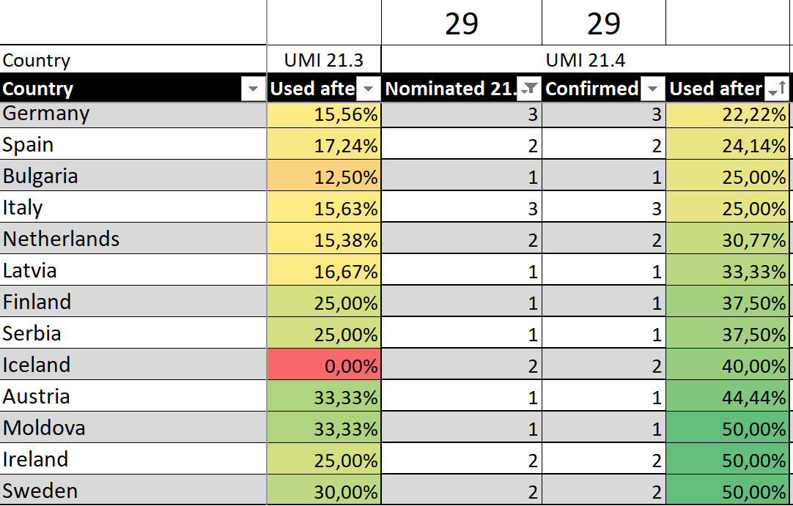
4. Participants’ selection procedure – 21st Cycle
UMI 21.4 - process
5 places have to
be reduced
-1 place each

Slide 11
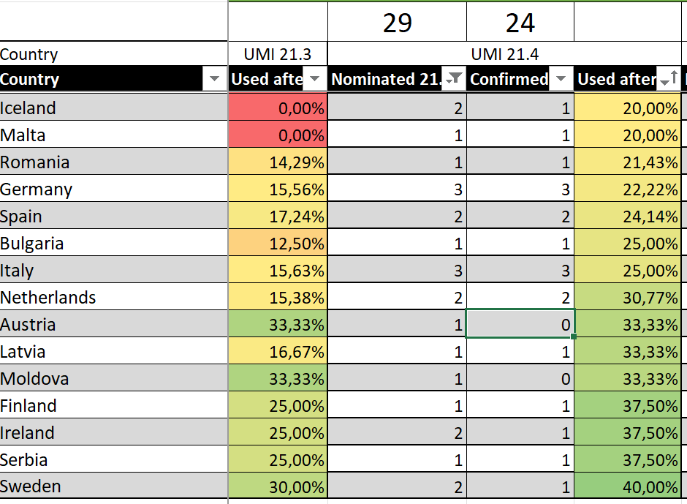
4. Participants’ selection procedure
UMI 21.4 - result

Slide 12
4. Participants’ selection procedure
Future for UMI, ODC, ODC adv.
Course place distribution by EC
Selection after first deadline
Places not used by „quota countries“ ➔ distributed according to priority list given by EC

Slide 13
4. Participants’ selection procedure
Additional comments
SEC adv. 21.1 ➔ 7 nominations (5 x DE)
IMC adv. 21.1 ➔ 16 nominations (3 x DE)
TLC 21.1 ➔ 15 nominations
DCC 21.1 – 21.3 ➔ 21/21/(20) nominations
  Certification?
  ORC ➔ EUCPT Member?
And
Addtional comments help us
Overlapping nominations

Slide 14
6. Collaboration with NTC
Selection procedure & lessons learnt
Cancellations:
  Participants should make cancellations via the NTC, not directly.
  Ideally, the NTC would have a suitable replacement available immediately upon cancellation to ensure that the nomination is maintained.
Registration after the deadline:
  The TVC Secretariat will inform the NTC of the open spot.
  The NTC will then contact the applicant and ask them to complete the registration form.
  DG ECHO will then validate the form on behalf of the NTC on ORT and the TVC Secretariat confirms the new participant.
Prioritize nominations:
  When nominating multiple participants, please specify a ranking or priority in the comments or in a separate email.
  Alternatively, enter the ranking in the note section on O
.
Overall, the collaboration with NTC is going well, with issues being resolved in a professional and friendly manner. Thank you for your support!“ (TVC Secretariat)

Slide 15

7. Recommendations to NTC’s
Use the comment-function in the ORT to set priorities in case you nominate more that one participant. This eases the process and avoids additional communication after selecting countries.
Nominate according to the profiles for the specific courses, only then participants get most out of it. We cannot select EUCP expert for the DCC. When using "Other response capacity" box and then "other" it should be a capacity that is already officially offered to the ECPP.
Click yes for "I am participating in this course for certification purposes" only if the capacity is offered to the ECPP.
see: https://civil-protection-knowledge-network.europa.eu/welcome-european-civil-protection-pool-ecpp-or-pool#bcl-inpage-item-9115

Slide 16
7. Recommendations to NTC’s
Gaps between previous pathway courses and new pathway courses. A validity period for all courses should be considered.
The participants should be nominated according to the funfcion profiles
To test the level of the English knoledge
From DCC to the ODC ADV

Slide 17
7. Participants Assessment and Evaluation (WG and Manual)
Oct 2025
Updated PPAE Trainer’s Manual
(Streamlined annexes, revised structure)
DEC 2025
Working Group Draft
(Streamlined A&E forms)
Updated PPAE Trainer’s Manual & A&E Forms Working Group
New PPAE Trainer’s Manual (OCT 2025) with streamlined annexes and clearer structure.
Provides a consistent, fair, and practical framework to guide trainers.
Working Group established to harmonize A&E forms (draft by DEC 2025).
Goals: align formats, reduce duplication, and improve usability for trainers.

Slide 18

8. Monitoring & Evaluation
Results of M&E Activities (20° cycle)
Evaluation package for each course typology includes:
daily questionnaires
end-of-course surveys
trainers’ feedback forms
6/12-month post-course surveys

Slide 19
8. Monitoring & Evaluation
End of course feedback from participants
Approx 501 participants provided feedback
They showed high satisfaction with an average rating of 4,5 out of 5,0.
The content of courses was considered up-to-date, relevant, and significantly enhanced their knowledge and skills.
Trainers and lecturers were praised for their professionalism and training quality but more interactive elements were suggested.

Slide 20
8. Monitoring & Evaluation
Feedback from lecturers and trainers
109 responses. Vast majority satisfied with the course content, while some suggested minor adjustments such as allocating more time for specific learning activities and reducing redundancy in online materials.
High satisfaction with methodologies used, learning objectives, and consistency in course development
Consistency in course development: 91% satisfied, but calls for increased collaboration and feedback among trainers, standardized briefings and debriefings.

Slide 21
8. Monitoring & Evaluation
6/12-month post-course evaluation
Purpose: Assess training impact on professional growth and deployment readiness 6 to 12 months post-training. (165 replies)
1
Key Positive Outcomes: Training enhanced team dynamics, stakeholder coordination, and boosted confidence for missions
2
Valued Training Components: Scenario-based exercises, information management, leadership, and cultural awareness were highly appreciated.
3
Training Gaps and Improvement Areas: Deeper legal framework coverage, funding mechanisms, and advanced coordination strategies.
4
Barriers to Knowledge Application: limited deployment opportunities, organizational constraints, and misalignment with national procedures.
5
Positive Overall Sentiment: Participants rated the training highly and recommended it for enhancing individual and organizational growth.
6
Transformative Participant Impact: Training improved leadership, motivation, English proficiency, cultural sensitivity, and preparedness for disaster response.
7

Slide 22

8. Monitoring & Evaluation
New measures being introduced
Longitudinal measure
Tracks a sample of participants who journey through the training pathway and on to subsequent deployments.
Serves the purpose of gathering additional insights related to ‘the effects’ of training activities organised
Offers correlative insights that complement existing evaluation tools and strengthen the evidence base for the continued relevance and refinement of Lot 1 training courses.
  Outputs:
    Criteria for identifying the pool of trainees
    Definition of tools to collect data (surveys, interviews…)
    Actual data gathering
    Processing and analysis of data and reporting (April 2026)

Slide 23
8. Monitoring & Evaluation
New measures being introduced
LOT 1 ‘large loop’ System-wide review measure
Looks at trends over a longer period of time in relation to wider systemic issues, such as any potential gaps/overlaps between courses.
Differs from the curriculum review and adopts a broader lens, focusing on interlinkages, areas of overlap, and the building-block approach across the deployable path as a whole.
Objectives
    Inform strategic recommendations to the Commission for consideration beyond present course cycles.
    Identify and address gaps, duplications, and linkages in training content/curricula across Lot 1 courses and support alignment between iterative course improvements (“small loop”) and broader trends in the model (“large loop”).
    Strengthen the overall quality and coherence of the Lot 1 training portfolio.

Slide 24
9. D&I Integration in the deployable UCPM Training Programme
Why Diversity and Inclusion (D&I) Matters
COM request (Aug 2024) → D&I as one of the cross-cutting competencies in UCPM Training Programme
Enhances mission readiness, team cohesion, and trust in deployment
Direct link to safety, effectiveness, and credibility in operations
Notes:
Consistency, depth, and intentional assessment are tailored to the specific course and to utmost added value for its participants.

Slide 25
9. D&I Integration in the deployable UCPM Training Programme
Milestones Achieved (2024-2025)
Concept Note & Framework aligned with COM D&I definitions (Nov24)
Course Directors + TFPs review → D&I integrated into all deployable courses
Common D&I Thread identified across the UCPM TP
Practical integration piloted since Jan 2025 (SIMEX, team building, tasks)
COM feedback received (Sep 2025) – positive direction
Notes:
Consistency, depth, and intentional assessment are tailored to the specific course and to utmost added value for its participants.

Slide 26
9. D&I Integration in the deployable UCPM Training Programme
Tools Under Development
D&I Handbook (baseline reference)
Pocket Guide (quick-use field tool)
Trainer’s Manual Outline (practical integration guidance)
PAE form (Assessment & Evaluation) → finalised by end 2025
Notes:
Consistency, depth, and intentional assessment are tailored to the specific course and to utmost added value for its participants.

Slide 27
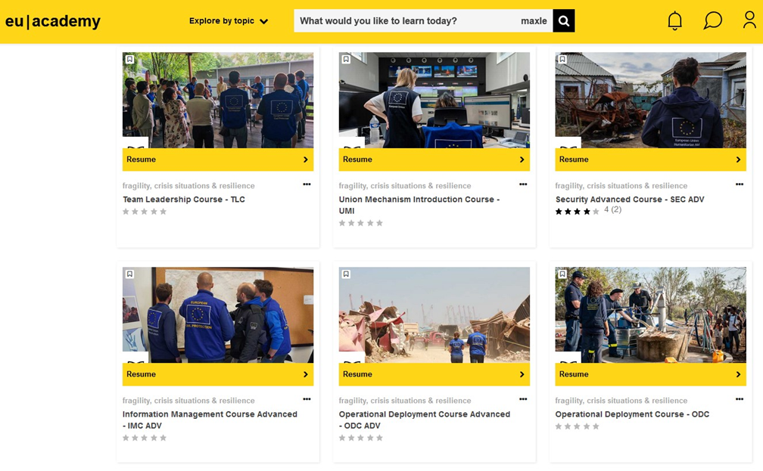
9. EU Academy & Online Modules
Status EU Academy
Information Pages for all eight courses (published)
Update for the 21st cycle (work in progress):
- new course calendar
- curriculum review
Integration D&I (work in progress):
- embedded into the eight information pages?
- own information page (incl. access to the handbook)?
- additional SCORM module or quiz?

Slide 28

9. EU Academy & Online Modules
Working Group “FlexiCourse”
Concept “Asynchronous web-based course content”
Focus on UMI, ODC, ODC ADV and IMC ADV
Working group (incl. WebDesign and IT Support resources, information exchange with TLC / BBK)
Software licenses for Articulate 360 purchased
Monthly online meetings, face-to-face workshops in August and November
Know how development (Rise 360, Review 360, Story Line 360 etc.) within the working group
Demo course (incl. functions and options, CI concept EU Academy, comparison with evaluations...)
Additional benefit (f. e. SCORM module for asynchronous online SEC ADV or D&I)

Slide 29

9. Visibility and communications
What our topics are:
reports from our 29 courses each training cycle
reports about innovation & new initiatives within the UCPM Training Programme: for example: digital tools, new teaching or evaluation techniques, trainee programme, the D&I initiative
background interviews with lecturers & stakeholders about new developments within the UCPM mechanism and how to respond in training
participants’ testimonials, alumni’s opinions & staff portraits
What we don’t address actively:
training consortium inner workings and relations

Slide 30
Connect. Share. Grow.
Thank you!
LOT 1 Team

