Slide 1





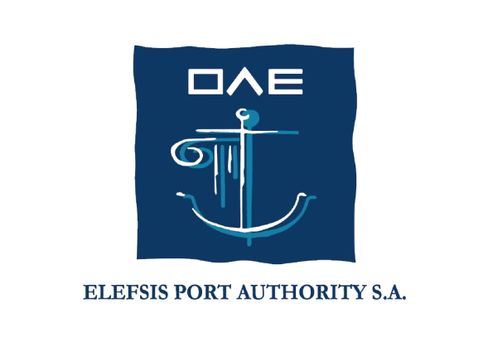



EMMERA: Easter Mediterranean Marine Environmental Risk Assessment
Final Dissemination Event
Angelos Menelaou,
Head, Dept of Maritime Transport & Commerce (DMTC)
Frederick University
Piraeus - 25 May, 2026

Slide 2
EMMERA: The Project Specifics
Core Aim
Web system for marine environmental risk monitoring, integrating data, statistical analysis, visualisation, performance measurement, and drone operations for real-time marine pollution detection and warning.
The Project Key Parameters
Total Budget 1,103,274.86
EU Contribution 937,783.63
Duration: 24 months
Kick Off: 12/03/2024
Call:UCPM-2023-KAPP— Knowledge for Action in Prevention and Preparedness
Funding Rate: EC (85%) of Eligible Cost
Coordinator: Dept. of Maritime Transport and Commerce, Frederick University
Consortium
Frederick University –DMTC & CSEE
University of Haifa (HFU)
University of Piraeus Research Center (UPRC)
Cyprus Port Authority (CPA)
Eleusis Port Authority (EPA)

Slide 3
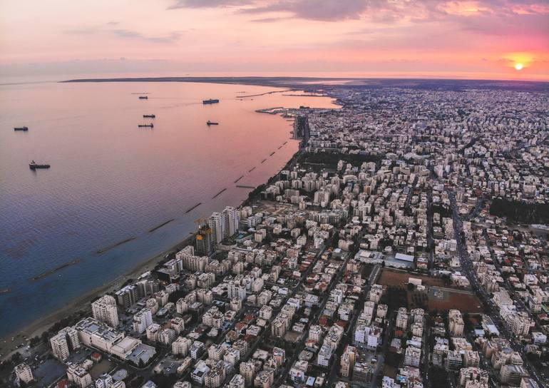
Coastal Areas – Why they matter for Mediterranean Countries?
Coastal areas are vital for tourism, shipping, fisheries, water security,
and economic growth
Cyprus, Greece, and Israel depend on healthy marine ecosystems
BUT growing coastal activity is increasing environmental pressure and pollution risks

Slide 4
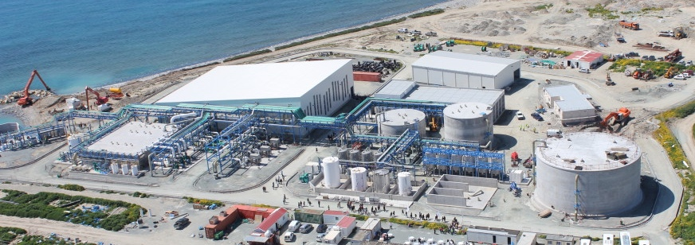
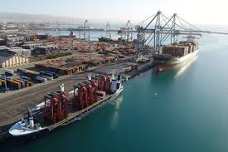
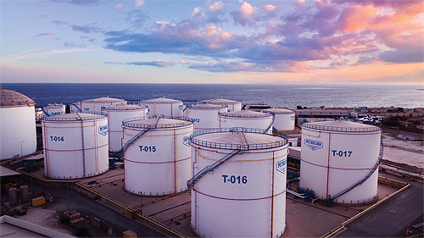
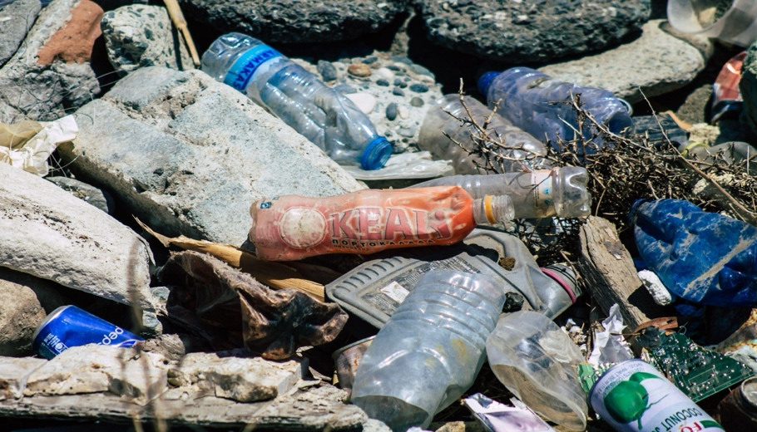
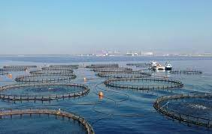
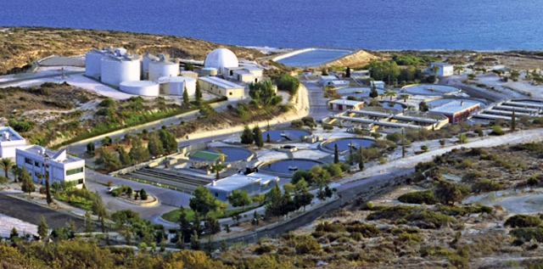
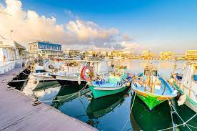
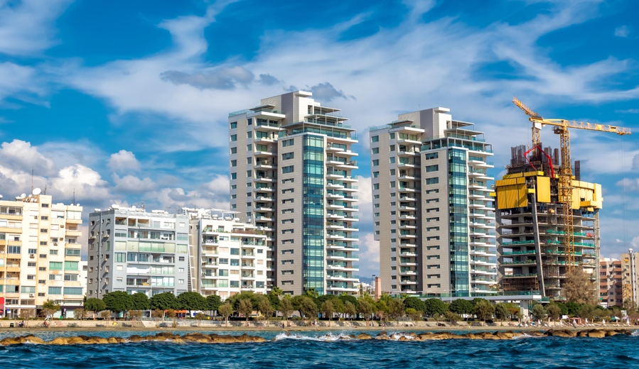
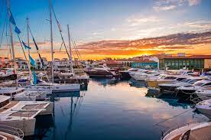
Background of Project Concept
Increasing Risks to Marine Coastal Environment In Limassol Coast
DESALINATION
OIL & GAS ACTIVITIES
PORTS & SHIPPING
ENVIRONMENTAL
PRESSURE & RISK
AQUACULTURE
SOLID & LIQUID WASTE
FISHERIES
MARINAS & RECREATIONAL YACHTING
COASTAL CONSTRUCTION
Notes:
Cyprus is producing 673 kilogrammes of waste per inhabitant a year, making the island the 5th highest producer of municipal solid waste in the EU.
Cyprus is the EU’s highest food-waste generator, with the average Cypriot discarding nearly 294 kilograms of food annually, exceeding the European average of 132 kilograms, according to data from 2022.
On an annual basis, Cyprus produces 93,000 tonnes of plastic waste, which adds up to 94 kg per capita per year. 2 This is well above the European average of 64 kg per capita per year

Slide 5
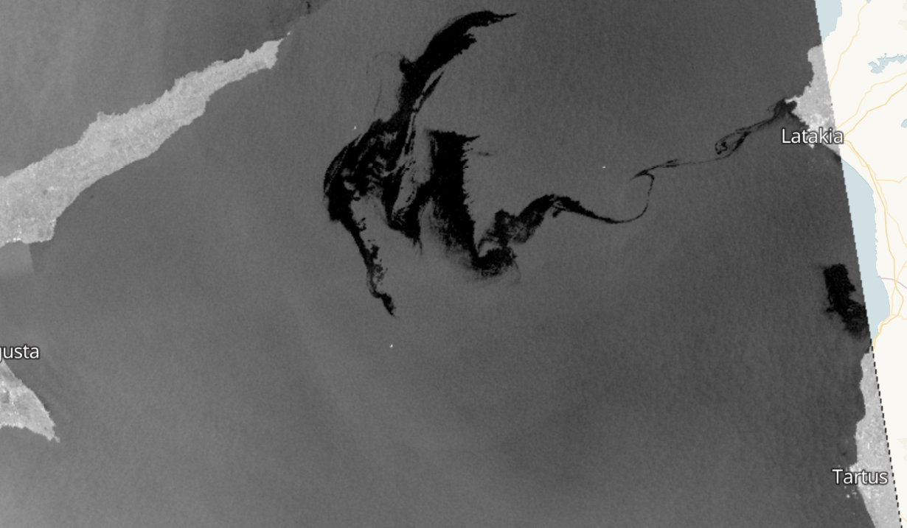
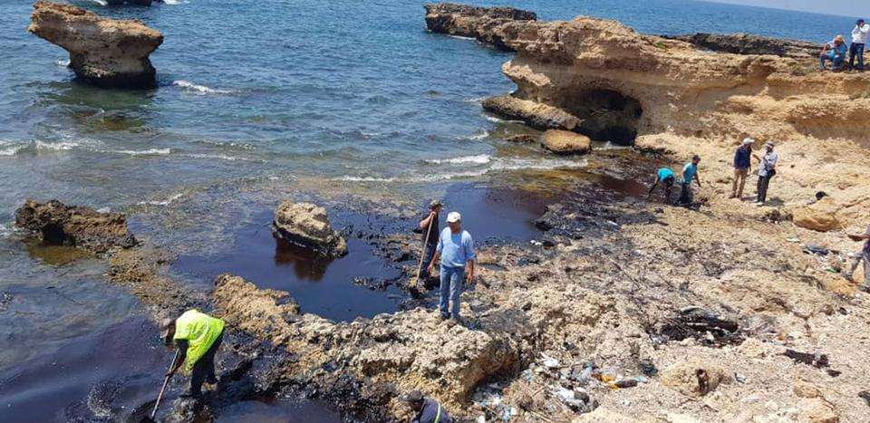
Sustainability?
ENVIRONMENTAL
RISK
ENVIRONMENTAL
MANAGEMENT

Slide 6
Key Findings of the Blue Limassol Risk Assessment, 2021
Cumulative environmental pressures can be catastrophic for the Limassol Coastal Environment!
Main Contributory Factors
Fragmentation of responsibility among many overseeing bodies
Incomplete enforcement of extant regulations
Limited monitoring and digital technologies
Absence of long-term planning
Limited environmental consciousness and educationCumulative environmental pressures

Slide 7
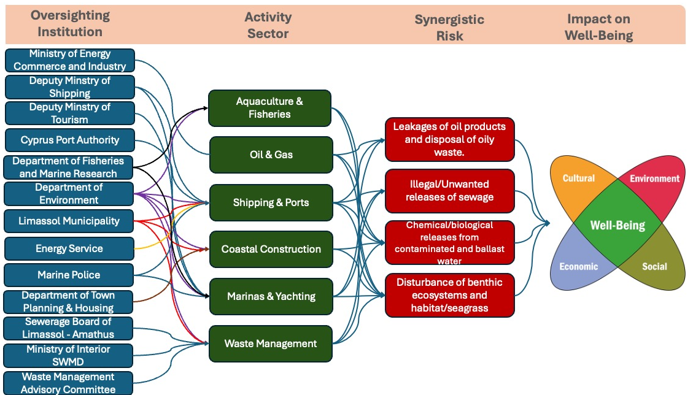
Fragmentation of Responsiblities across Organising Bodies

Slide 8
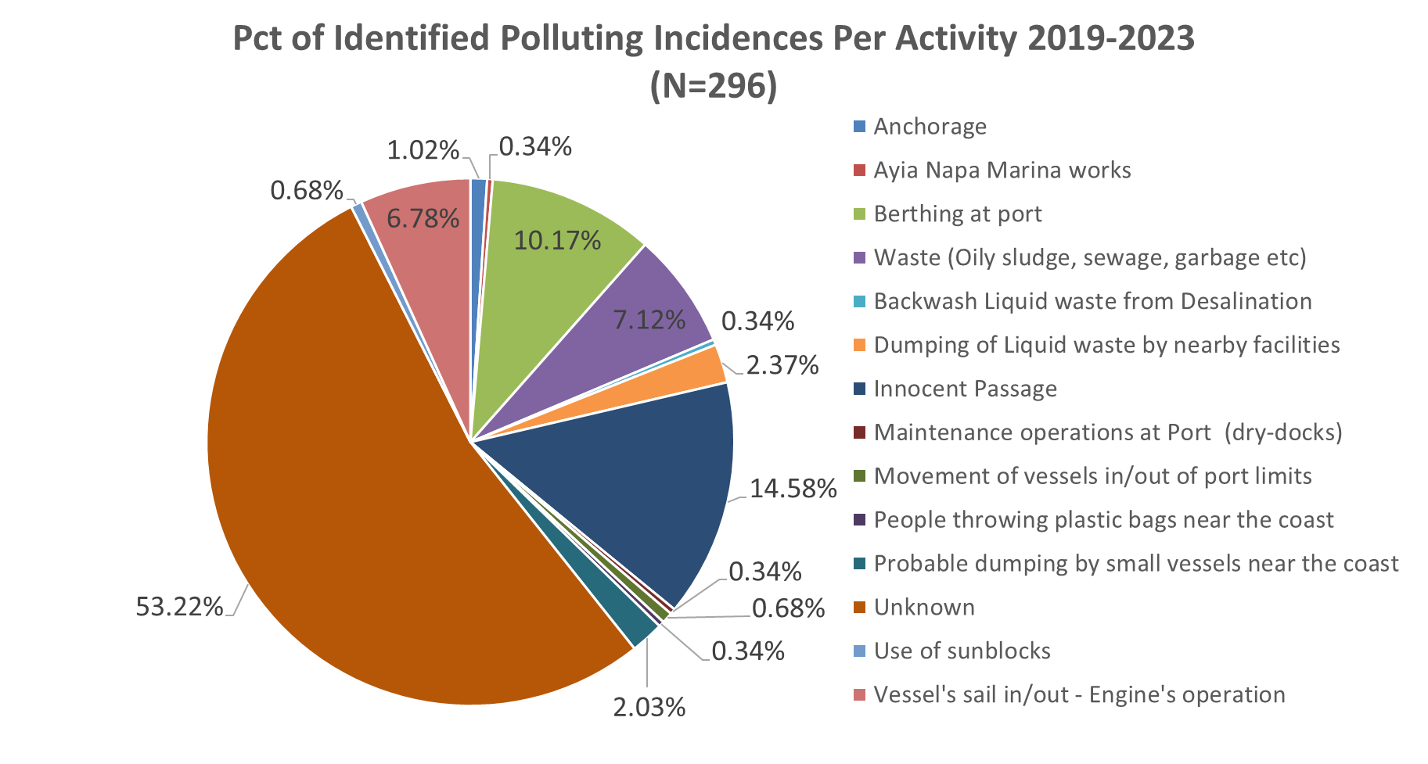
Pollution Incidents Hard to Detect

Slide 9
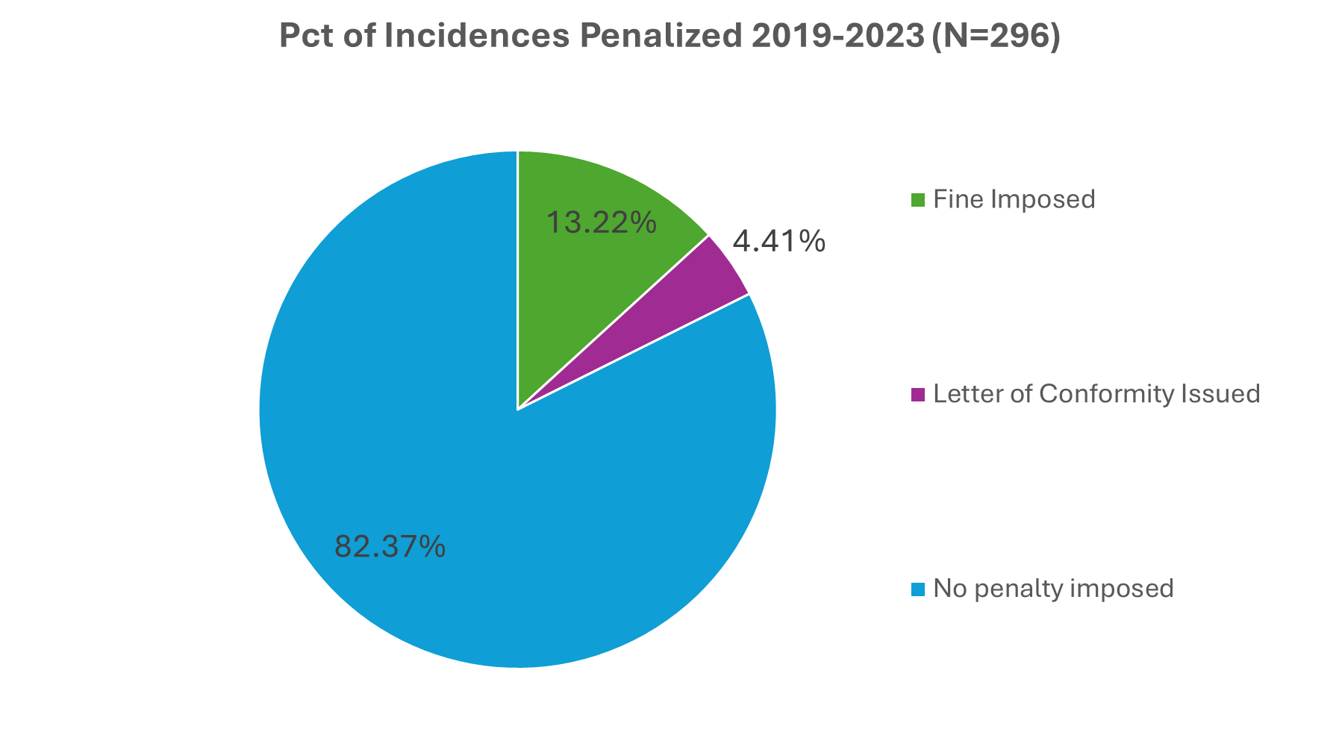
Only a Fraction of Incidents are Penalised

Slide 10
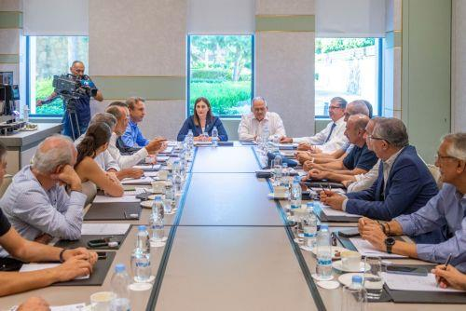
Marine Pollution Special Committee
Following a Council of Ministers decision (February 2024), a national coordination mechanism for marine pollution prevention and response was established.
Key Features
Led by the Shipping Deputy Ministry
Multi-agency coordination framework
Participation of key national stakeholders
Frederick University acting as Scientific Advisor
Objective
Strengthen coordinated monitoring, prevention,
synergies, accountability and response to marine pollution incidents.

Slide 11
EMMERA: Digital Platform Purpose and Main Functionalities
Web Platform
Combines static (baseline) and dynamic data from agencies, drones, APIs, and IoT.
Aerial drone tech
Detection of pollution incidents in real time
Action plan
Dynamic analysis
Algorithms – Dynamic Risk Assessment
For the first time, EMMERA brings together dynamic and static data from all relevant sources, enabling continuous monitoring, detection, risk assessment, and performance appraisal
KPIs
Quantification of socioeconomic impacts of coastal pollution
Platform Scalability
Future integration: IoT, Instant (Real Time) communication and interaction with citizen

Slide 12
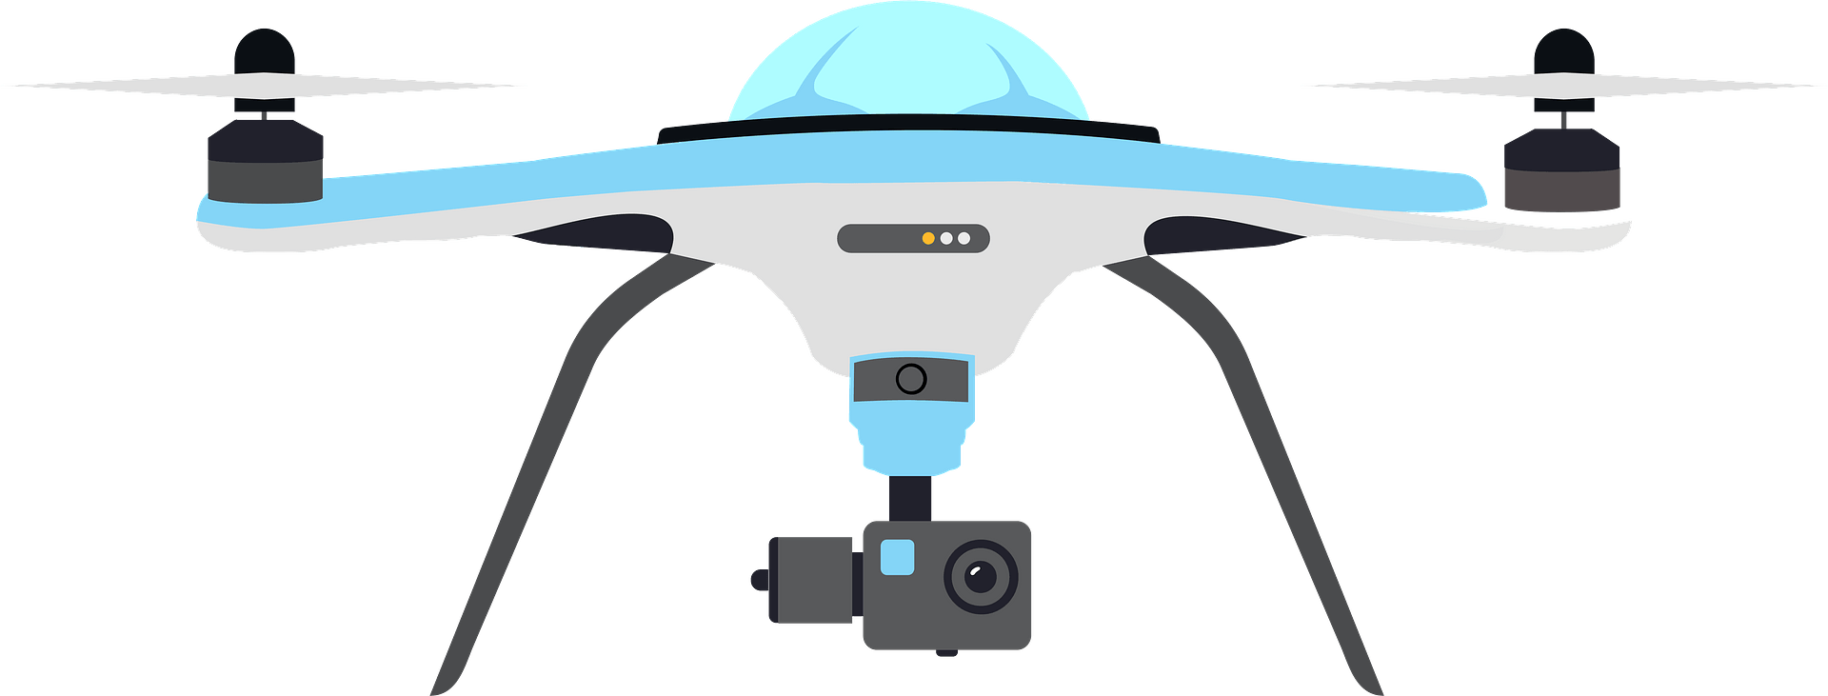

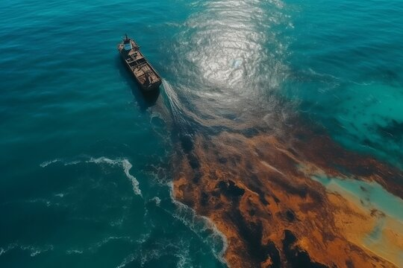



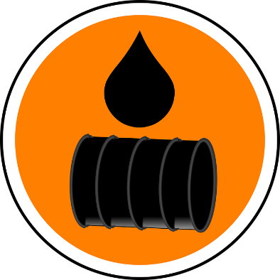









I have done my best to tidy this up – please ask whoever created the slide to fix it
EMMERA : Digital Platform Functionality
Dynamic Information Provider - Efficient Monitoring of Cyprus Coastal and Sea Area
Application Layer
Network Infrastructure Layer
Solution: AI-based web system that will offer
  Data integration, statistical analysis, visualization, prediction, and performance measuring.
  Drone operations for real-time detection and warning.
Data Acquisiton Layer
Notes:
Data Acquisition Layer: the environment we collect data (sea, ships, citizens, authorities, etc) as well as the infrastructure that hosts the data (databases)
Network Layer: the infrastructure that will forward the data to the application layer (e.g., cellular network, satellite network, LORAWAN, etc.)
Application Layer: all intelligence and visualizations (algorithms, statistics, dashbords, web portal for data management, etc.)

Slide 13
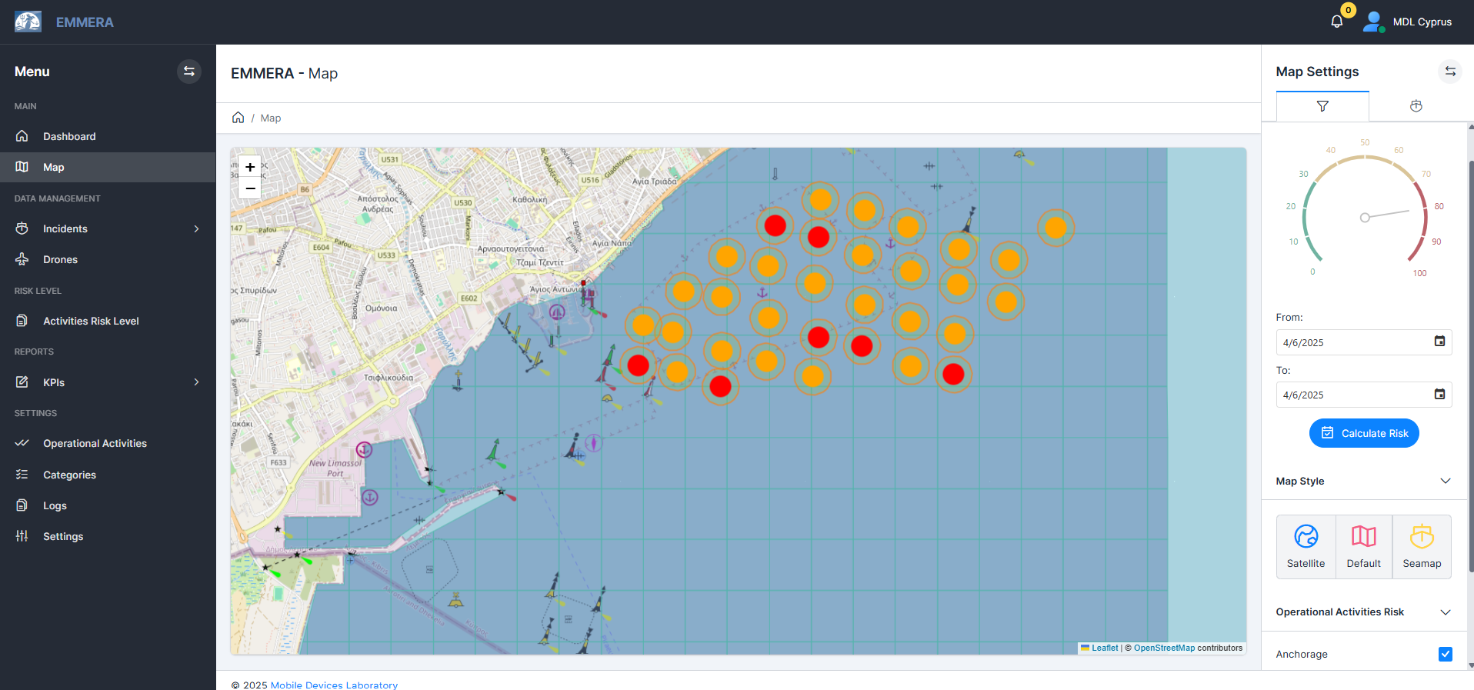
Digital Platform – Dynamic Data
Notes:
Color coded risk assessment per activity location (e.g., anchorage)

Slide 14
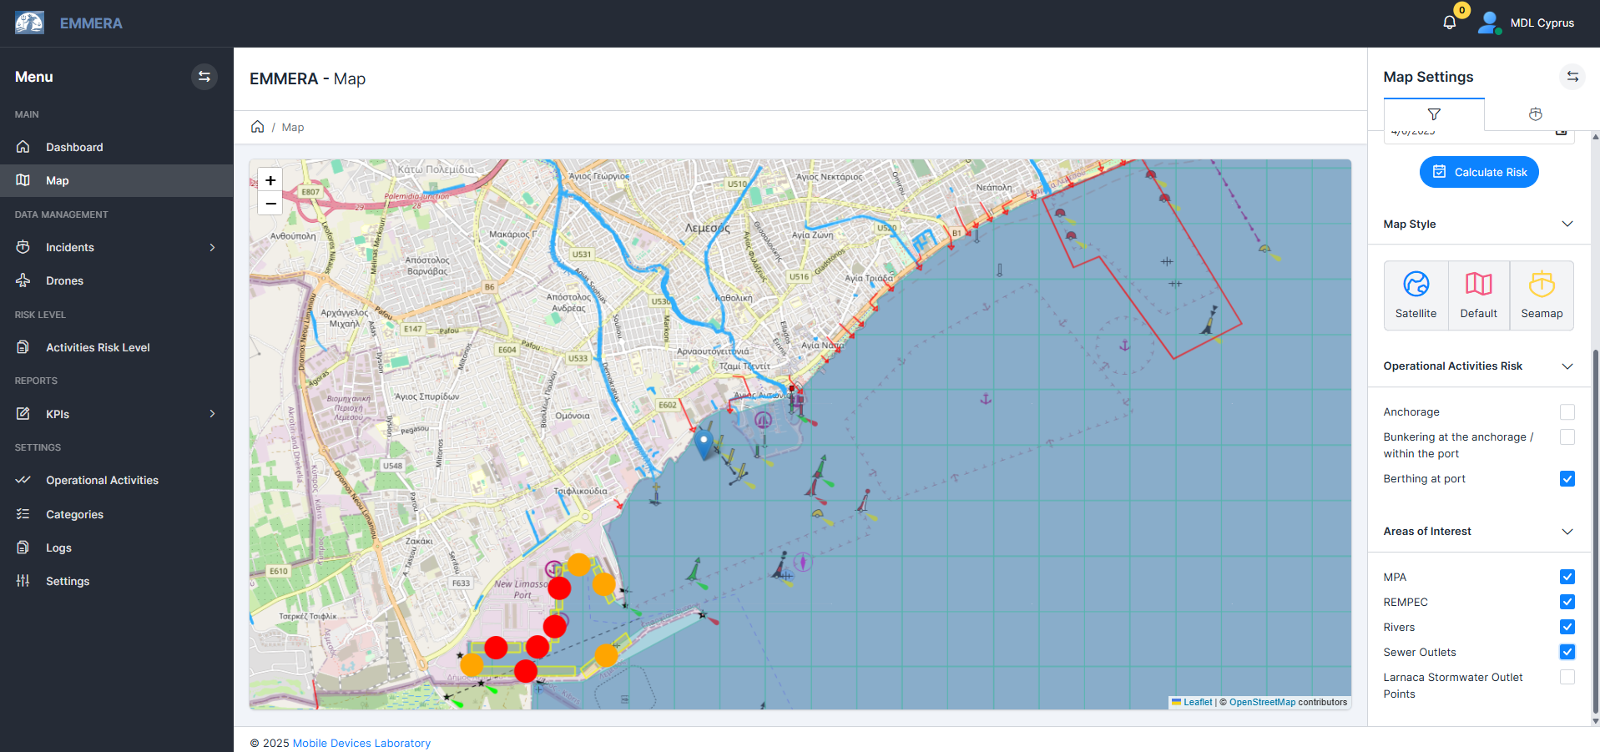
Digital Platform – Static Data
Notes:
Color coded risk assessment for berthing at port as well as various static data (e.g., rivers, data from REMPEC source, sewer outlets)

Slide 15
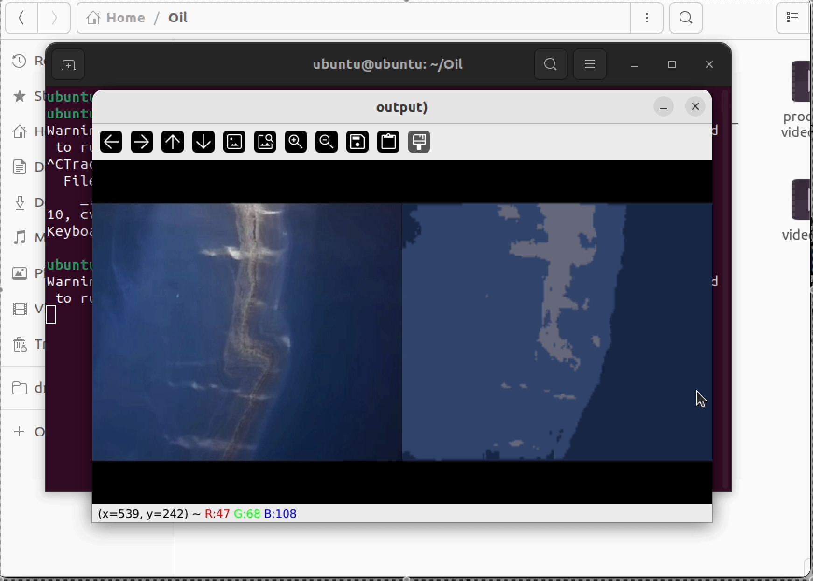
Drone Operation
Real-time Data Acquisition and Pollution Detection
Notes:
Captures data by using motion and image analysis – color variations on the images

Slide 16
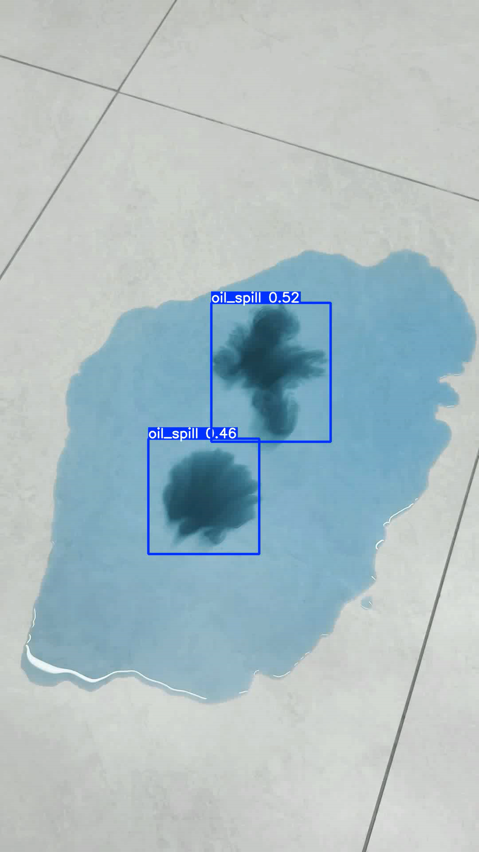
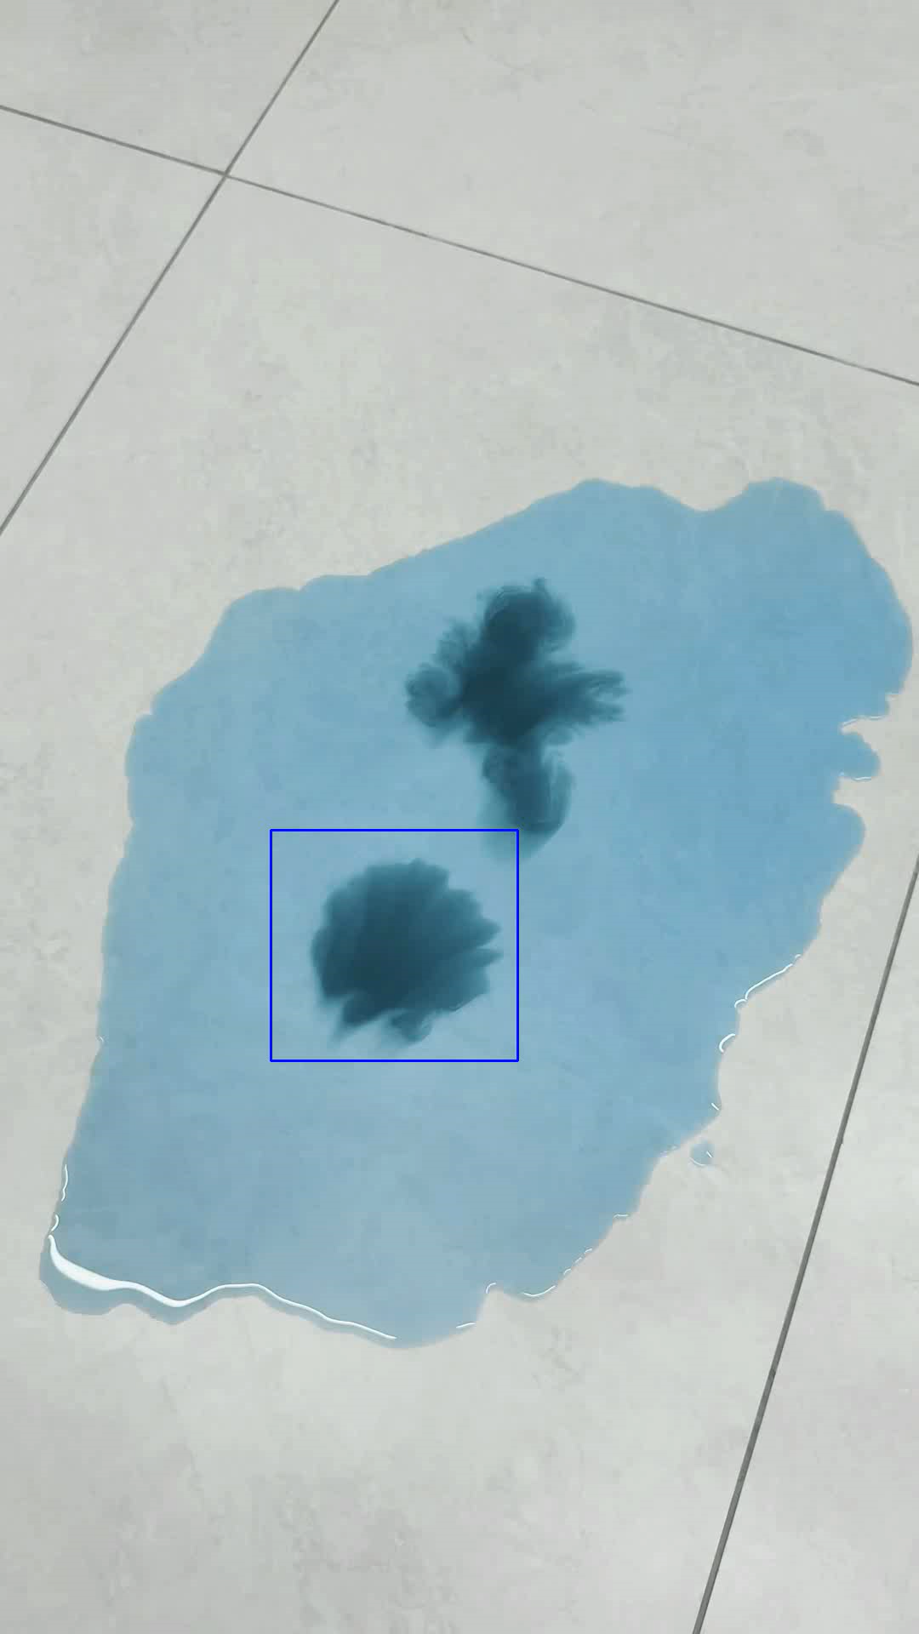
Drone Operation
Real-time Pollution Detection
Deep Learning
Computational Geometry
Using Computational Geometry:
  More Accuracy
  More Stability
  No training
Compared to Deep Learning
Notes:
Shows the more stable and accurate pollution detection between the two techniques. Specifically it shows that deep learning sometimes confuses the two oli spills and considers them one (overlapping rectangles)

Slide 17
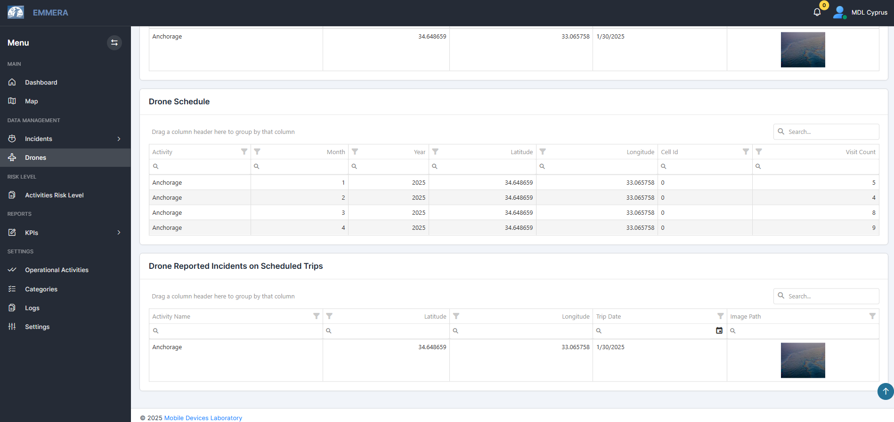
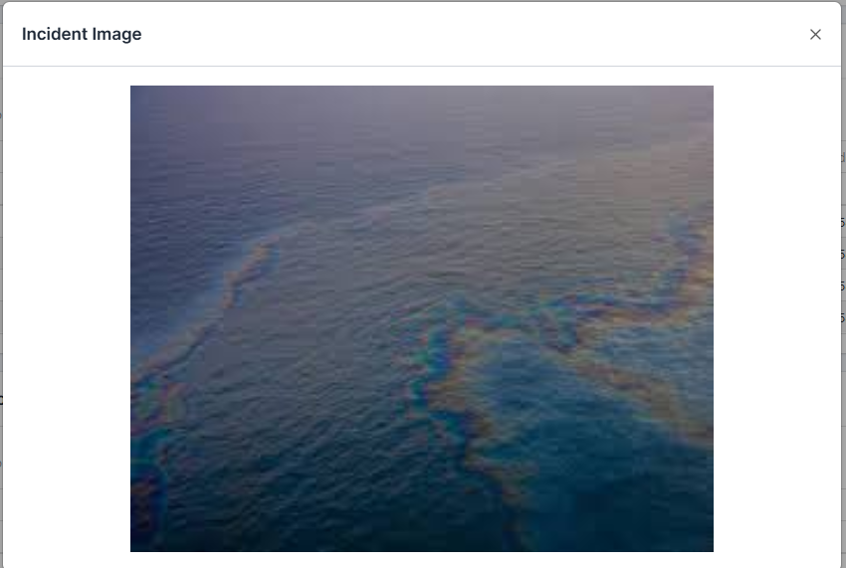
Electronic Data – Operation of Drones
Ηλεκτρονική Πλατφόρμα – Δυναμικά Δεδομένα
Ηλεκτρονική Πλατφόρμα
Notes:
TOP of the figure: reporting of pollution detection from manual incident
CENTER – DRONE SCHEDULE: drone schedule for visiting specific activity locations – shows the frequency that he drone will visit a location per month, each year
BOTTOM: reported incidents from scheduled surveillance

Slide 18
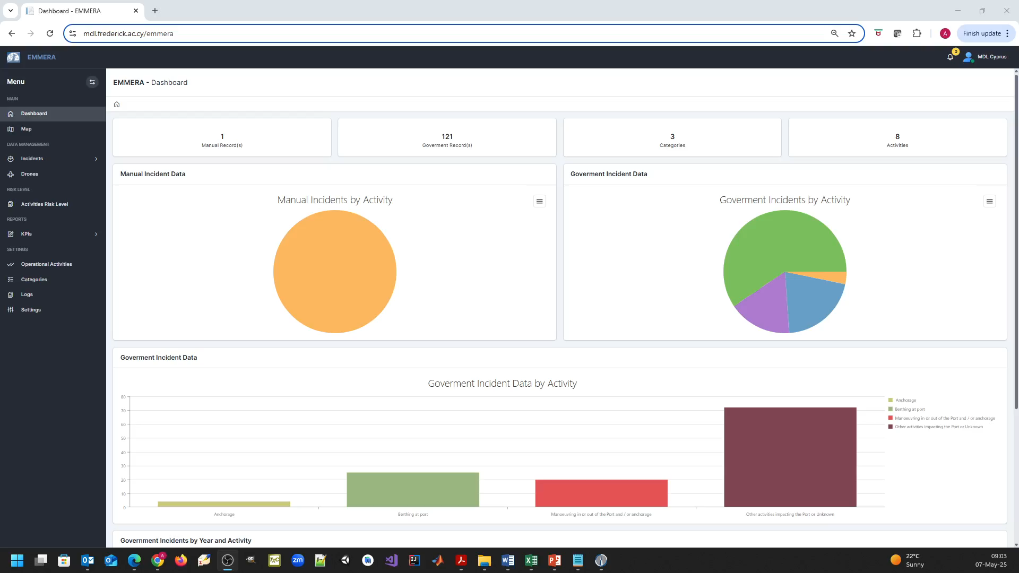
Notes:
The video shows the dashboard, credit risk of the whole port, real-time data of vessels around the coastal area (it is for whole cyprus to be more accurate), map with color coded risk assessment of activity locations, static data of MPA, riners, etc, historical data from authorities – past incident, then the data of authorities in table format, risk assessment calculation per period/ activity, the form to be completed by the authorities for manual incident reporting and to triger a warning for the operator to fly the drone there, finally is the page explained in the next slide.

Slide 19
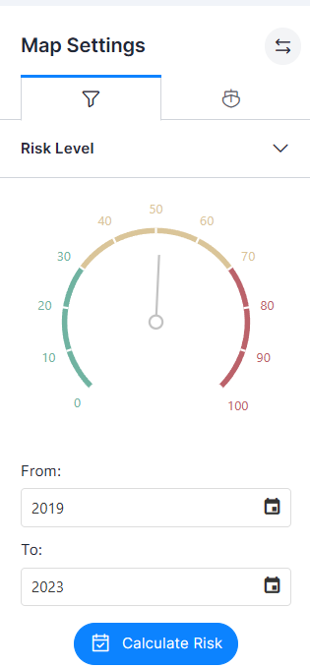
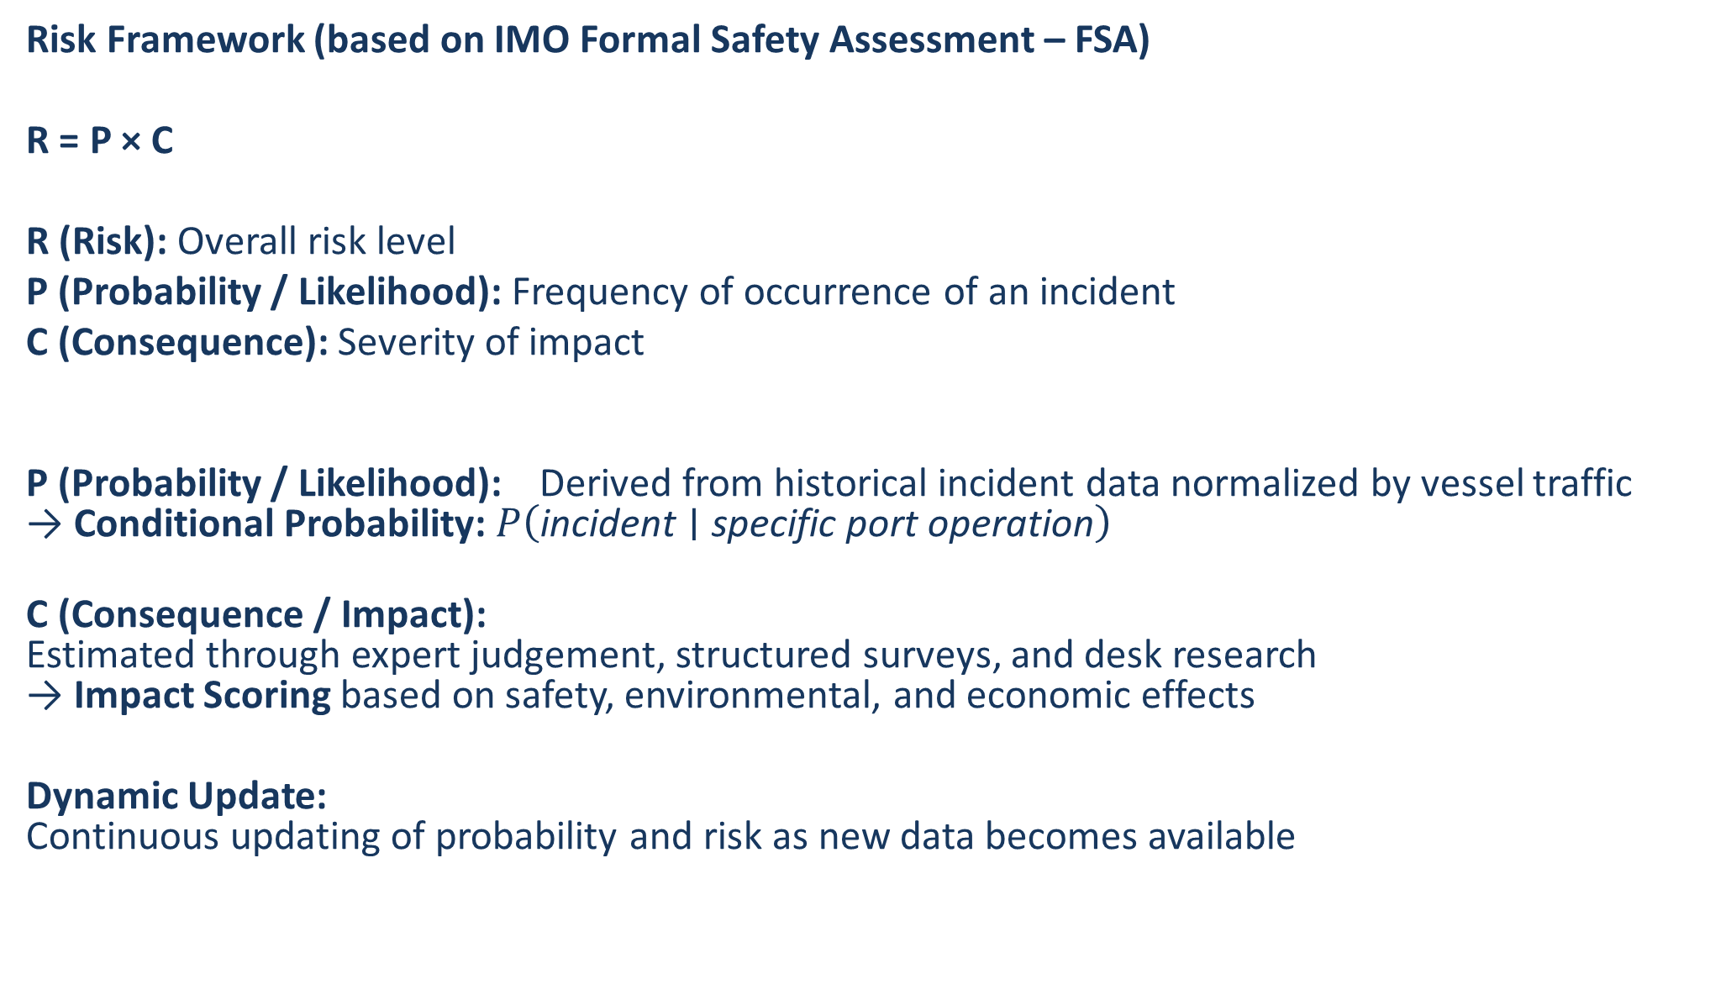
Risk Calculation (I)
Risk Framework (based on IMO Formal Safety Assessment – FSA)
R = P × C
R (Risk): Overall risk level
P (Probability / Likelihood): Frequency of occurrence of an incident
C (Consequence): Severity of impact
P (Probability / Likelihood): Derived from historical incident data normalized by vessel traffic
→ Conditional Probability: $P\left(\text{incident}∣\text{specific} \text{port} \text{operation}\right)$
C (Consequence / Impact):
Estimated through expert judgement, structured surveys, and desk research
→ Impact Scoring based on safety, environmental, and economic effects
Dynamic Update:
Continuous updating of probability and risk as new data becomes available
Notes:
Methodology is in line with the IMO Formal Safety Assessment framework, risk is quantified as the product of probability and consequence.”
Probability is essentially the ratio of incidents to vessel traffic, grouped by specific port operations.”

Slide 20
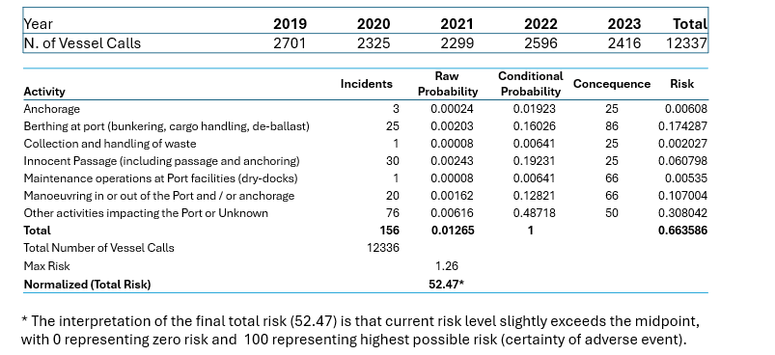
Risk Calculation (II)
Current Risk Calculation
Notes:
“For the period 2019–2023, the normalized total risk is 52.47, indicating a moderate risk level, slightly above the midpoint.”

Slide 21
Key Performance and Other Indicators (I)
Selection and Management of Indicators
Indicators and KPIs combine incident data, vessel traffic, and macroeconomic factors
They enable continuous monitoring of performance and effectiveness of measures
Significant changes in Indicator’s trigger further analysis and potential risk reassessment
KPI’s are data-driven and updated dynamically (EMMERA platform & official statistics
Notes:
Shows the more stable and accurate pollution detection between the two techniques. Specifically it shows that deep learning sometimes confuses the two oli spills and considers them one (overlapping rectangles)

Slide 22
Port Indicators Framework:
Operational, Environmental & Socio-Economic Performance (II)
Operational Activity & Incident Occurrence
Incident Rate = Number of incidents / Number of vessel calls
Oil Spill Rate = Number of oil spill incidents / Number of vessel calls
Sewage Spill Rate = Number of sewage disposal incidents / Number of vessel calls
Monitoring, Detection & Response Effectiveness
Detection Rate = Number of incidents recorded and characterized / Total number of incidents
Detected Incident Frequency Rate = Incident Rate × Detection Rate
Response Rate = Number of responses to incidents / Number of reported incidents
Penalization Rate = Number of punishable incidents / Number of reported incidents
Economic & Social Performance
Employment Rate 1 = (1 − Unemployment Rate) / Vessel Traffic
Employment Rate 2 = (1 − Unemployment Rate) / Cargo Throughput
Economic Growth 1 = GDP / Vessel Traffic
Economic Growth 2 = GDP / Cargo Throughput
Notes:
Shows the more stable and accurate pollution detection between the two techniques. Specifically it shows that deep learning sometimes confuses the two oli spills and considers them one (overlapping rectangles)

Slide 23
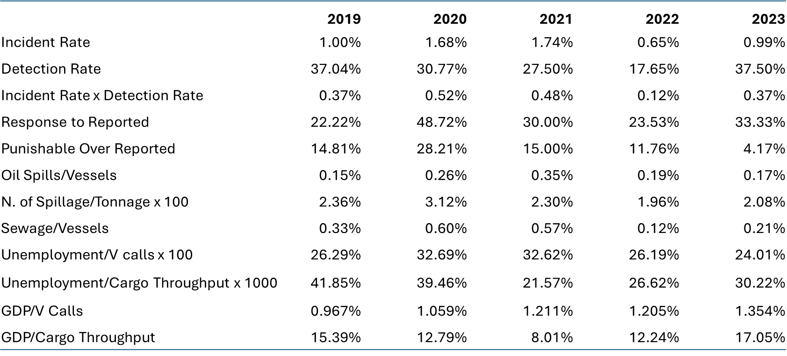
Key Performance Indicators (III)
Current Estimation of KPIs
Notes:
Shows the more stable and accurate pollution detection between the two techniques. Specifically it shows that deep learning sometimes confuses the two oli spills and considers them one (overlapping rectangles)

Slide 24

EMMERA puts Theory into Practice
Key Outcomes
  Established an integrated framework for marine pollution monitoring
  Combined AI, dynamic data, drones, and risk assessment tools
  Strengthened inter-agency coordination and decision support
  Supported national efforts for pollution prevention and response
  Introduced KPI-driven monitoring and accountability mechanisms
Long-Term Contribution
EMMERA creates the foundation for:
  real-time environmental monitoring,
  data-driven policy making,
  scalable coastal risk management,
  and future smart marine governance in the Eastern Mediterranean.
From fragmented monitoring → to integrated environmental intelligence

Slide 25



Thank You
Get In Touch
+357 25 730 975 or 357 99 587006‬
bus.ma@frederick.ac.cy
Funded by the European Union. Views and opinions expressed are however those of the author(s) only and do not necessarily reflect those of the European Union or the European Commission. Neither the European Union nor the European Commission can be held responsible for them.

