Slide 1


EMMERA
East Med Cross-border Marine
Environmental Risk Assessment
Data Collection and Analysis Report
Visual redesign | 2016–2024 evidence atlas

Slide 2
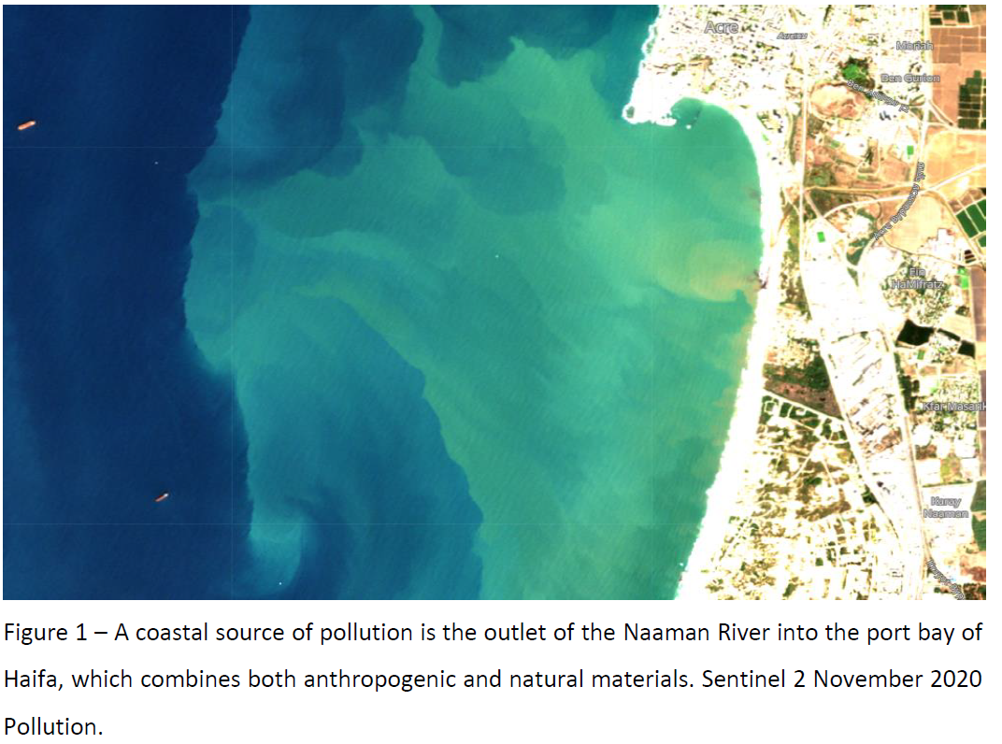
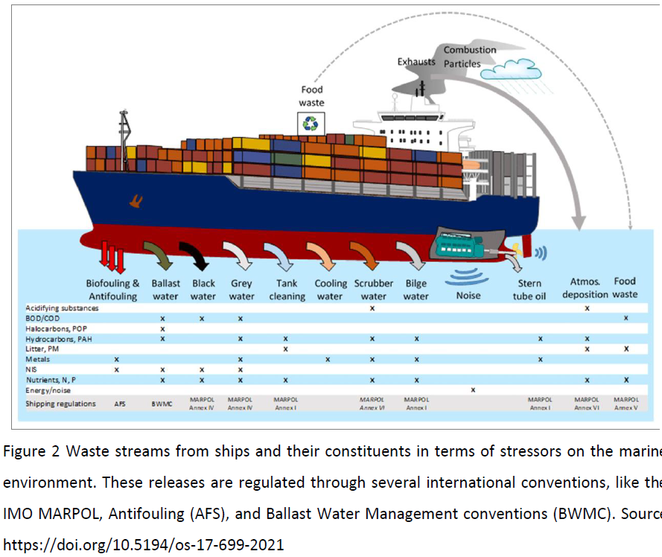
EMMERA
Marine pollution signals: natural context + human pressure
Natural sources
Anthropogenic sources
The assessment separates background variability from pollution linked to maritime activity, ports, coastal infrastructure and other human drivers.
East Med Cross-border Marine Environmental Risk Assessment
01

Slide 3
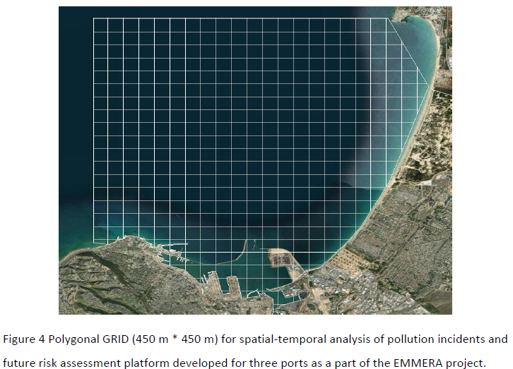
EMMERA
Methodology: gridded spatial assessment
A common polygonal grid converts heterogeneous observations into comparable spatial units for risk mapping and cross-port analysis.
1
Define AOIs
Bound the port, coastal zone and adjacent waters.
2
Digitize events
Translate incidents and satellite detections to grid polygons.
3
Aggregate metrics
Summarize size, frequency and pollution source.
4
Build atlas
Produce comparable hotspot maps for East Med ports.
East Med Cross-border Marine Environmental Risk Assessment
02

Slide 4




EMMERA
Data collection methodology: evidence stack
Free open data
Public authorities
Sentinel-1/2
GIS + statistics
REMPEC and public incident records
Port partners and local marine authorities
Radar and optical satellite observations
Polygonal grids, spatial aggregation and analysis
Integrated workflow
Data ingestion → anomaly detection → GIS gridding → statistical summaries → pollution atlas
East Med Cross-border Marine Environmental Risk Assessment
03

Slide 5
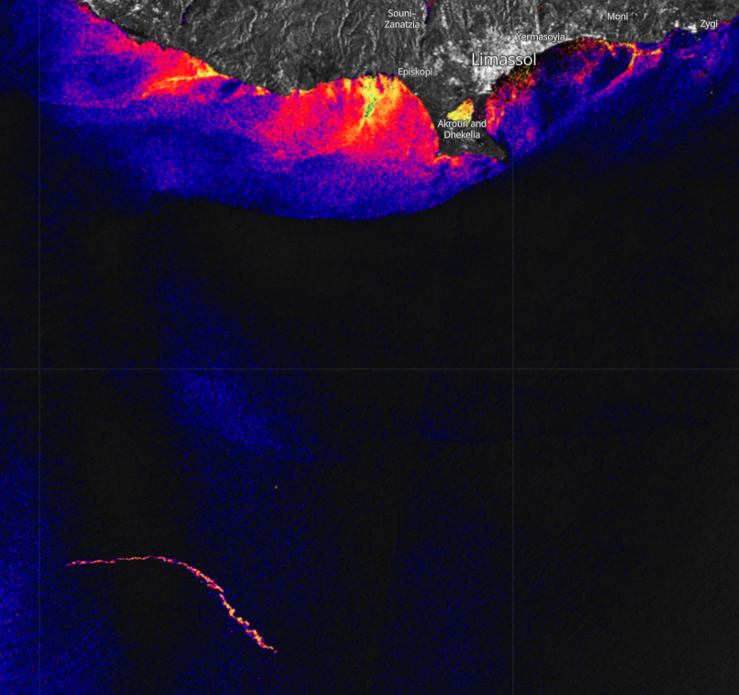
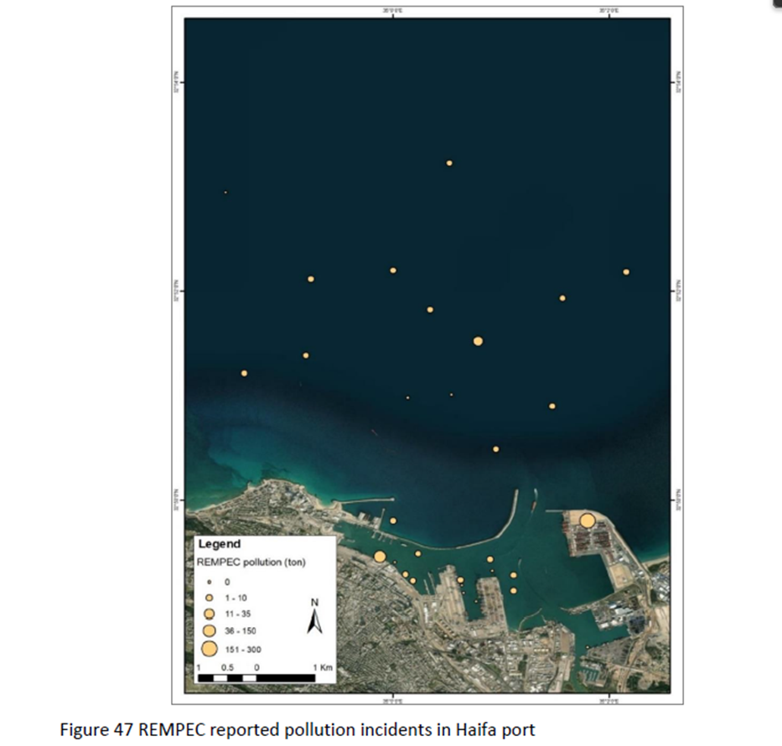
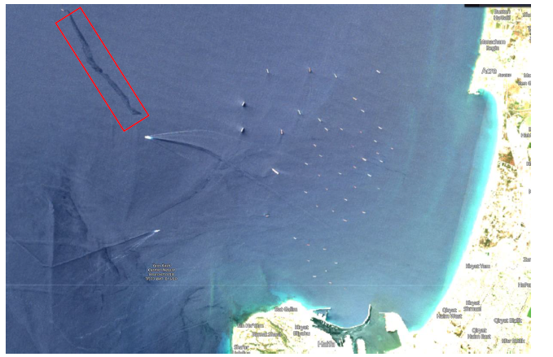
EMMERA
Data sources used for the East Med assessment
REMPEC 1982–2022
Sentinel-2 optical
Sentinel-1 radar
Local marine environment authorities complete the record with verified, port-specific information.
East Med Cross-border Marine Environmental Risk Assessment
04

Slide 6
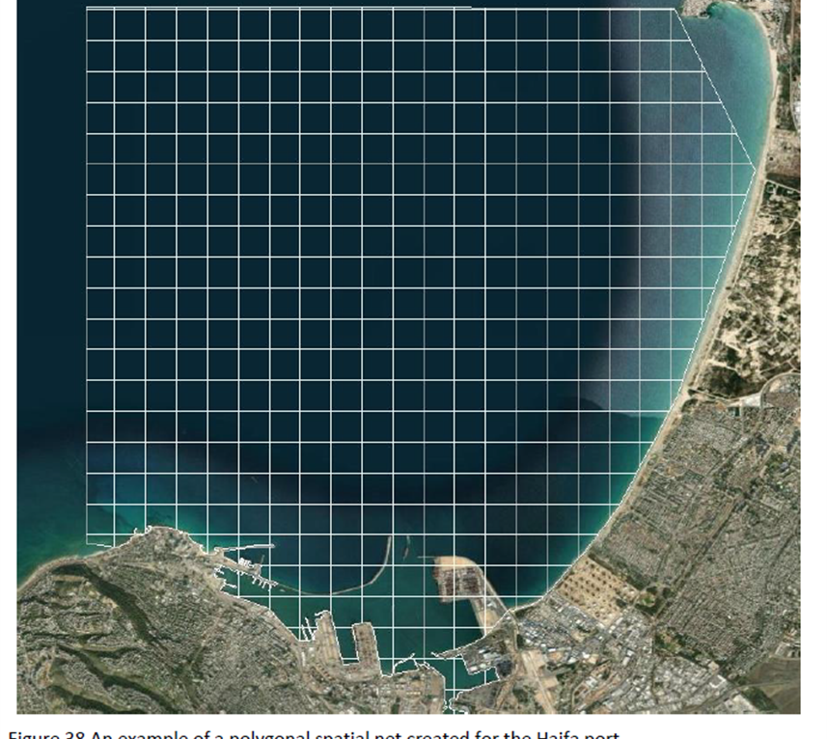
EMMERA
Data collection process: from observations to analysis
1
Define AOIs
Port boundaries and adjacent marine zones.
2
Detect anomalies
Satellite screening for potential pollution signatures.
3
Collect partner data
Compile incidents from port and environment partners.
4
Create GIS polygons
Digitize affected cells and observation footprints.
5
Run statistics
Aggregate size, frequency and source by port.
East Med Cross-border Marine Environmental Risk Assessment
05

Slide 7
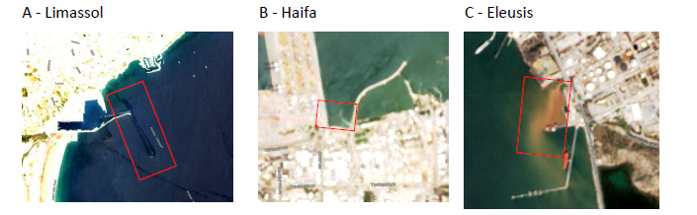
EMMERA
Ports analyzed: three AOIs across the East Mediterranean
3
1,000+
Atlas
ports analyzed: Haifa, Limassol and Eleusis
Sentinel-1 and Sentinel-2 scenes screened
pollution maps for hotspot identification
East Med Cross-border Marine Environmental Risk Assessment
06

Slide 8
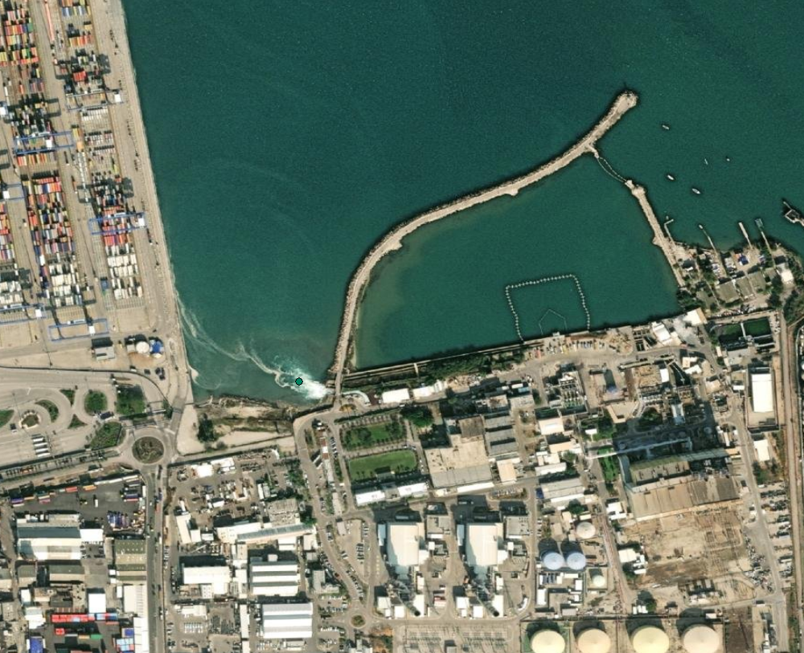
EMMERA
Source of pollution: satellite detections + partner records
Key findings
• Hotspots appear near port entrances, discharge points and dense vessel activity.
• Pollution sources differ by port, requiring port-specific risk controls.
• Gridded outputs make events comparable across jurisdictions and years.
Output: atlas of pollution maps with size, frequency and source layers
East Med Cross-border Marine Environmental Risk Assessment
07

Slide 9
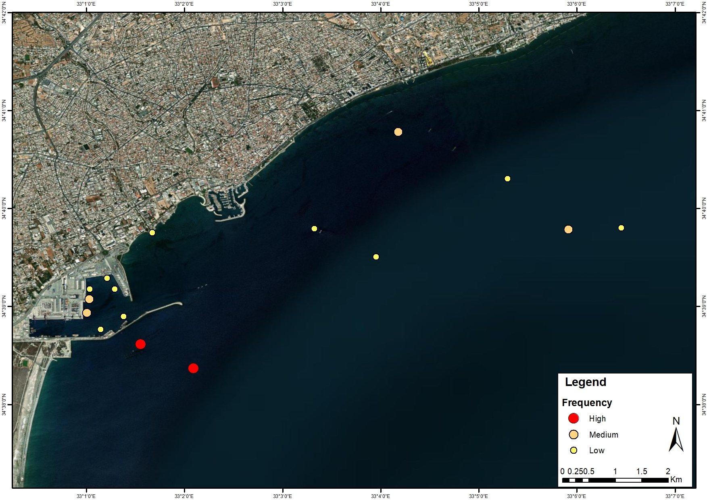
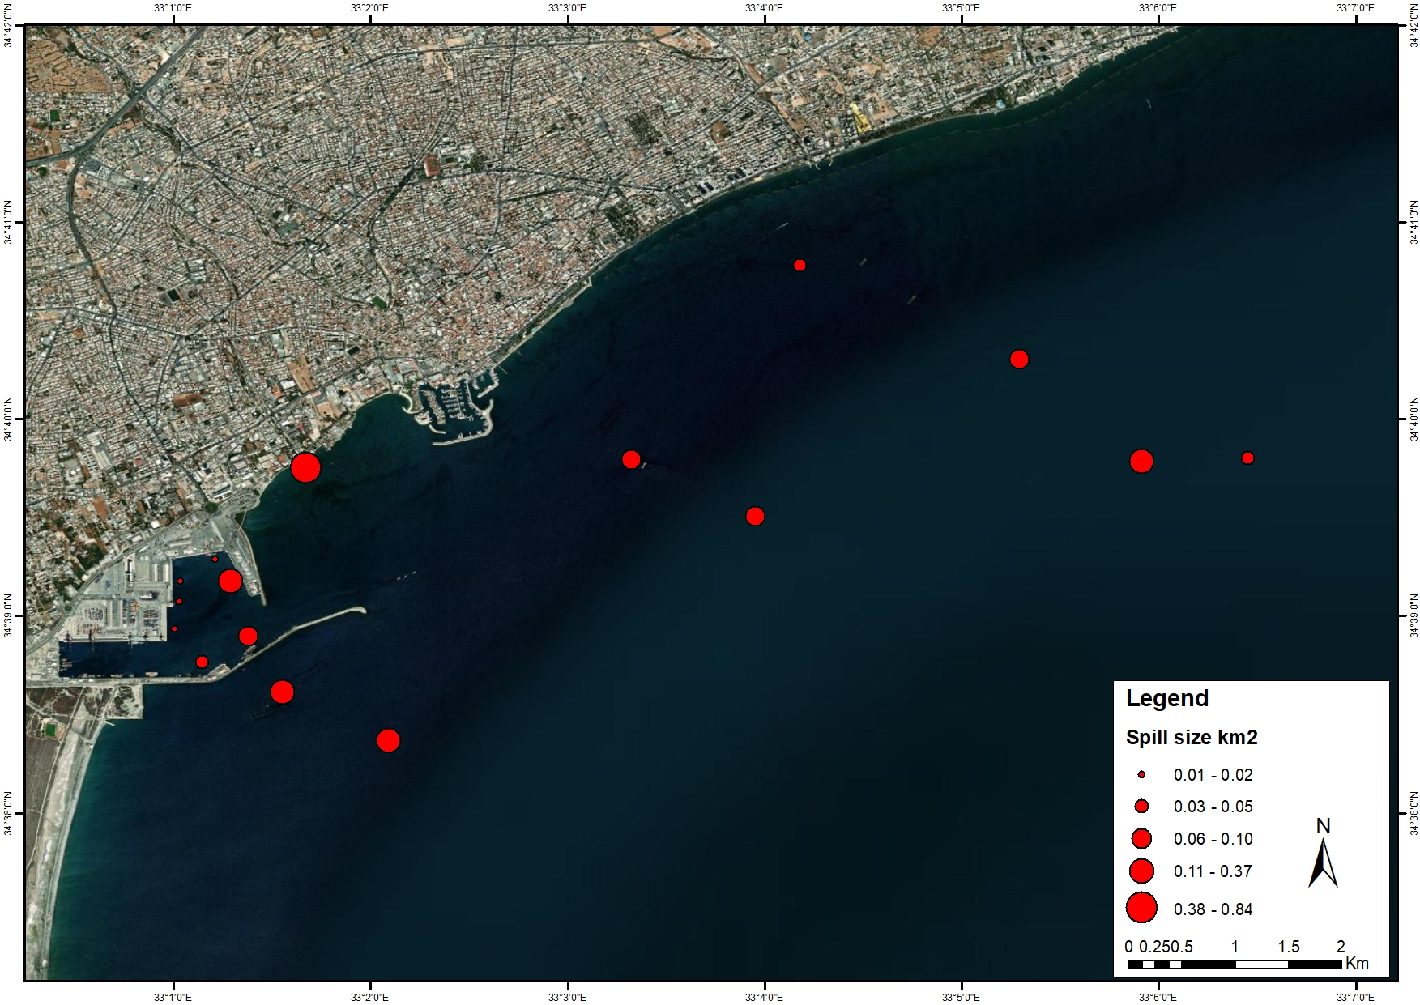
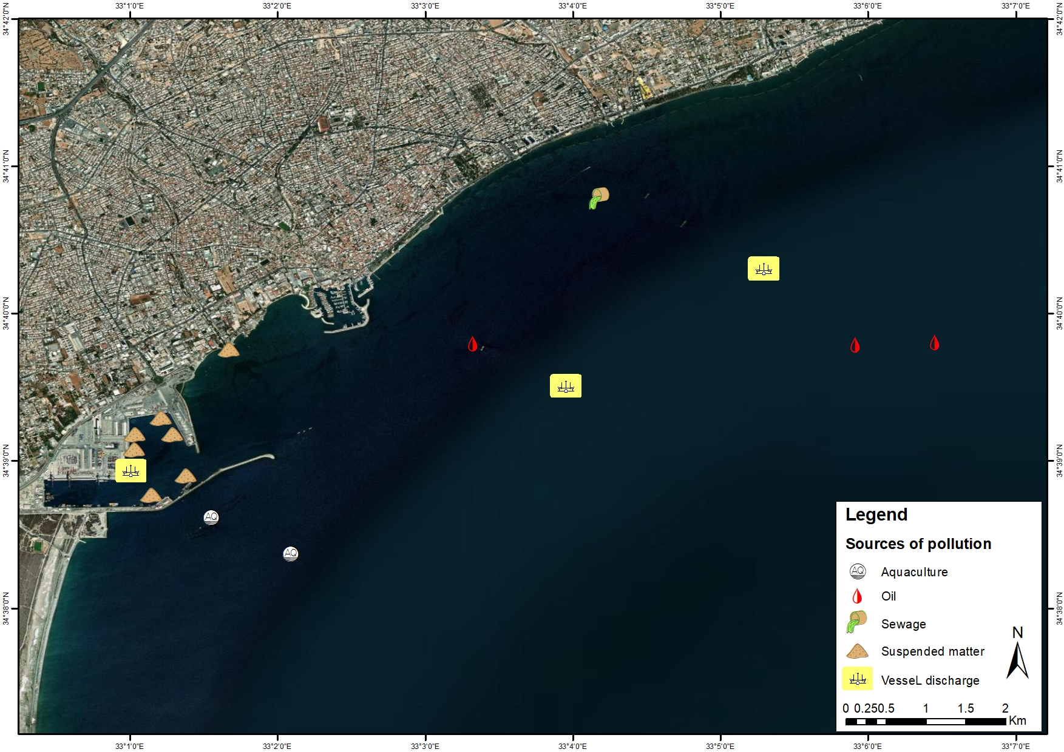
EMMERA
Limassol digitized pollution, 2016–2024
Spill size
Frequency
Source
Dominant cumulative source: Coastal (0.89 km²)
East Med Cross-border Marine Environmental Risk Assessment
08

Slide 10
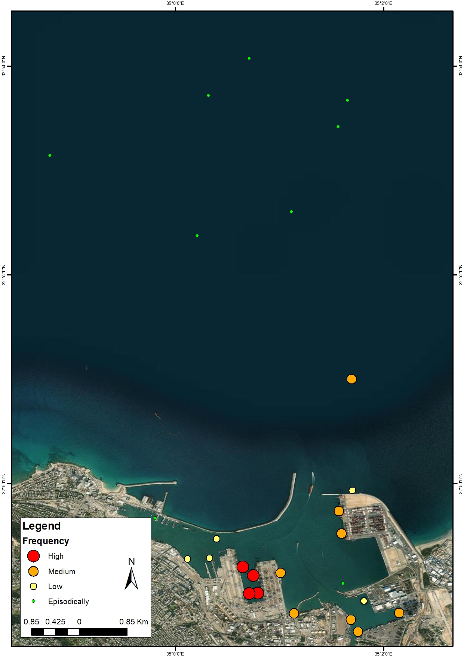
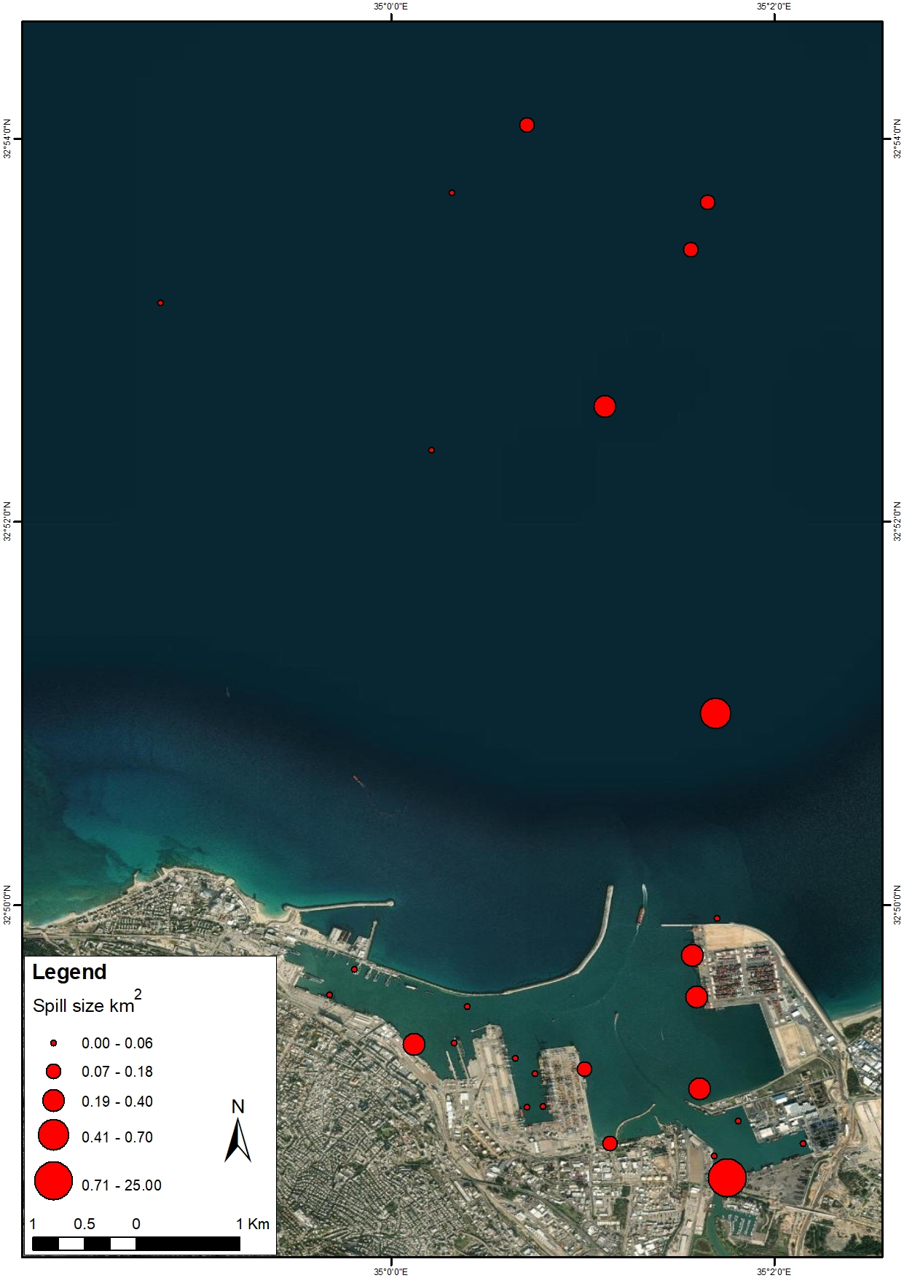
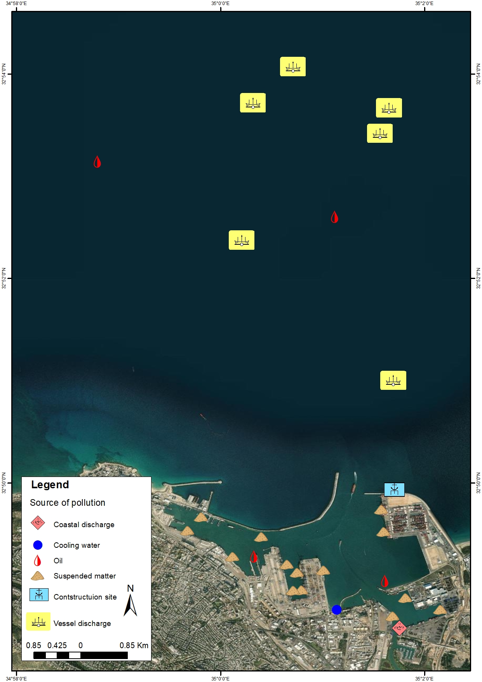
EMMERA
Haifa digitized pollution, 2016–2024
Spill size
Frequency
Source
Dominant cumulative source: Vessel (7.79 km²)
East Med Cross-border Marine Environmental Risk Assessment
09

Slide 11
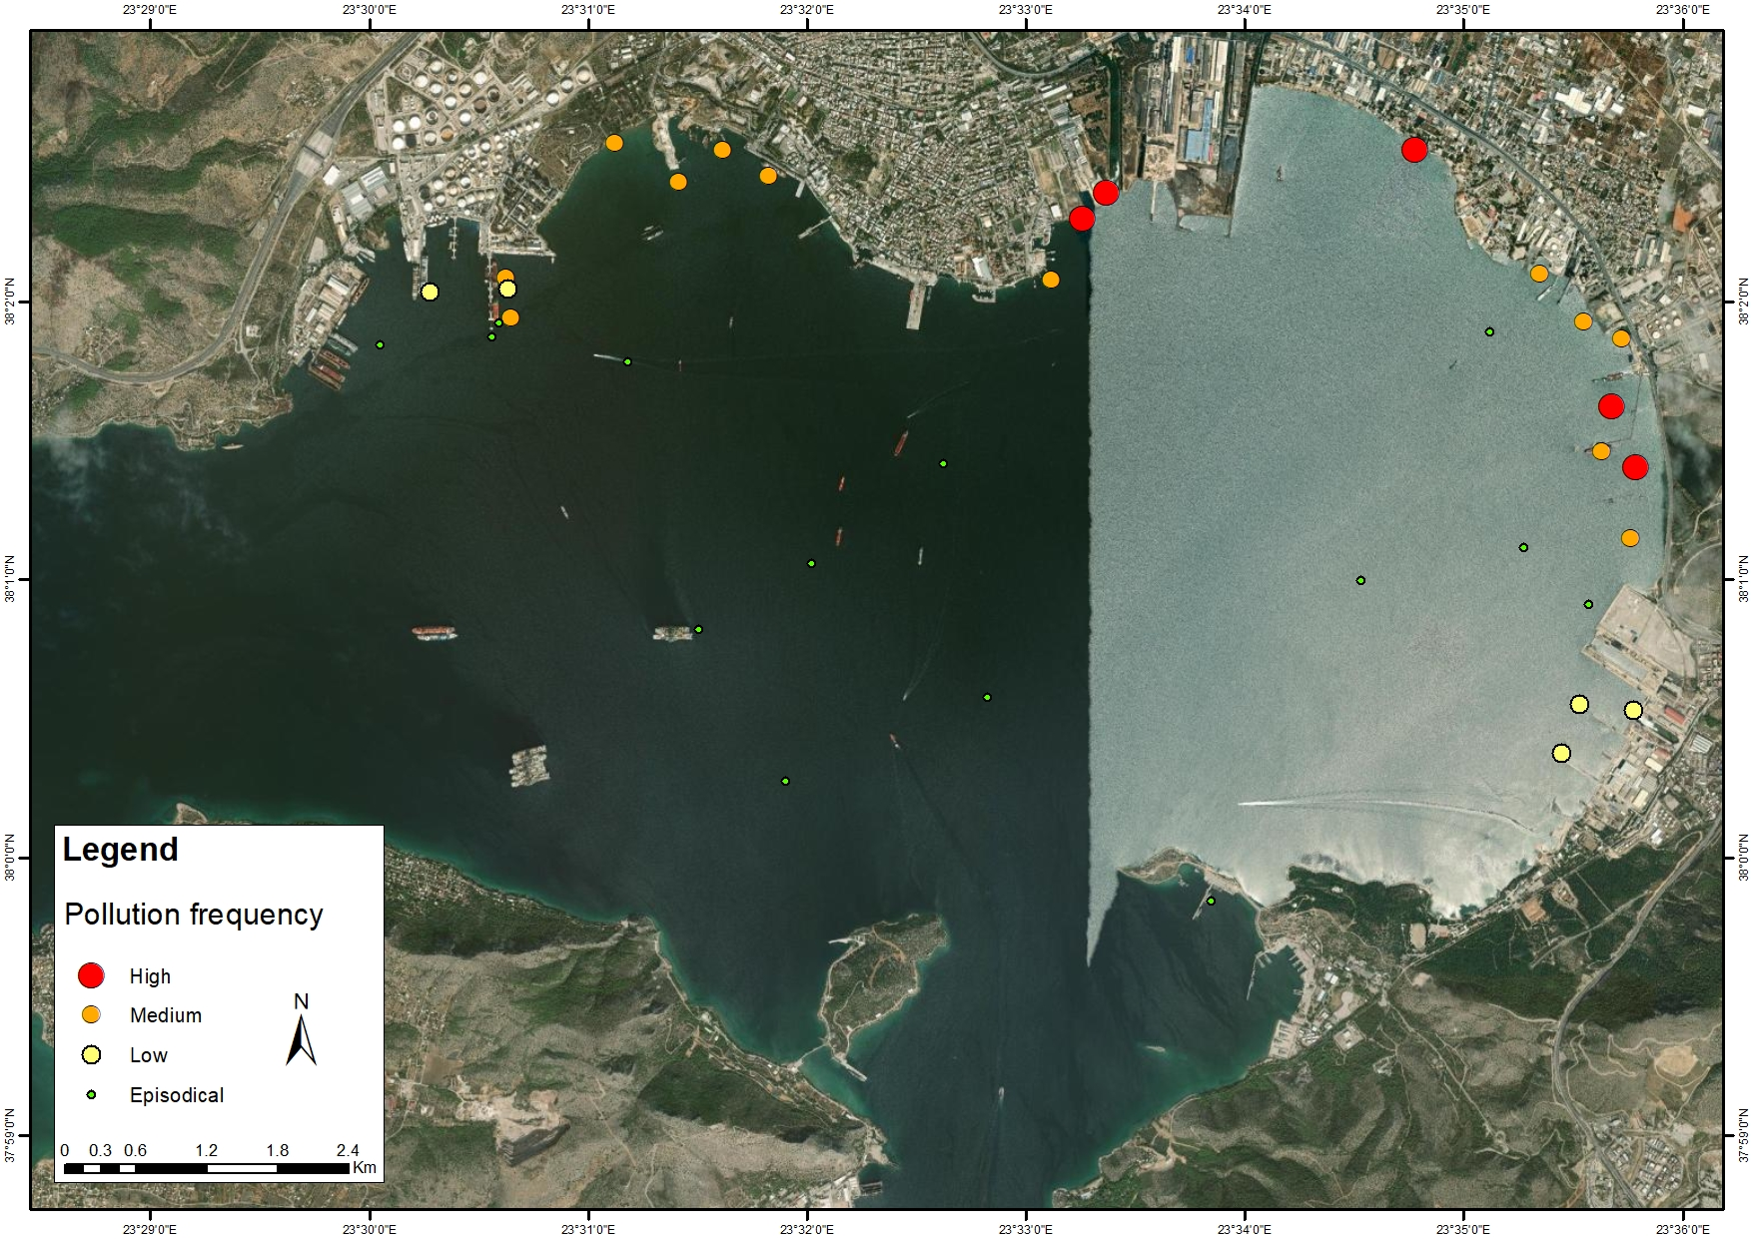
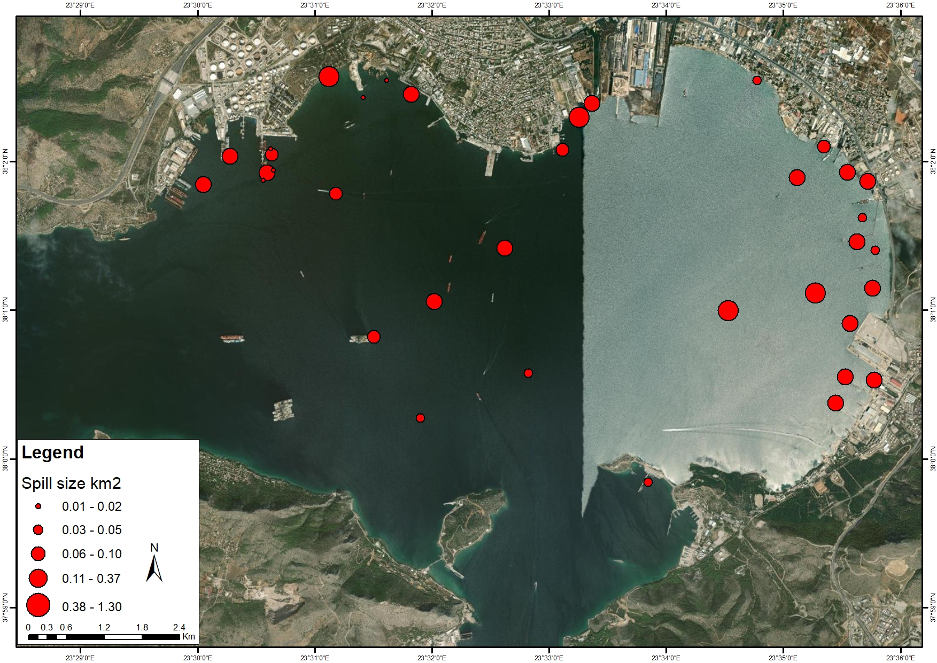
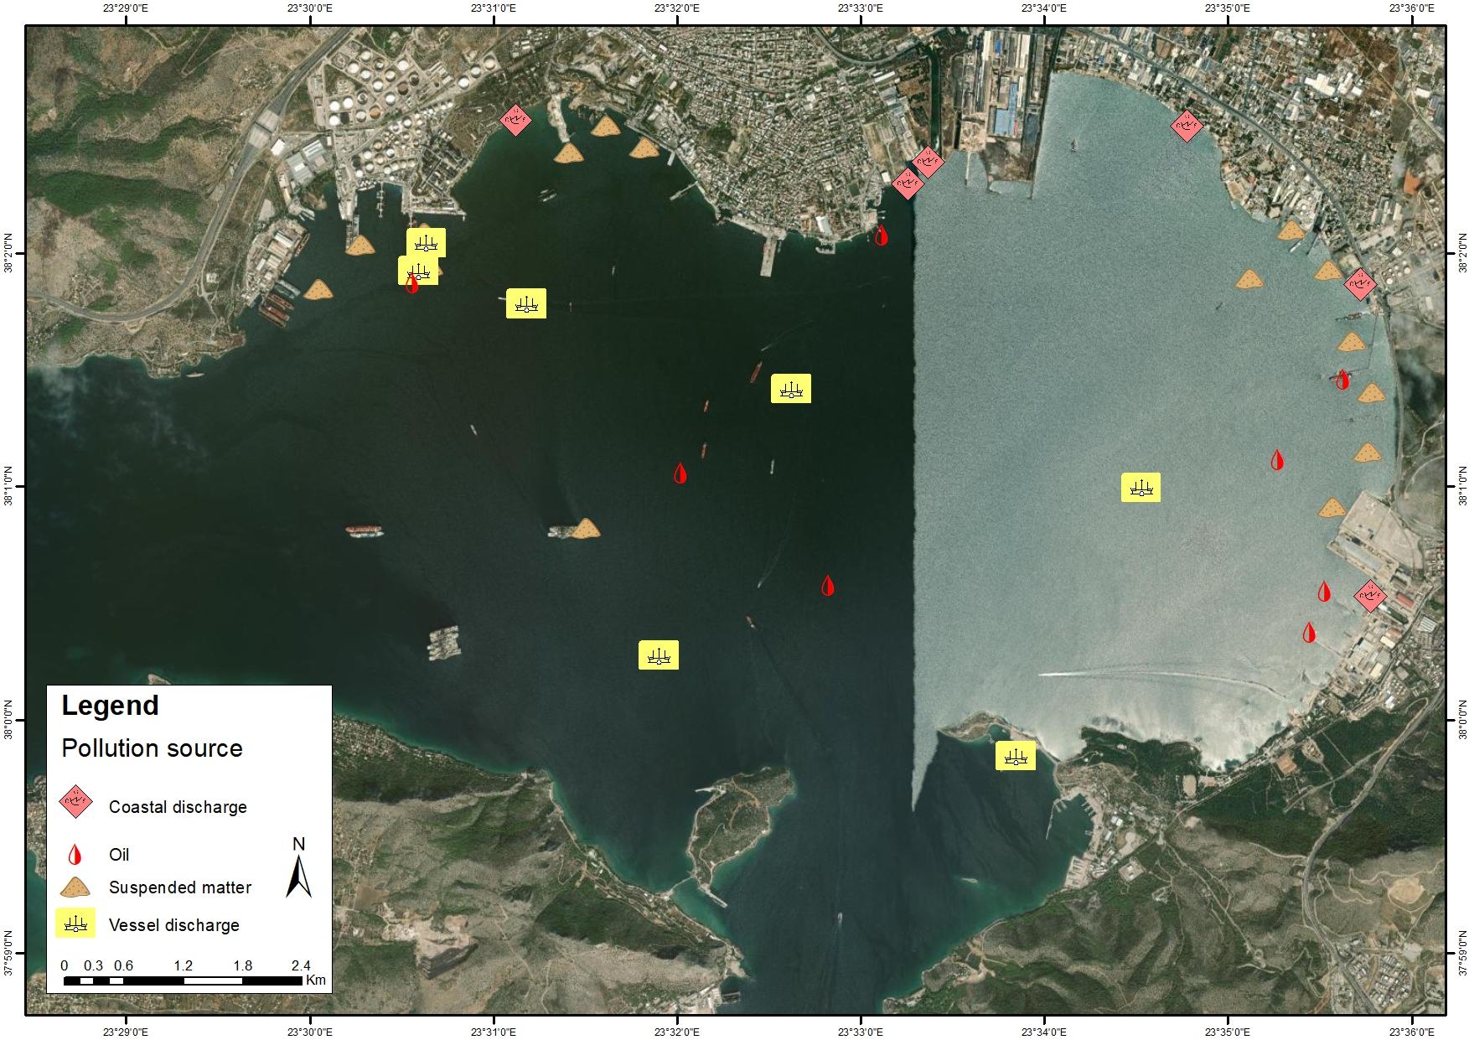
EMMERA
Eleusis digitized pollution, 2016–2024
Frequency
Spill size
Source
East Med Cross-border Marine Environmental Risk Assessment
10

Slide 12
EMMERA
Cumulative polluted area by port
Interpretation
• Haifa shows the largest cumulative affected area in the digitized dataset.
• Vessel-related sources dominate Haifa and Eleusis.
• Limassol is more balanced, with coastal sources slightly leading.
East Med Cross-border Marine Environmental Risk Assessment
11

Slide 13
EMMERA
Limassol source profile: cumulative polluted area
Area by source (km²)
2.33 km²
total cumulative polluted area
East Med Cross-border Marine Environmental Risk Assessment
12

Slide 14
EMMERA
Haifa source profile: cumulative polluted area
Area by source (km²)
East Med Cross-border Marine Environmental Risk Assessment
13

Slide 15
EMMERA
Eleusis source profile: cumulative polluted area
Area by source (km²)
East Med Cross-border Marine Environmental Risk Assessment
14

Slide 16
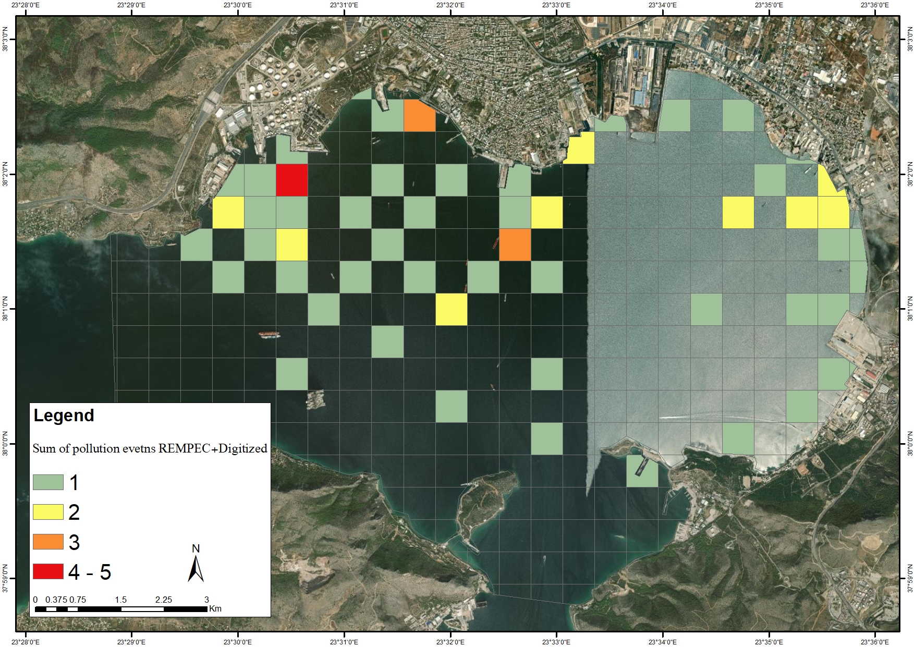
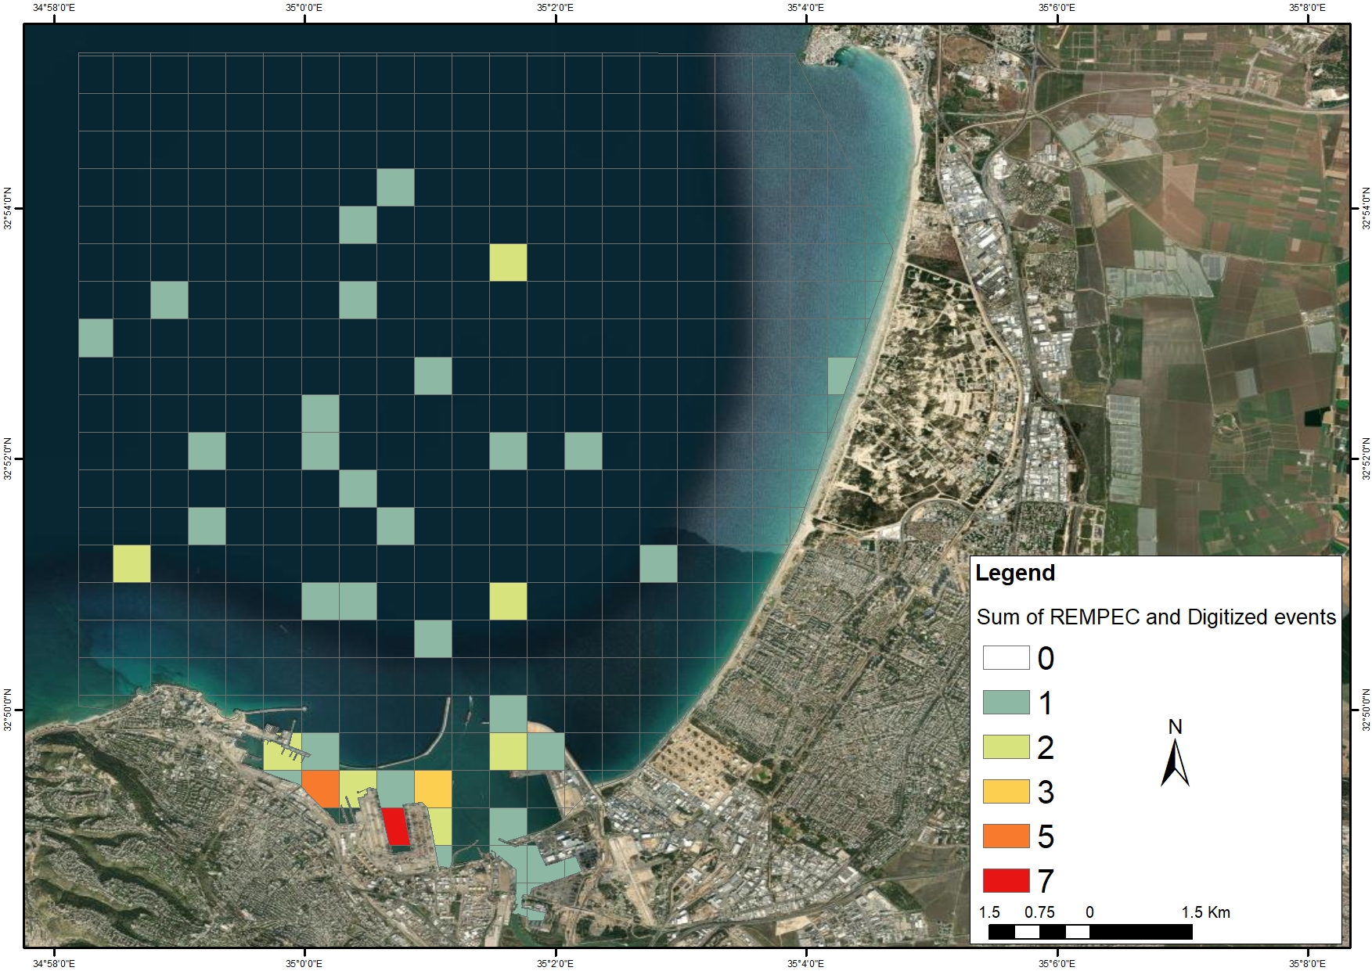
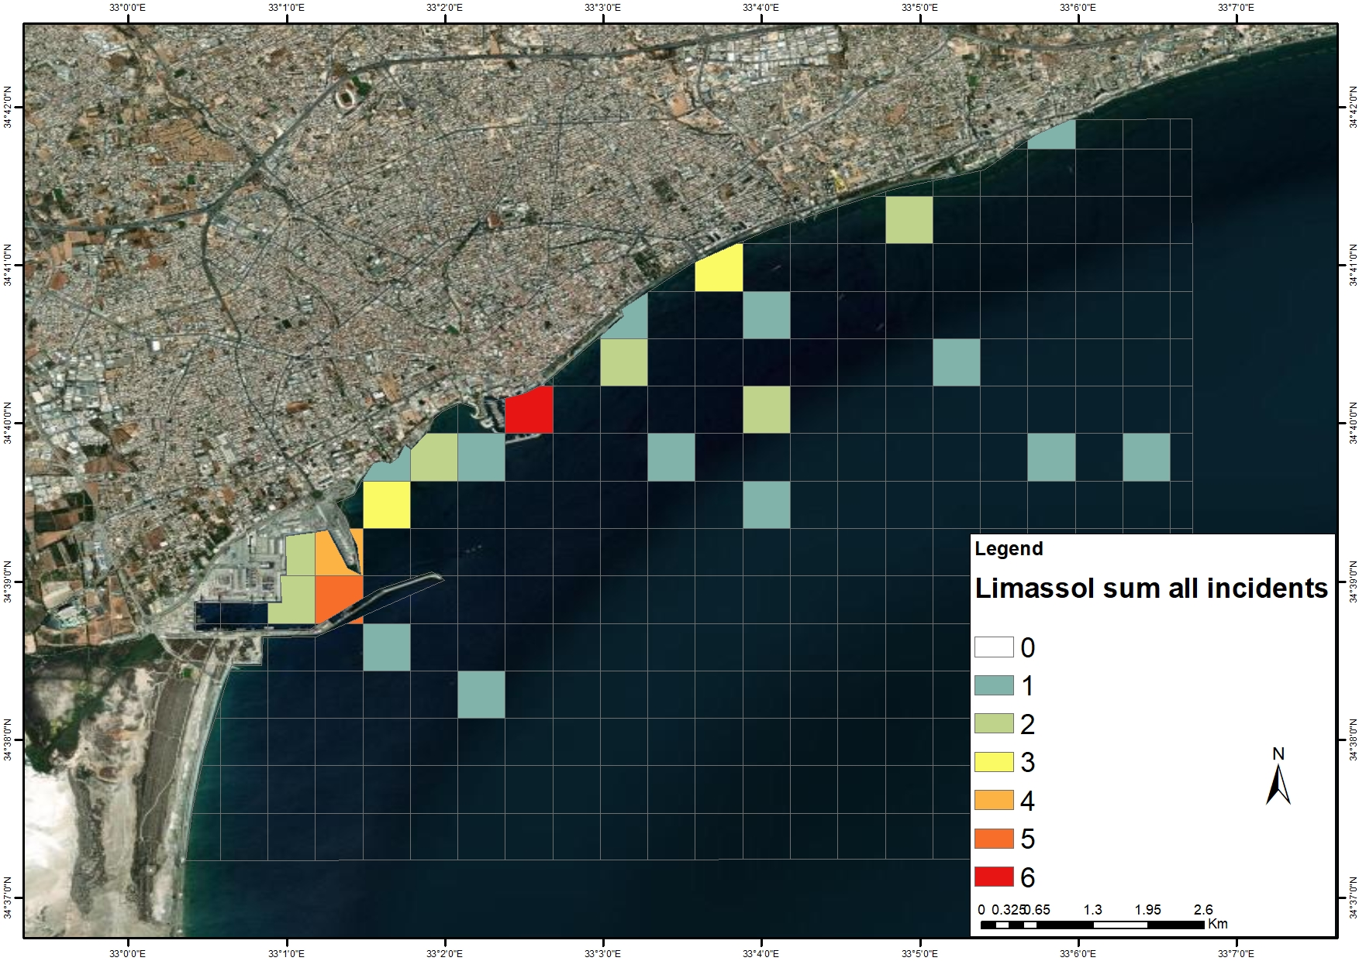
EMMERA
Overall pollution: comparative atlas and next steps
Eleusis
Haifa
Limassol
Recommended next step: convert the atlas into a repeatable risk dashboard with automated satellite ingestion, partner validation and periodic hotspot updates.
Funded by the European Union. Views and opinions expressed are however those of the author(s) only and do not necessarily reflect those of the European Union or the European Commission. Neither the European Union nor the European Commission can be held responsible for them.
East Med Cross-border Marine Environmental Risk Assessment
15

