Slide 1
East Med Cross-border Marine Environmental Risk Assessment through E-Platform Integrated Data Management
EMMERA
Co-funded by the European Union (EU)
Dr Anastasios Ziakas
ziakasan@unipi.gr

Slide 2
The EMMERA project
The project is set for a 24-month duration, starting on March 1, 2024, and ending on February 28, 2026, under Union Civil Protection Mechanism (UCPM) – 2023 – Knowledge for Action in Prevention and Preparedness (KAPP) call.
Risk Assessment Methodology Development: Creating frameworks for assessing marine pollution risks.
E-Platform Development: Building and deploying an electronic platform for data sharing and incident management.
Stakeholder Engagement and Training: Conducting workshops, training sessions, and simulation exercises to engage stakeholders and enhance the capabilities of regional actors in managing marine pollution.
EMMERA project seeks to strengthen the cooperation among the Eastern Mediterranean countries for preventing natural and man-made disasters including marine pollution at sea and on shore.

Slide 3
Expected outcomes of EMMERA
1. The development of a novel system via drone technology for the identification of polluting incidences.
2. The establishment of a harmonized cross-border and multi-country risk assessment methodology to identify risks for the marine pollution environment, and
3. The development and establishment of a software E-platform to integrate fragmented environmental data, and information sharing tools on marine pollution incidents, to improve understanding, knowledge and sharing of current and future disaster risks.

Slide 4
Risk assessment
A thorough risk assessment has been conducted, under the scope of the "East Med Cross-border Marine Environmental Risk Assessment through E-Platform Integrated Data Management – EMMERA” project, in the Eastern Mediterranean region, focusing on:
Environmental
Economic
Social
Cultural risks
stemming from port activities and anchorage, with a particular emphasis on oil spills.

Slide 5
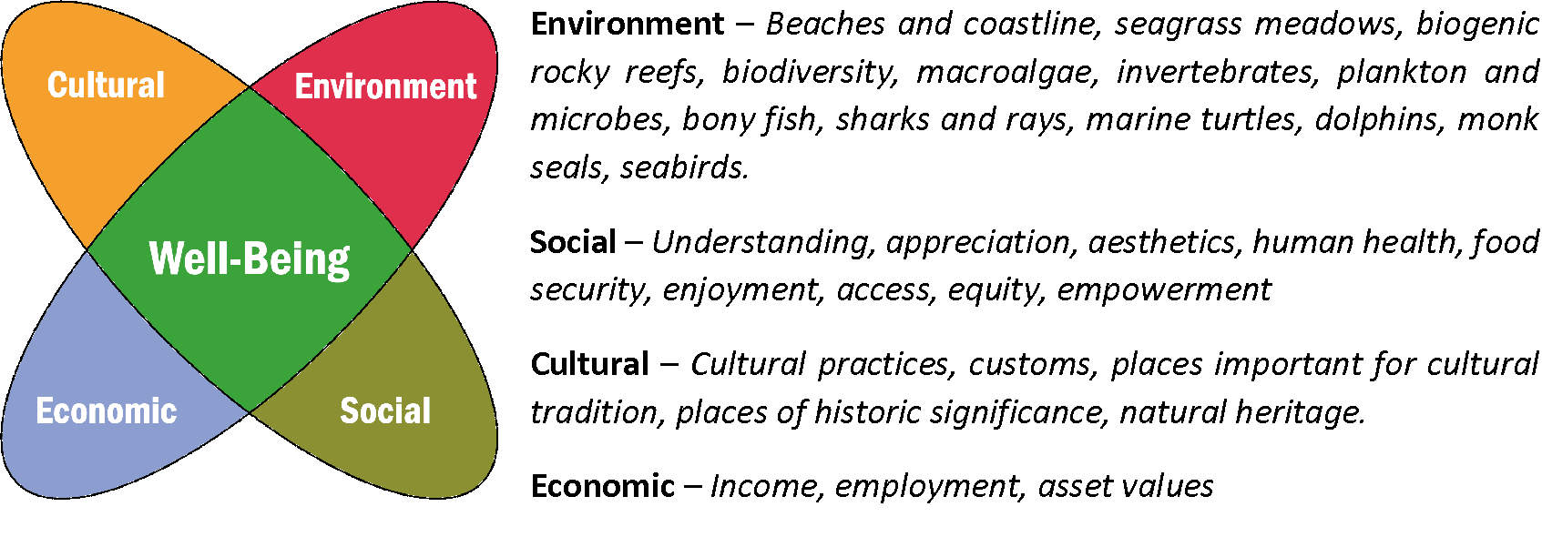
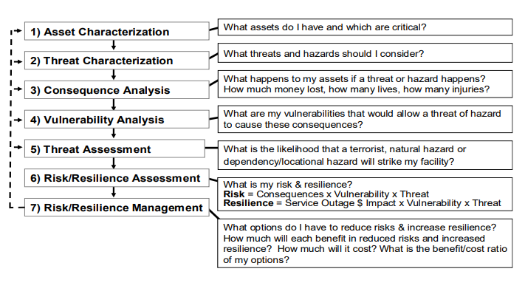
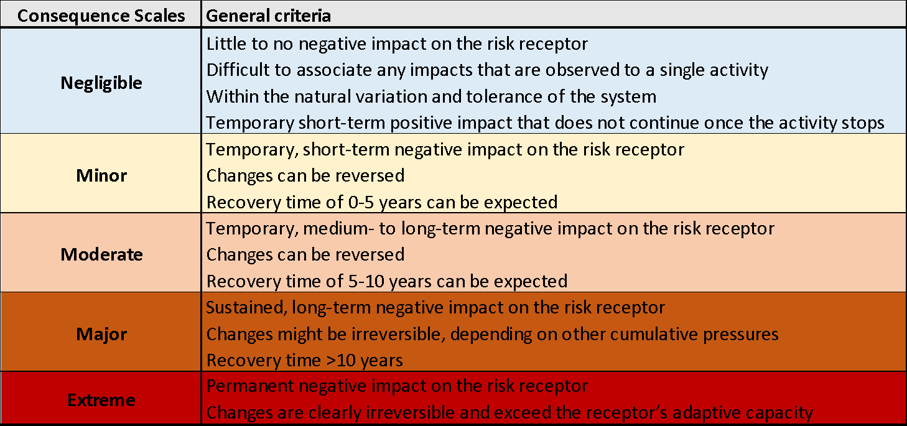
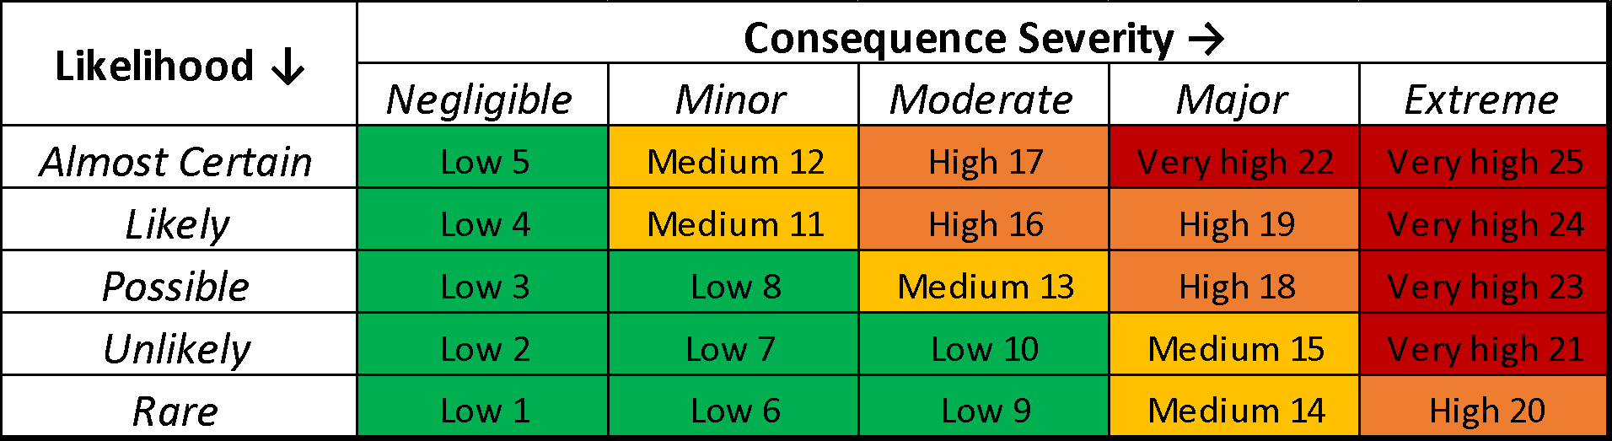
Methodology and steps
Source: Brashear and Jones, 2010
Parameters
Value (risk receptors)
  Environment (Beaches and coastline, seagrass meadows, biogenic reefs, biodiversity, macroalgae, invertebrates, plankton and microbes, bony fish, sharks and rays, sea turtles, dolphins, monk seals, seabirds)
  Social (Understanding, appreciation, aesthetics, human health, food security, enjoyment, access, equity, empowerment)
  Cultural (Cultural practices, customs, places important for cultural tradition, places of historic significance, natural heritage)
  Economic (Income, employment)
Hazard (A source of potential harm to the environment or humans)
Event (An incident that is induced or significantly exacerbated by a sector activity that can pose a hazard and that occurs in a particular place during a particular interval of time.)
Consequence (The outcome of the event)
Likelihood (The chance of an event happening)
Steps
Characterize the sector (in our case we have only one sector)
  What activities and where?
  Detailed description of the sector
  Sector significance
Identify risks
  Hazards associated with each activity
  What, where and how it can be affected
  Sensitivity and exposure
Analyse risks
  Risk level - Consequence x Likelihood matrix
  Confidence of assessment
Evaluate risks and suggest treatment
  Avoid
  Mitigate
  Offset
Source: Australian and Queensland Governments, Risk Assessment – Permission System, 2019

Slide 6
Results of the Risk Assessment
The findings of the risk assessment highlight significant risks associated with oil spills, marine traffic, and port-related industrial activities, which pose threats to marine ecosystems, local economies, and coastal communities.
After ranking the identified risks, treatment measures have been proposed for each of the three ports to minimize the likelihood and impact of hazardous events.
While each port applies context-specific measures shaped by its regulatory environment and operational profile, shared challenges highlight the necessity for transnational solutions.

Slide 7
Elefsis Port Authority - Greece
Nautical communication | Disruption in communication, potentially leading to accidents or incidents on land or at sea, resulting in injuries, loss of life, spills, leaks, fires, explosions, vessel sinking, grounding, asset/personnel/data ransom, or information security breaches.
 | Failure in process control, posing risks of operational and technical malfunctions. Grounding due to navigational error
Anchorage | Loss of anchor and chain
 | Structural damage to the vessel
 | Grounding Collision with other vessels Sinking
 | Fire/explosion Leakage of fuel/contaminants/chemicals
 | Injury Life loss
Berthing at port | Leakage of fuel/contaminants/chemicals
 | Injury Life loss
 | Pollution from normal operations: Degradation of seabed ecosystems; accumulation of sediments; impact on air and water quality; environmental noise disturbance.
Maneuvering | Leakage of fuel/contaminants/chemicals
 | Injury Life loss
 | Pollution from normal operations: Degradation of seabed ecosystems; accumulation of sediments; impact on air and water quality; environmental noise disturbance.
Cargo loading/unloading | Injury Life loss
 | Pollution from normal operations: Degradation of seabed ecosystems; accumulation of sediments; impact on air and water quality; environmental noise disturbance.
 | Leakage of fuel/contaminants/chemicals
Dangerous cargo handling | Leakage of fuel/contaminants/chemicals
 | Injury Life loss
 | Pollution from normal operations: Degradation of seabed ecosystems; accumulation of sediments; impact on air and water quality; environmental noise disturbance.

Slide 8
Elefsis Port Authority - Greece
Ballast operations | Pollution from normal operations: Degradation of seabed ecosystems; accumulation of sediments; impact on air and water quality; environmental noise disturbance.
Bunkering at anchorage | Vessel damage
 | Fire/Explosion
 | Leakage of fuel/contaminants/chemicals
 | Pollution from normal operations: Degradation of seabed ecosystems; accumulation of sediments; impact on air and water quality; environmental noise disturbance.
Bunkering withing the port | Equipment malfunction, damage, or loss, such as pipeline, hose, tank, or valve ruptures.
 | Injury, health damage, life loss
 | Leakage of fuel/contaminants/chemicals
 | Pollution from normal operations: Degradation of seabed ecosystems; accumulation of sediments; impact on air and water quality; environmental noise disturbance.
Storage of oil products | Leakage of fuel/contaminants/chemicals
 | Injury, health damage, life loss
 | Pollution from normal operations: Degradation of seabed ecosystems; accumulation of sediments; impact on air and water quality; environmental noise disturbance.
Waste management | Equipment malfunction, damage, or loss, such as pipeline, hose, tank, or valve ruptures.
 | Pollution from normal operations: Degradation of seabed ecosystems; accumulation of sediments; impact on air and water quality; environmental noise disturbance.
 | Vehicle collisions, including vehicle control loss, impact of vehicle or cargo with worker / person
 | Intentional or unintentional waste illegal leaks to environment
 | Loss of situation control resulting in accident
 | Injury, health damage, life loss
Ship repairs and maintenance | Equipment malfunction, damage, or loss, such as pipeline, hose, tank, or valve ruptures.
 | Fire/explosion Leakage of fuel/contaminants/chemicals
 | Loss of situation control resulting in accident
 | Injury, health damage, life loss
 | Pollution from normal operations: Degradation of seabed ecosystems; accumulation of sediments; impact on air and water quality; environmental noise disturbance.

Slide 9
Elefsis Port Authority - Greece
Docking/Undocking on floating docks | Damage to the vessel being docked
 | Injury, health damage, life loss
 | Fire/explosion
 | Pollution from normal operations: Degradation of seabed ecosystems; accumulation of sediments; impact on air and water quality; environmental noise disturbance.
Tanks/Buoy monitoring and maintenance | Grounding/Collisions
 | Pollution from normal operations: Degradation of seabed ecosystems; accumulation of sediments; impact on air and water quality; environmental noise disturbance.
Shipwrecks | Fire/explosion Leakage of fuel/contaminants/chemicals
 | Injury, health damage, life loss
 | Pollution from normal operations: Degradation of seabed ecosystems; accumulation of sediments; impact on air and water quality; environmental noise disturbance.
Port infrastructure maintenance (e.g., dredging) | Injury, health damage, life loss
 | Flooding
 | Damage to critical infrastructure
 | Loss of business revenues
 | Supply chain disruptions
Onboard hot works | Injury, health damage, life loss
 | Pollution from normal operations: Degradation of seabed ecosystems; accumulation of sediments; impact on air and water quality; environmental noise disturbance.
Operational emergency response | Equipment or infrastructure failure, communication disruption with potential accidents / incidents ashore or in sea, loss of life or injuries, spills, leakages, fires, explosion, sinking, grounding, ransom of assets/people/data, information security breach, etc. Inability of process control, operational and technical failure risk.
Operational HSQE performance monitoring and reporting | Failures in cargo handling, heavy equipment usage, heavy trucks traffic, berthing unberthing activities. Inability of process control, operational and technical failure risk.

Slide 10
Cross-border action plans
Several cross-border action plans have been developed, tailored to the conditions of each case and complemented by joint regional initiatives among the three countries.
Action plans are tailored to the conditions of each case study port, while also extending to joint activities for regional coordination among the three partner countries. These include:
  Development of standardized safety protocols and inspection regimes.
  Establishment of real-time data-sharing mechanisms via the EMMERA electronic platform.
  Workforce training programs to strengthen preparedness and response.
  Harmonized monitoring and enforcement procedures to address environmental risks such as oil spills, stormwater runoff, and invasive species.
  Regional contingency planning and resource-pooling for major incidents.

Slide 11

Thank you!
Dr Anastasios Ziakas
Quantitative Analysis in Shipping Laboratory (Quals), University of Piraeus
ziakasan@unipi.gr
Funded by the European Union. Views and opinions expressed are however those of the author(s) only and do not necessarily reflect those of the European Union or the European Commission. Neither the European Union nor the European Commission can be held responsible for them.

