Slide 1




European Civil Protection Forum
3-4 November 2026 | Tour & Taxis, Brussels (BE)
Preparing today, ready for tomorrow
Social media toolkit

Slide 2
About the event
Preparing today, ready for tomorrow
The Forum is the flagship event of the European civil protection community. It brings together experts and decision-makers to strengthen preparedness and crisis response.
Held every two years
This year’s theme is Preparing today, ready for tomorrow
Event location: Tour & Taxis, Brussels (Belgium)
Event date: 3-4 November 2026

Slide 3
Why you should attend ​
Preparing today, ready for tomorrow
Crises are becoming more frequent, complex and interconnected and can overwhelm national resources, making stronger cooperation across borders and preparation essential.​
Event ambassadors: To exchange knowledge, build partnerships and develop solutions for a safer, more resilient Europe
Influencers: To gain first-hand access to experts and inform citizens about how the EU is working to protect them during crises

Slide 4
European Civil Protection Forum
Preparing today, ready for tomorrow
Event messaging​

Slide 5

Event messaging
Preparing today, ready for tomorrow
Event title: European Civil Protection Forum 2026
Mandatory hashtag: #CPForum2026
Optional hashtag: #EUCivilProtection
The forum allows Europe’s civil protection community to exchange ideas, share expertise and strengthen cooperation.
The EU and Member States are working together for better preparedness and a more resilient Europe.
Preparedness is a shared responsibility.
Stronger cooperation through the EU Civil Protection Mechanism means a safer and more resilient Europe.

Slide 6
European Civil Protection Forum
Preparing today, ready for tomorrow
Social media posts guidelines & templates​

Slide 7
Quick start guide
Preparing today, ready for tomorrow
How to use the social media templates?
On slides 16-24 you will find social media posts tailored for: before, during and after the event. Slides 16-20 are for event ambassadors and participants, slides 21-24 for influencers. Add your details in the placeholders and publish them on your own accounts.
Which channel and asset should I choose?
The asset are designed for Bluesky, Facebook, Instagram, LinkedIn or X.
Event ambassadors: focus on LinkedIn. You are
of course free to use the other channels as well.
Influencers: focus on Bluesky, Facebook, Instagram
and X.
How should I customise placeholders?
Replace all text in [square brackets] with your own details, perspective or call to action. Remove any unused placeholders, but keep the approved key messages and hashtags #CPForum2026 and #EUCivilProtection.
What about accessibility and alt-text?
Add clear, concise alt text describing the image and any essential text shown on it. Use accessible language, capitalise multiword hashtags. Avoid relying on images or emojis alone to communicate key information.
Approval and contact details
If you have any questions about the content you would like to publish, you can reach out to the designated DG ECHO communication contact Hélène IGOT (helene.igot@ec.europa.eu).
What are the final asset filenames?
Use the files marked FINAL and select the correct platform and campaign phase, for example:
CPF2026_[Platform][PreEvent/DuringEvent/PostEvent]
[Format]_FINAL.[extension]

Slide 8
Social media
Preparing today, ready for tomorrow
Please tag the following accounts when you post:
X : @eu_echo
Bluesky: euinemergencies.ec.europa.eu
Instagram : @eu_echo
Facebook: @EUinEmergencies & Linkedin: Tag the European Commission Civil Protection & Humanitarian Aid Operations page using LinkedIn’s @ mention function
Tag an account using @AccountName so that the organisation is identified and notified. Add hashtags #CPForum2026 and #EUCivilProtection to categorise the post and support discovery.

Slide 9
Your role at every stage
Preparing today, ready for tomorrow
BEFORE
DURING
AFTER
Prepare & announce
3–4 November
Recap & extend
AMBASSADORS /
Choose a LinkedIn template.
Add your role or session.
Publish with #CPForum2026 and/or #EUCivilProtection.
Share expert takeaways and event moments.
Tag DG ECHO.
Feel free to use suggested messages.
Publish a professional recap.
Share lessons, contacts and next steps.
Continue the conversation.
PARTICIPANTS
Lead with expertise
and professional insight
INFLUENCERS
Select channels and a visual.
Preview what you’ll explore.
Invite audience questions.
Publish with #CPForum2026 and/or #EUCivilProtection.
Post real-time stories and visuals.
Tag DG ECHO.
Spotlight people and solutions.
Ask your audience to engage.
Turn key insights into an accessible recap.
Share highlights and links.
Invite audience reactions.
Make the event relevant
and accessible to audiences

Slide 10
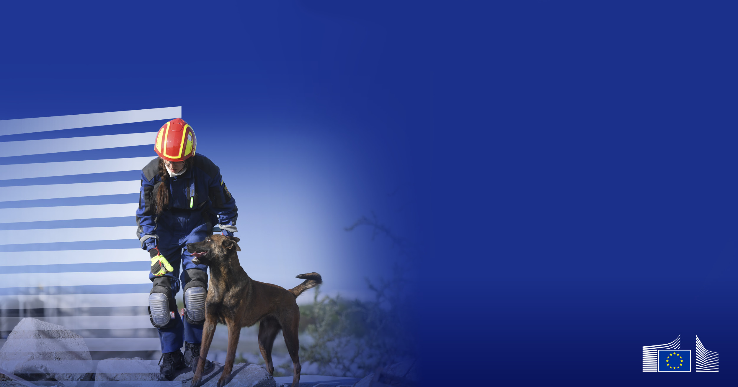


Social media templates Visuals - Before
Preparing today, ready for tomorrow
General post
Programme post
Watch online
See the programme
See how the EU civil protection makes Europe more resilient
Explore sessions, speakers and exhibition activities
#CPForum2026
3-4 November 2026 | Tour & Taxis, Brussels
#CPForum2026
3-4 November 2026 | Tour & Taxis, Brussels
10

Slide 11
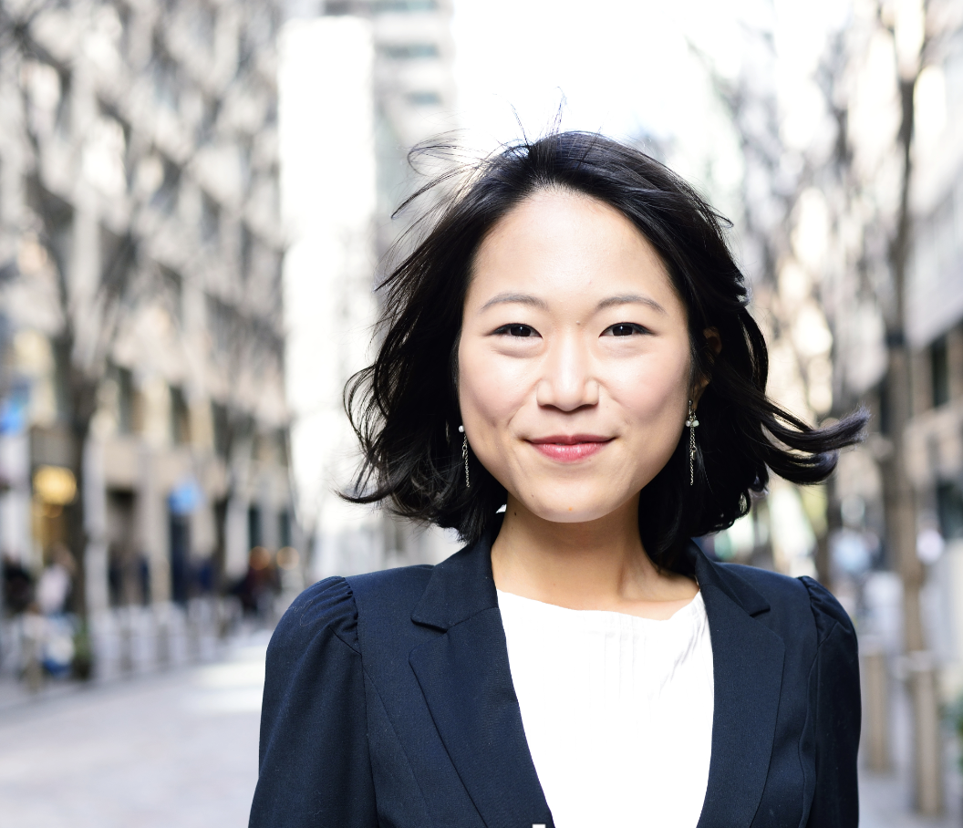



Social media templates Visuals - During
Preparing today, ready for tomorrow
Speaker general
LI vertical Option
Speaker Template photo
NAME SURNAME
Job Title – Organisation
SPEAKER
SPEAKER
NAME SURNAME
SPEAKER
Job Title Organisation
SESSION TITLE
SESSION TITLE
#CPForum2026
3-4 November 2026 | Tour & Taxis, Brussels
#CPForum2026
3-4 November 2026 | Tour & Taxis, Brussels
11

Slide 12

Social media templates Visuals - During
Preparing today, ready for tomorrow
Exhibition post
Quote card
Visit the exhibition
Innovation action
Preparedness is a shared responsibility.
Effective preparedness depends
on cooperation between institutions, partners
and communities.
[Project / Solution Name]
Stand [XX]
Name Surname
Job Title
Organisation
#CPForum2026
3-4 November 2026 | Tour & Taxis, Brussels
#CPForum2026
3-4 November 2026 | Tour & Taxis, Brussels
12

Slide 13
Social media templates
Preparing today, ready for tomorrow
HOW TO USE THE TEMPLATES
STEP 1
STEP 2
EDIT
EXPORT
Update the text and images
Save the relevant visual as a JPG
TO SUIT YOUR AUDIENCE
CLICK VISUAL> EXPORT > CHANGE FILE TYPE
Visuals templates in PowerPoint are fully editable. Crop vertical formats after export and check platform character limits before publishing.

Slide 14
Social media templates
Preparing today, ready for tomorrow
The speaker file with a photo is in PowerPoint to allow for easy editing. To use it:
  Edit the text
  Select the photo, then choose Picture Format → Change Picture (In Ribbon) → From a File
  Select all parts of the visual, right-click, and choose Group
  Right-click the grouped visual → choose Save as Picture
  For the vertical version, crop the saved image if needed
Example Speaker
photo LI vertical option
NAME SURNAME
Job Title – Organisation
SPEAKER
SESSION TITLE
SESSION TITLE
#CPForum2026
3-4 November 2026 | Tour & Taxis, Brussels

Slide 15
Social media templates
Preparing today, ready for tomorrow
TEMPLATE GUIDE
SLIDES
SLIDES
16–20
21–24
Social media templates for
Social media templates for
EVENT AMBASSADORS
INFLUENCERS
You are welcome to use the suggested messages in slides 16-24 on your preferred platform, not only on the ones we propose. The only thing to keep in mind is the character limit.

Slide 16
For ambassadors/participants
Preparing today, ready for tomorrow
Suggested messages before the event
Platform | Countdown to the event | See the programme
X | [Number] days to go until #CPForum2026. I’m looking forward to [session/topic/meeting the community] in Brussels. Will you be there? [link] | The #CPForum2026 programme is live. Explore sessions on [theme/topic], hear from [speaker/name] and plan your two days in Brussels. View the programme: [link]
Bluesky | The countdown is on: [number] days until #CPForum2026. See you in Brussels for two days of knowledge-sharing and cooperation. [link] | What will you explore at #CPForum2026? Browse the programme, choose your sessions in Brussels, 3–4 November: [link]
Facebook | Only [number] days to go until the European Civil Protection Forum 2026. I’m looking forward to [personal reason, session or activity]. Join us in Brussels on 3–4 November: [link] #CPForum2026 | The programme for the European Civil Protection Forum 2026 is available. Discover sessions on [main themes/topics], hear from [speaker names or organisations] and plan your visit to Brussels. See the programme: [link] #CPForum2026
Instagram | [Number] days to go! Brussels is getting ready for #CPForum2026 – and so are we. What are you most looking forward to? [link in bio/link] #EUCivilProtection | Plan your #CPForum2026 experience. Explore sessions on [theme 1], [theme 2] and [theme 3], and look out for [speaker/session highlight]. Programme: [link in bio/link] #EUCivilProtection
LinkedIn | With [number] days to go until the European Civil Protection Forum 2026, I’m preparing to [speak/attend/exhibit/contribute] on [topic]. I look forward to exchanging perspectives with colleagues from across Europe. [link] #CPForum2026 | The programme for the European Civil Protection Forum 2026 is available. I’m particularly interested in [session/topic] because [reason]. Explore the programme and identify the conversations you want to join: [link] #CPForum2026
16

Slide 17
For ambassadors/participants
Preparing today, ready for tomorrow
Suggested messages during the event 1/2
Platform | I’m speaking at the event (for speakers only) | Watch the livestream
X | I’m speaking at #CPForum2026 today. Join me at [time] in [room/location] for “[session title]”, where we’ll discuss [topic/key question]. [programme link] | Can’t make it to Brussels? Watch #CPForum2026 live on 3–4 November and follow the conversations shaping Europe’s future preparedness. Tune in: [livestream link]
Bluesky | I’m speaking at #CPForum2026 today about [topic]. Join “[session title]” at [time] in [room/location] and bring your questions. [link] | Join #CPForum2026 from wherever you are. Watch the livestream on 3–4 November and share the ideas that stand out to you: [livestream link]
Facebook | I’m pleased to be speaking at the European Civil Protection Forum 2026. Join me for “[session title]” at [time] in [room/location], where I’ll discuss [topic] with [other speakers/panellists]. I hope to see you there. [link] #CPForum2026 | Can’t join us in Brussels? You can still follow the European Civil Protection Forum 2026 live on 3–4 November. Watch the discussions, share your takeaways and join the conversation online: [livestream link] #CPForum2026
Instagram | On stage today at #CPForum2026. I’ll be speaking about [topic] during “[session title]” at [time], [room/location]. Come along and join the conversation. #EUCivilProtection | Join #CPForum2026 live from Brussels. Watch the livestream on 3–4 November and share the moments and ideas that inspire you. [link in bio/link] #EUCivilProtection
LinkedIn | I’m pleased to be speaking at the European Civil Protection Forum 2026 in my role as [job title] at [organisation]. Join “[session title]” at [time] in [room/location] for a discussion on [topic] and [key question]. I look forward to sharing [insight/example] and hearing other perspectives. [link] #CPForum2026 | The European Civil Protection Forum 2026 will be livestreamed from Brussels on 3–4 November. I encourage my network to tune in, follow the expert discussions and share the insights most relevant to your work. Watch here: [livestream link] #CPForum2026
17

Slide 18
For ambassadors/participants
Preparing today, ready for tomorrow
Suggested messages during the event 2/2
Platform | Share a session takeaway | Networking moment / live reaction
X | One takeaway from “[session title]” at #CPForum2026: [key insight]. It matters because [why it matters]. What would help turn this into action? [link] | A valuable #CPForum2026 conversation with [name/organisation] about [topic]. My immediate reaction: [insight or question]. Let’s keep the exchange going.
Bluesky | A key idea from “[session title]” at #CPForum2026: [takeaway]. The next question is [question or implication]. What’s your view? [link] | Good to connect with [name/organisation] at #CPForum2026 about [topic]. One thought I’m taking away: [insight]. What are you hearing today?
Facebook | A key takeaway from “[session title]” at the European Civil Protection Forum 2026 was [insight]. It matters for [audience/area] because [reason]. My next step is to [action]. What stood out to you? [link] #CPForum2026 | One of the most valuable parts of the European Civil Protection Forum 2026 is meeting people who bring different perspectives. I enjoyed exchanging ideas with [name/organisation] about [topic]. My immediate reaction: [insight or question]. #CPForum2026
Instagram | Today’s takeaway from “[session title]”: [short insight]. How can we turn it into action? Share your view. #CPForum2026 #EUCivilProtection | A great #CPForum2026 moment with [name/organisation], exchanging ideas on [topic]. My live reaction: [short insight]. What is inspiring you today? #EUCivilProtection
LinkedIn | A key takeaway from “[session title]” at the European Civil Protection Forum 2026 was [insight]. For [organisation/sector], this matters because [reason]. I will take this discussion forward by [next step]. What implications do you see for your work? [link] #CPForum2026 | A valuable conversation at the European Civil Protection Forum 2026 with [name/organisation] about [topic]. We discussed [challenge or opportunity], and my immediate reflection is [insight]. I would welcome perspectives from others working on this issue. #CPForum2026
18

Slide 19
For ambassadors/participants
Preparing today, ready for tomorrow
Suggested messages after the event 1/2
Platform | Thank you for participating | Outcomes and decisions
X | Thank you to everyone who made #CPForum2026 possible – and to all who shared their expertise, questions and ideas. Together, we are preparing today to be ready for tomorrow! | #CPForum2026 closed with a clear message: [main outcome]. Next, [organisation/community] will [action or commitment] to strengthen [area of preparedness or response]. More: [link]
Bluesky | Thank you for two inspiring days at #CPForum2026. The conversations, connections and shared commitment will help strengthen preparedness across Europe. | What comes next after #CPForum2026? [Main outcome or decision], followed by [next step]. Read the key conclusions: [link]
Facebook | Thank you to everyone who participated in the European Civil Protection Forum 2026: speakers, partners, exhibitors and members of the civil protection community. Your expertise and engagement made these two days in Brussels truly valuable. #CPForum2026 | The European Civil Protection Forum 2026 concluded with important messages for the future of European preparedness. Key outcomes included [outcome 1], [outcome 2] and [outcome 3]. The next step is [decision/action]. Read more: [link] #CPForum2026
Instagram | Two days. One committed community. Thank you to everyone who joined #CPForum2026 and helped turn knowledge into connection and action. #EUCivilProtection | From discussion to action. The key outcomes of #CPForum2026: [outcome 1]; [outcome 2]; [outcome 3]. Next step: [action]. Find out more via [link in bio/link].
LinkedIn | Thank you to everyone who contributed to the European Civil Protection Forum 2026. The exchange of knowledge, operational experience and perspectives across sectors has created valuable momentum for the work ahead. I am grateful to [people/organisations] for [specific contribution]. #CPForum2026 | The European Civil Protection Forum 2026 set out several priorities for the work ahead: [outcome 1], [outcome 2] and [outcome 3]. For [organisation], the most significant takeaway is [message], and our next step will be [action]. Read the conclusions: [link] #CPForum2026
19

Slide 20
For ambassadors/participants
Preparing today, ready for tomorrow
Suggested messages after the event 2/2
Platform | Photos, videos, highlights and speeches
X | Relive #CPForum2026. Explore the photos, videos, session highlights and speeches from two days of exchange and cooperation in Brussels: [link]
Bluesky | Missed a moment from #CPForum2026 – or want to revisit one? See the photos, videos, highlights and speeches: [link]
Facebook | Relive the European Civil Protection Forum 2026. Browse event photos, watch video highlights and revisit speeches and key moments from Brussels. Explore the collection: [link] #CPForum2026
Instagram | Revisit the people, ideas and moments that shaped #CPForum2026. Photos, videos and highlights are now available via [link in bio/link]. #EUCivilProtection
LinkedIn | Resources from the European Civil Protection Forum 2026 are now available. Revisit the discussions through event photos, videos, highlights and speeches, and share the insights most relevant to your network. Access the materials: [link] #CPForum2026
20

Slide 21
For influencers
Preparing today, ready for tomorrow
Suggested messages before the event
Platform | See the programme | Countdown to the event
X | The #CPForum2026 programme is live. I’m exploring sessions on [theme/topic] and looking forward to hearing from [speaker/name]. See what’s planned: [link] | [Number] days until #CPForum2026! I’ll be in Brussels sharing expert insights and behind-the-scenes moments with you. What would you like me to explore? [link]
Bluesky | The #CPForum2026 programme is out. I’m choosing the sessions and speakers I want to follow - and share them with you. Explore it: [link] | The countdown is on: [number] days until #CPForum2026. I’m getting ready to bring you the conversations and ideas shaping Europe’s preparedness. [link]
Facebook | The European Civil Protection Forum 2026 programme is available. I’m especially interested in [theme/session] and what it could mean for our communities. Explore the programme: [link] #CPForum2026 | Only [number] days until the European Civil Protection Forum 2026. I’ll be in Brussels following the discussions, meeting experts and sharing insights with you. What should I ask? [link] #CPForum2026
Instagram | The #CPForum2026 programme is live. I’m planning my sessions around [theme 1], [theme 2] and [speaker/session highlight]. Follow along for the ideas worth sharing. [link in bio] #EUCivilProtection | [Number] days to go! I’m getting ready for #CPForum2026 in Brussels - and to take you behind the scenes. What topic should I cover? [link in bio] #EUCivilProtection
LinkedIn | The European Civil Protection Forum 2026 programme is available. I’ll be attending [session/topic] because [reason], and I’ll share takeaways with my network. Explore it: [link] #CPForum2026 | With [number] days until #CPForum2026, I’m preparing to join conversations on [topic] and share the most useful insights with my network. What would you like to learn? [link]
21

Slide 22
For influencers
Preparing today, ready for tomorrow
Suggested messages during the event 1/2
Platform | Watch the livestream
X | Join me online for #CPForum2026 on 3–4 November. I’ll follow the livestream and share the ideas that matter most for Europe’s preparedness. Watch with me: [livestream link]
Bluesky | Join me online for #CPForum2026 on 3–4 November. I’ll watch the livestream and share key takeaways as experts discuss how Europe can prepare for crises: [livestream link]
Facebook | You don’t need to be in Brussels to join the European Civil Protection Forum 2026. I’ll be watching the livestream on 3–4 November and sharing the insights that stand out. Watch with me: [livestream link] #CPForum2026
Instagram | Watch #CPForum2026 live with me on 3–4 November. I’ll share the moments, people and ideas shaping a better-prepared Europe. Join via [link in bio/link]. #EUCivilProtection
LinkedIn | The European Civil Protection Forum 2026 will be livestreamed from Brussels on 3–4 November. I invite my network to watch with me and join the conversation on Europe’s preparedness and crisis response: [livestream link] #CPForum2026
22

Slide 23
For influencers
Preparing today, ready for tomorrow
Suggested messages during the event 2/2
Platform | Share a session takeaway | Networking moment / live reaction
X | One takeaway from “[session title]” at #CPForum2026: [key insight]. It matters because [why it matters]. What would help turn this into action? [link] | A valuable #CPForum2026 conversation with [name/organisation] about [topic]. My immediate reaction: [insight or question]. Let’s keep the exchange going.
Bluesky | A key idea from “[session title]” at #CPForum2026: [takeaway]. The next question is [question or implication]. What’s your view? [link] | Good to connect with [name/organisation] at #CPForum2026 about [topic]. One thought I’m taking away: [insight]. What are you hearing today?
Facebook | A key takeaway from “[session title]” at the European Civil Protection Forum 2026 was [insight]. It matters for [audience/area] because [reason]. What stood out to you? [link] #CPForum2026 | One of the most valuable parts of the European Civil Protection Forum 2026 is meeting people who bring different perspectives. I enjoyed exchanging ideas with [name/organisation] about [topic]. My immediate reaction: [insight or question]. #CPForum2026
Instagram | Today’s takeaway from “[session title]”: [short insight]. How can we turn it into action? Share your view. #CPForum2026 #EUCivilProtection | A great #CPForum2026 moment with [name/organisation], exchanging ideas on [topic]. My live reaction: [short insight]. What is inspiring you today? #EUCivilProtection
LinkedIn | A key takeaway from “[session title]” at the European Civil Protection Forum 2026 was [insight]. This matters because [reason]. What implications do you see? [link] #CPForum2026 | A valuable conversation at the European Civil Protection Forum 2026 with [name/organisation] about [topic]. We discussed [challenge or opportunity], and my immediate reflection is [insight]. I would welcome perspectives from others working on this issue. #CPForum2026
23

Slide 24
For influencers
Preparing today, ready for tomorrow
Suggested messages after the event
Platform | Photos, videos, highlights and speeches
X | Relive #CPForum2026. Explore the photos, videos, session highlights and speeches from two days of exchange and cooperation in Brussels: [link]
Bluesky | Missed a moment from #CPForum2026 – or want to revisit one? See the photos, videos, highlights and speeches: [link]
Facebook | Relive the European Civil Protection Forum 2026. Browse event photos, watch video highlights and revisit speeches and key moments from Brussels. Explore the collection: [link] #CPForum2026
Instagram | Revisit the people, ideas and moments that shaped #CPForum2026. Photos, videos and highlights are now available via [link in bio/link]. #EUCivilProtection
LinkedIn | Resources from the European Civil Protection Forum 2026 are now available. Revisit the discussions through event photos, videos, highlights and speeches, and share the insights most relevant to your network. Access the materials: [link] #CPForum2026
24

Slide 25
Preparing today, ready for tomorrow
THANK YOU

